Slide 1

  ADAPTING Clinical Guidelines
  dr. Martin Rusnak

Slide 2
Why ADAPTing and not Developing Guidelines?
Systematic identification and critical analysis of evidence are the most costly and time-consuming components in the guideline development process.
Unnecessary duplication of effort could be avoided if existing guidelines were adapted rather than developed de novo.
Quality of published guidelines is highly variable

Slide 3
ADAPTE
ADAPTE process provides a systematic approach to adapting guidelines produced in one setting for use in a different cultural and organizational context.
The process has been designed to ensure that the adapted guideline not only addresses specific health questions relevant to the context of use but also is suited to the needs, priorities, legislation, policies, and resources in the targeted setting.

Slide 4
Guideline ADAPTATION
A systematic process that guides local groups to identify, evaluate, adapt and use already available guidelines for their own purposes.
An alternative to de novo development which requires extensive search and synthesis of primary research data
Reduces duplication of effort while maintaining the validity of recommendations
Encourages participative approach involving key stakeholders to foster local ownership of recommendations and promote utilization

Slide 5
Guideline ADAPTATION
  Ensures consideration of (regional and local) contextual factors to ensure relevance for practice and improve uptake by targeted users
  Increases knowledge and commitment to
  evidence-based principles by using reliable
  methods to ensure quality and validity
  Promotes explicitness and transparency in
  documenting recommendations

Slide 6
STEP 1: Call-to-Action
Guide pp. 20-23
1.1 Clarify the motivation, purpose and scope of the proposed initiative
Consider:
What is the agency/ institutional mandate and infrastructure supporting evidence-informed practice?
Is this a response to a specific practice challenge?
Is a guideline the most appropriate solution to the challenge?
Who (person/group) will lead, implement and maintain these recommendations?
What is the intended practice jurisdiction (local, regional, national)?

Slide 7
STEP 1: Call-to-Action
Guide pp. 20-23
A critical, strategic element requiring strong facilitation and
leadership skills; establishes legitimate guideline development
mandate and infrastructure; especially important for new groups
Plan an orientation session for participants;
Discuss: What is a “guideline”?

Slide 8
STEP 2: Plan
Guide pp. 24-36
2.1 Establish scope of guideline and articulate Health Question(s).
2.2 Determine feasibility of adaptation.
2.3 Form steering committee and working panel(s) and determine
key stakeholders and necessary resources
2.4 Determine consensus process.
2.5 Write the Work Plan.

Slide 9
STEP 2: Plan
Use the PIPOH instrument to develop health questions
Determine required expertise and resources; (using the Skills Assessment Checklist)
Understand Facilitation and the role of the Coordinator
Draft Work Pan – an essential document outlining:
  Scope of topic and health questions
  Terms of reference (steering committee and working panel(s)
  Funding and resource commitments
  Consensus process
  Conflicts of interest
  Projected timeline
  Meeting arrangements

Slide 10
Tool 2.1a PIPOH Checklist
P Patient population: average risk women
I Intervention: screening
P Professionals: family physicians/ GPs/nurses
O Outcomes: screening interval/modality
H Healthcare setting: family practice
Example Question: What is appropriate cervical cancer screening (CCS) for average risk women seen in family practice?

Slide 11
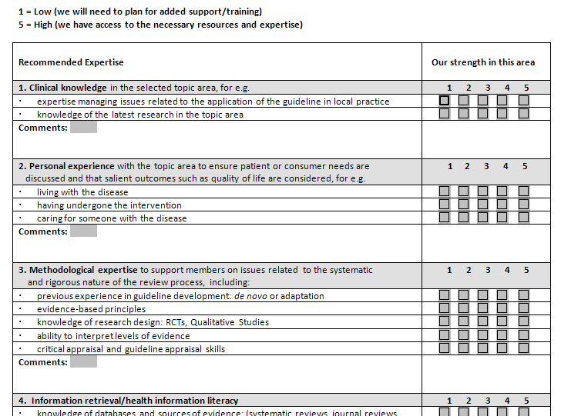
Tool 2.3a Skills Assessment checklist

Slide 12
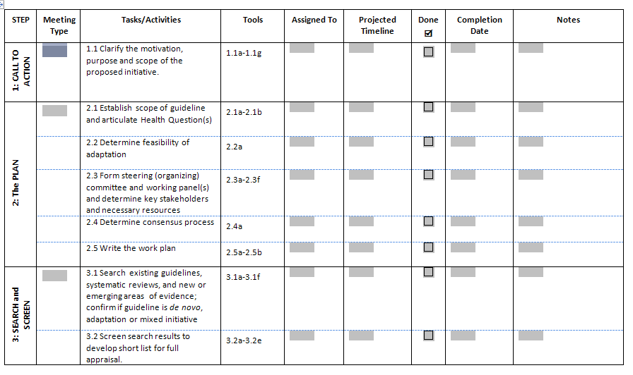
Tool 2.5a Sample Work Plan

Slide 13
STEP 3: Search and Screen
Guide pp. 37-41
3.1 Search existing guidelines, systematic reviews, and new or
emerging areas of evidence; confirm if guideline is de novo,
adaptation or mixed initiative.
3.2 Screen search results to develop short list for full appraisal;
document selection.

Slide 14
STEP 3: Search and Screen
Designing and executing the search - engaging services of a health science librarian or information specialist
Managing citations: Developing a screening protocol and documenting selection decisions
  Library Science Supplement and Toolkit resources

Slide 15
Designing the search:
Choosing inclusion/exclusion criteria
Selecting only evidence-based guidelines (guideline must include a report on systematic literature searches and explicit links between individual recommendations and their supporting evidence)
Selecting only national and/or international guidelines; selecting guidelines written in a particular language (Fr/Eng?)
Specifying a range of dates for publication; selecting only those published since an important review was published;
Selecting peer reviewed publications only; excluding guidelines written by a single author not on behalf of an organization – ideally has multidisciplinary input;
Excluding guidelines published without references – panel must have access to the evidence

Slide 16
STEP 4: Assess and Select
Guide pp. 42-54
4.1 Assess shortlisted guidelines (recommendations and supporting evidence) in detail for: quality (e.g. AGREE), currency, content, coherence between evidence and recommendations, and applicability and acceptability to local context.
4.2 Decision and Selection: review all assessments and achieve consensus with respect to Selecting, Rejecting or Modifying specific recommendations

Slide 17
STEP 4: Assess and Select
Assessing Quality of guidelines
  Using the AGREE instrument
  Summarizing and displaying AGREE scores
  Assessing Quality of Systematic Reviews
Assessing guideline Currency
Assessing guideline Content
  Preparing the ‘Recommendations Matrix’
  The evidence: type and level; classification systems
  Critical appraisal (interpretation and Consistency of evidence)
Assessing Acceptability and Applicability
Making Decision to Accept, Reject or Modify
  Achieving and documenting consensus

Slide 18

www.agreetrust.org
Note: Check this site for release of AGREE II Instrument (May 2010)

Slide 19
AGREE SIX Domains
DOMAIN | ITEMS
Scope & purpose | 3
Stakeholder involvement | 4
Rigour of development | 7
Clarity & presentation | 4
Applicability | 3
Editorial independence | 2
TOTAL | 23

Slide 20
AGREE Tools
4 (7) point Likert Scale
Overall Assessment
User Guide and Manual
Web Based Application http://www.agreetrust.org/my-agree/

Slide 21
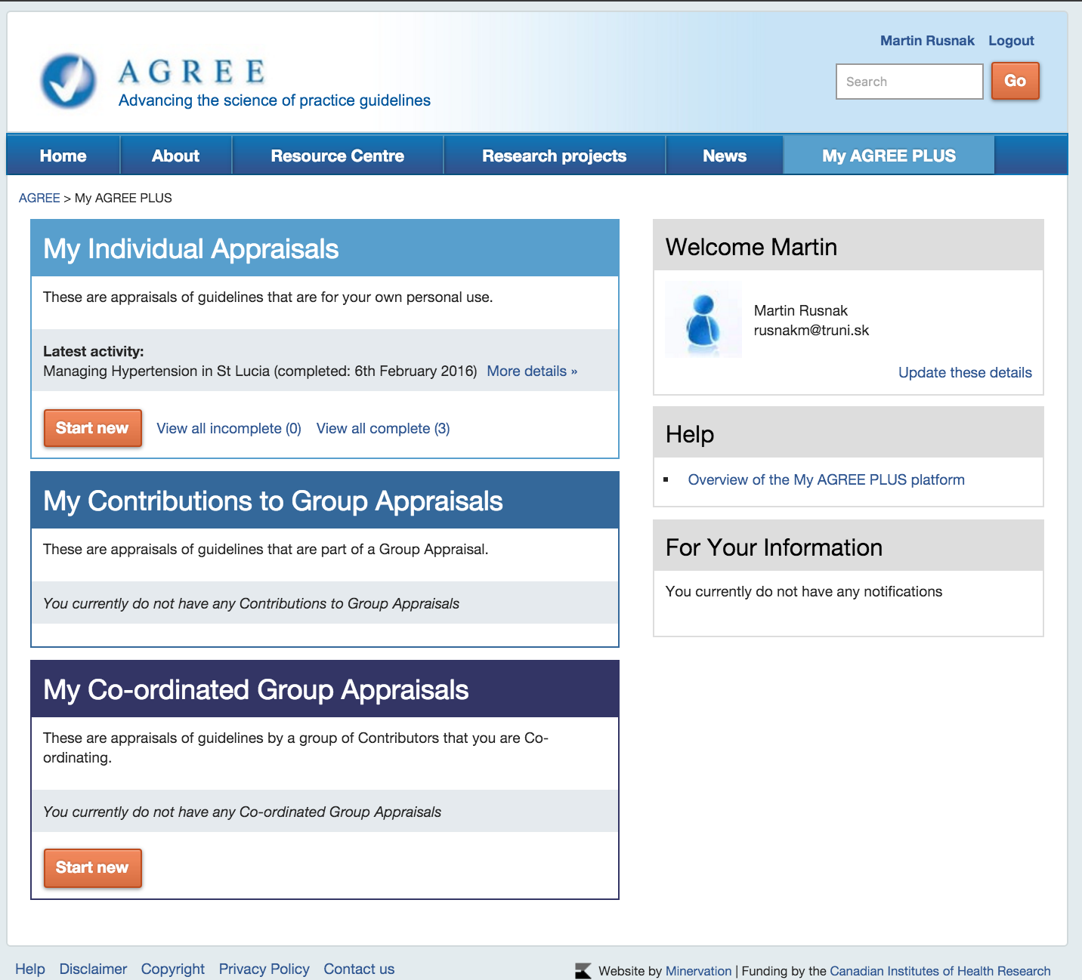

Slide 22
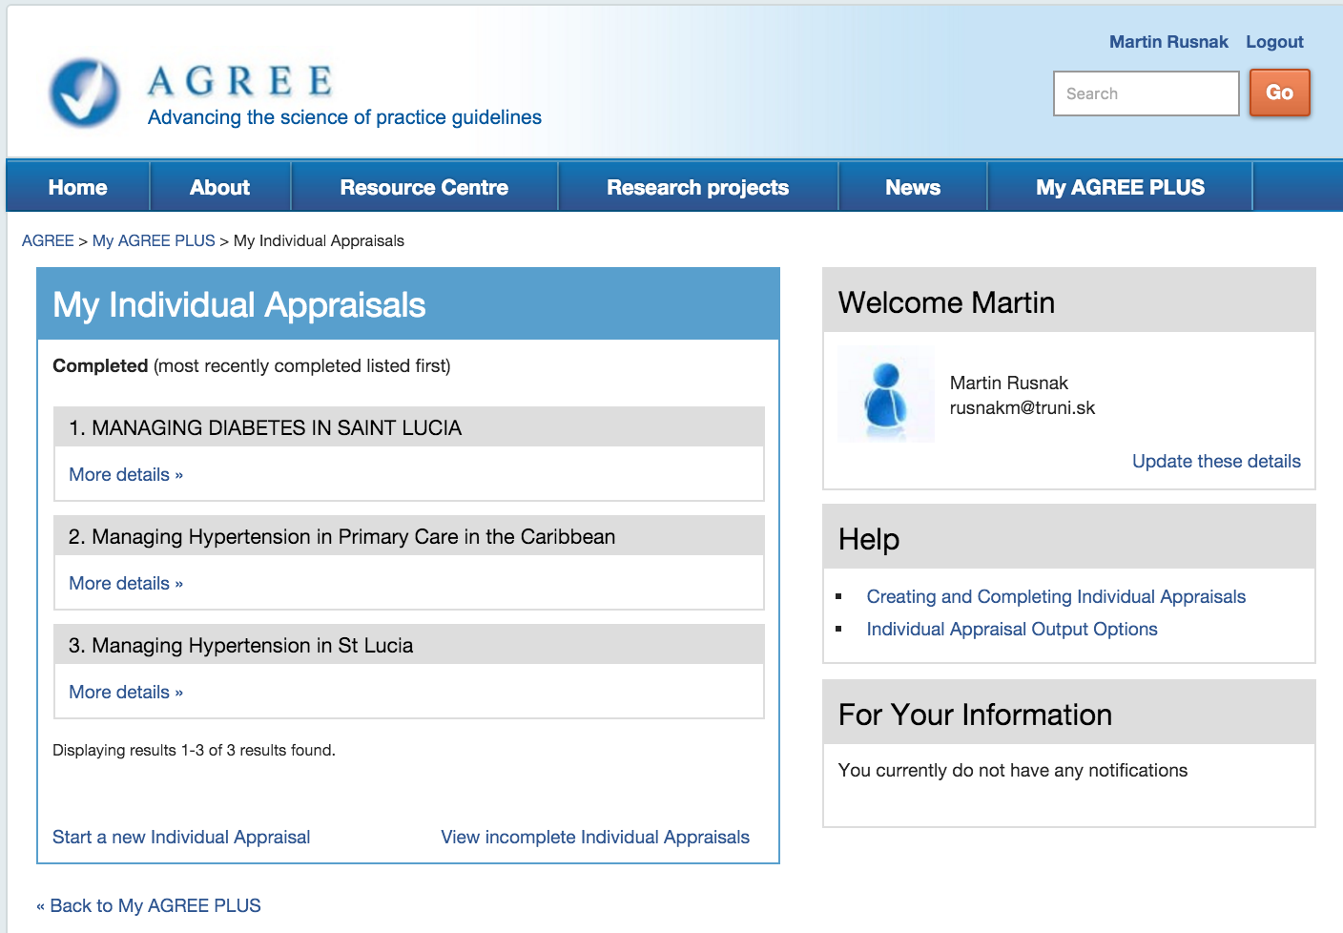

Slide 26
Scoring the St Lucia Guidelines on Managing Hypertension
Domain | Scores Observed | MaxPS | MinPS | Score
Scope and Purpose | 20 | 21 | 3 | 94
Stakeholder Involvement | 8 | 21 | 3 | 28
Rigour of Development | 18 | 56 | 8 | 21
Clarity of Presentation | 16 | 21 | 3 | 72
Applicability | 4 | 28 | 4 | 0
Editorial Independence | 2 | 14 | 2 | 0

Slide 27
CURRENCY Assessment
Is there any new evidence relevant to guideline?
Does new evidence invalidate any of the recommendations?
Are there any plans to update the guideline in the near future?
When was the guideline last updated?

Slide 28
CONSISTENCY Assessment
Quality of source guideline search strategy and study selection ( ADAPTE Tool 13)
  Was the search for evidence comprehensive?
  Is there any bias in the selection of articles?
Consistency between evidence and interpretations; between interpretations and recommendations ( ADAPTE Tool 14)
  Is the evidence valid, overall?
  Are the recommendations based on data and interpretations?

Slide 29
APPLICABILITY Assessment
Review of each of the recommendations with respect to 2 main questions (ADAPTE Tool 15)
Can the recommendation be put into practice?
Consider patient similarity, interventions, outcomes,
patient preferences, availability of equipment, availability
of expertise, any constraints?
Is the benefit from this recommendation worth implementing?

Slide 30
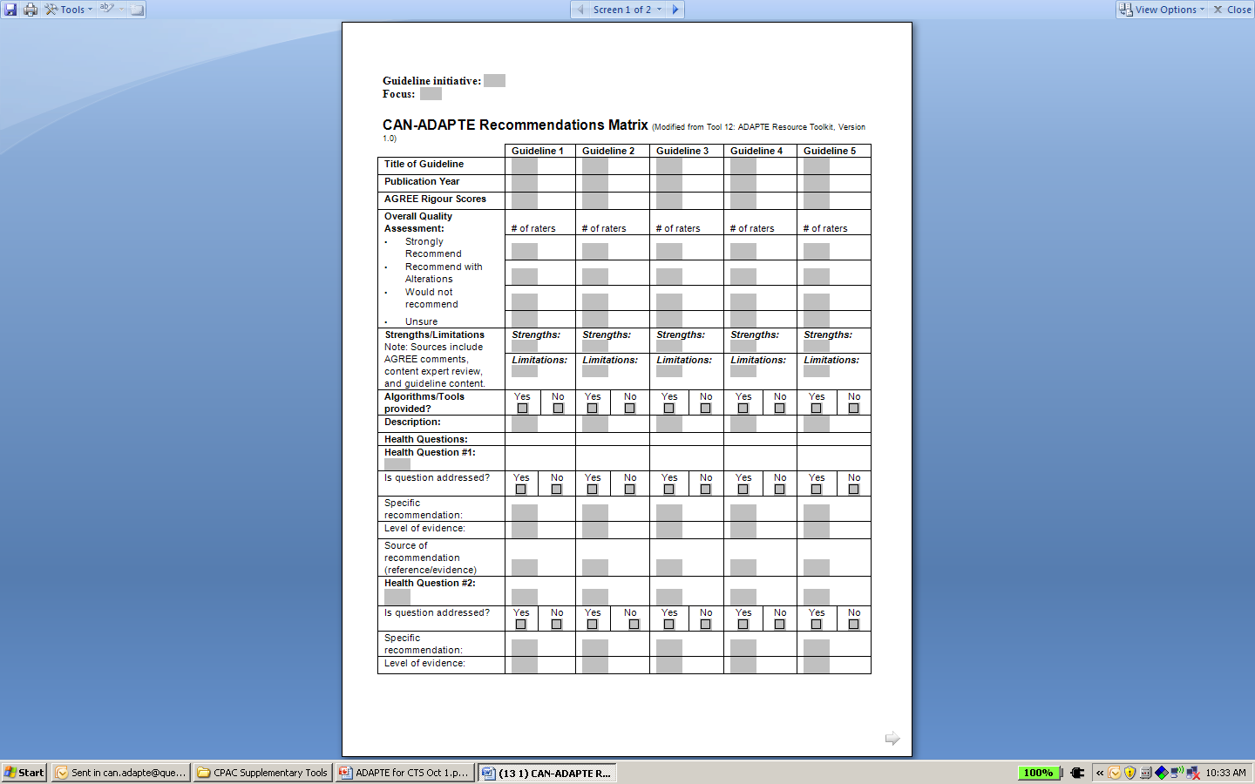
Tool 4.1o Recommendations Matrix (template)

Slide 31
Task 4.2 Decision and Selection Options
1. ACCEPT a whole guideline and all of its recommendations
After reviewing all of the assessments, the panel accepts the guideline as is.
2. REJECT a whole guideline and all of its recommendations
After reviewing all of the assessments, the panel decides to reject the complete guideline. The decision will be based on how the panel weighs the assessments (e.g., poor AGREE scores, guideline is out-of-date, the recommendations do not apply to the panel’s context).
3. ACCEPT the evidence summary of the guideline
After reviewing all of the assessments, the panel decides to accept the description of the evidence (or parts) but to reject the interpretation and the recommendations.
4. ACCEPT single recommendations
After reviewing the recommendations from the guideline or guidelines, the panel decides which to accept and which to reject which may be from one or more guidelines.
5. MODIFY single recommendations
After reviewing all of the recommendations from the guideline(s), the panel decides which are acceptable but need to be modified.

Slide 32
STEP 5: Draft, Revise, and Endorse
Recommendations
Guide pp. 55-61
5.1 Draft Customized Guideline
5.2 Conduct internal review and make revisions
5.3 Conduct external review and obtain endorsement
5.4 Prepare final documents, including any practitioner and patient information, records or application tools, and appropriate source acknowledgments
5.5 Establish a Renewal Plan

Slide 33
STEP 5: Draft, Revise, and Endorse
Recommendations
Guide pp. 55-61
Customizing recommendations:
  Using a template for structure and content
  Authors, acknowledgements, permissions and copyright issues from source developers
  Using brief, unambiguous, actionable language
  Including application tools, algorithms, patient information
  Including a short preface summarizing recommendations, and methodology; appendices and possible web links to documents
Important aspect: Transparency of all decision making (e.g., consensus process is described, how decisions were arrived at and resolved; if recommendations were modified, how and why they were modified);

Slide 34
External Review
External review with those affected by uptake, e.g., experts (practitioners, patients) and users (policy makers, managers)
Consultation with endorsement bodies
  Inclusion of representative on panel throughout process?
Consultation with source guideline developers
Acknowledgement of source documents

Slide 35
Sustainability/Planning for renewal
Guideline maintenance
  specifying in the guideline when, how and by whom the recommendations will be updated;
  In several countries as a standard after four or five years guidelines are reviewed.

Slide 36
STEP 6: Plan Implementation
Guide pp. 62-64
6.1 Dissemination and launch of guideline
6.2 Address implementation requirements
Note: Planning Implementation continues under study and will be fully developed for version 2.0 of the CAN-IMPLEMENT© Resource.

Slide 37

Using the CAN-IMPLEMENT© Resource
Features/Navigation
Field Notes
Tips
Checklists
Thinking about Implementation
Progress Checks
Steps1-6:
- Direction
- Outputs
- Documents
- Tools (indexed to task, links to toolkit)

Slide 38
References
ADAPTE Collaboration, (2007). The ADAPTE Resource Toolkit for Guideline Adaptation Version 1.0. available at www.adapte.org; or www.g-i-n.net
AGREE Collaboration (2001). Appraisal of guidelines for research & evaluation (AGREE) instrument monograph. Available from: http://www.agreetrust.org/docs/AGREE_Instrument_English.pdf
Atkins, D., Best, D., Briss, P.A., et al. (2004). Grading quality of evidence and strength of recommendations. British Medical Association Journal 328 (7454), 1490.
Estabrooks, C.A.. (1998) . Will Evidence- Based Nursing Practice Make Practice Perfect? Canadian Journal of Nursing Research 30 (1), 15-36.
Fervers, B., Burgers, J.S., Haugh, M.C., Latreille, J., Mlika-Cabanne, N., Paquet, L., Coulombe, M., Poirier, M., Burnand, B. (2006). Adaptation of clinical guidelines: literature review and proposition for a framework and procedure. International Journal of Quality in Health Care (13), 167-176.
Field, M.J., & Lohr, K.N. (Eds). (1990). Clinical Practice Guidelines: Directions for a New Program. Institute of Medicine, National Academy Press, Washington, DC., 38

Slide 39
References (continued)
Graham, I.D., Logan, J. Harrison, M.B., Straus, S.E., Tetroe, J., Caswell, W., & Robinson, N. (2006). Lost in Translation: Time for a Map? Journal of Continuing Education in the Health Professions, 26(1), 13-24.
Hayward, R.S.A., Wilson, M.C., Tunis, S.R., Bass, E.B., Guyatt, G., for the Evidence-Based Medicine Working Group (1995). Users’ guides to the medical literature VIII. How to use clinical practice guidelines. Are the recommendations valid? Journal of the American Medical Association (274), 570-574.
National Forum on Health (1998). Canada Health Action: Building on the Legacy, Volume 5. Making decisions: Evidence and information. Quebec: Editions MultiMondes
Sackett, D.L., Rosenberg, W.M., Gray, J.A., Haynes, R.B., & Richardson, W.S. (1996). Evidence based medicine: what it is and what it isn't. British Medical Journal, 312(7023), 71-72).
Shea, B.J., Grimshaw. J.M., Wells, G.A., Boers, M., Andersson, N., Hamel, C., Porter, A.C., Tugwell, P., Moher, D., Bouter, L.M. (2007). Development of AMSTAR: a measurement tool to assess the methodological quality of systematic reviews. BMC Medical Research Methodology, 7(10). Available at: http://www.biomedcentral.com/1471-2288/7/10
Sigma Theta Tau International 2005-2007 Research and Scholarship Advisory Committee (2008). Sigma Theta Tau International Position Statement on Evidence-Based Practice February 2007 Summary. Worldviews on Evidence-Based Nursing (Second Quarter) 57-59.

