Slide 1
International Health Regulations
Prof. MUDr. Martin Rusnák, CSc
Department of Public Health
Faculty of Health and Social Work
Trnava University in Trnava, Slovak Republic

Slide 2
Structure
What is IHR
Why IHR is important
WHO strategy
National Focal Points
Cases
PHEIC
National capacities

Slide 3
Learning objectives
Participants will:
Understand the IHR within a concept of public health surveillance
Recognize the PHEIC and be able to react adequately
Understand local capacities for IHR

Slide 4
International Health Regulations
Formal code of conduct for public health emergencies of international concern.
They're a matter of responsible citizenship and collective protection.
They involve all 193 World Health Organization member countries.

Slide 5
IHR cntd.
They are an international agreement that gives rise to international obligations. They focus on serious public health threats with potential to spread beyond a country's border to other parts of the world.
Such events are defined as public health emergencies of international concern, or PHEIC. The revised International Health Regulations outline the assessment, the management and the information sharing for PHEICs.

Slide 6
IHR cntd.
IHRs serve a common interest.
First of all, they address serious and unusual disease events that are inevitable in our world today.
They serve a common interest by recognizing that a health threat in one part of the world can threaten health anywhere, or everywhere.
And they are a formal code of conduct that helps contain or prevent serious risks to public health, while discouraging unnecessary or excessive traffic or trade restrictions for, quote, "public health," purposes.

Slide 7
Short history
The International Health Regulations (“the IHR” or “Regulations”) were adopted by the Health Assembly in 19691,
Preceded by the International Sanitary Regulations adopted by the Fourth World Health Assembly in 1951.
The 1969 Regulations, which initially covered six “quarantinable diseases” were amended in 1973 and 1981, primarily to reduce the number of covered diseases from six to three (yellow fever, plague and cholera) and to mark the global eradication of smallpox.
In consideration of the growth in international travel and trade, and the emergence or re-emergence of international disease threats and other public health risks, the Forty-eighth World Health Assembly in 1995 called for a substantial revision of the Regulations adopted in 19694.
The IHR (2005) were adopted by the Fifty-eighth World Health Assembly on 23 May 20057. They entered into force on 15 June 2007.

Slide 8
Why we need IHR?

Slide 9
Global movement of people
Serious and unusual disease events are inevitable
Globalisation - problem in one location is everybody’s headache
An agreed International Public Health code of conduct for a global approach

Slide 10
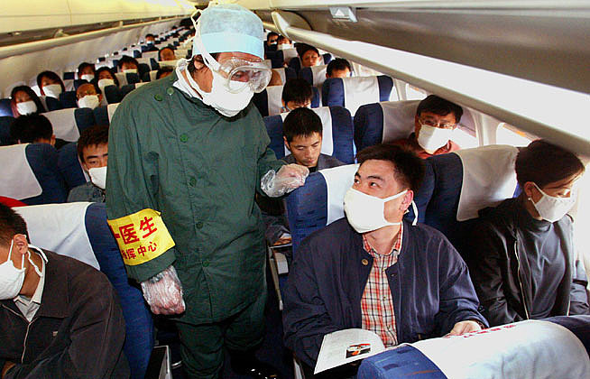
SARS
Notes:
SARS (9/10)
In November 2002, the first cases of SARS (Severe Acute Respiratory Syndrome) emerged in the Guangdong Province in China. After a few weeks, the virus reached Hong Kong, spread along the routes of international air travel causing outbreaks in Asia, Europe, and North and South America. By July 2003, SARS had infected 8,098 people, about 10 percent of whom had died.
SARS, a viral respiratory illness, is transmitted by droplet spread. Rapid action and effective treatment in 2003 eventually broke the chain of transmission and prevented the disease from spreading even further. A SARS infection has become unlikely, but scientists say the disease could re-emerge unexpectedly.

Slide 11
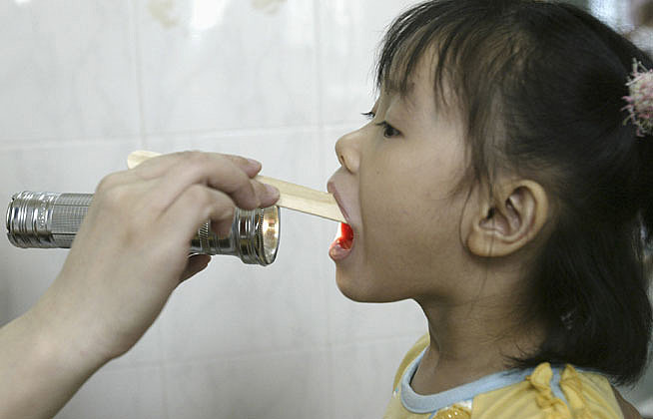
Influenza
Notes:
Hoci väčšina druhov chrípky, nie je smrteľných, "španielska chrípka" pandémia chrípky v roku 1918 zabila až 40 miliónov ľudí na celom svete, viac ľudí, než zomrelo v prvej svetovej vojne
Pandémie nastanú, keď je nový kmeň prenášaný z vtákov aj na iné zvieratá a na človeka. Posledná chrípková pandémia sa začala v Hong Kongu v roku 1968 rozšírila po celom svete v piatich mesiacoch a zabila asi 700.000 ľudí, ale bola obmedzená vzhľadom na lepšiu liečbu a vytvorenie ľudských protilátok.

Slide 12
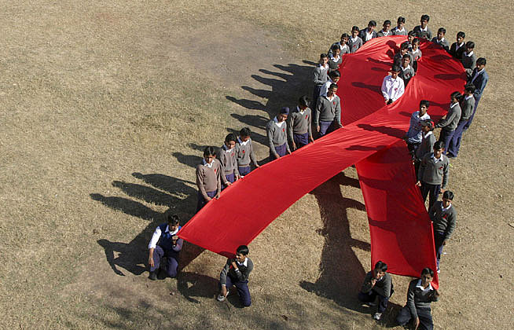
HIV/AIDS
Notes:
Prvé oficiálne prípady ľudskej imunodeficiencie (HIV) boli hlásené okolo roku 1981 v Spojených štátoch, ale vírus sa pravdepodobne najprv rozšíril od ľudí v Afrike už v roku 1930. Dnes, viac ako 33 miliónov ľudí na celom svete žije s vírusom HIV, dve tretiny z nich žijú v subsaharskej Afrike. V roku 2006, tri milióny ľudí zomrelo na Syndróm získaného imunodeficiencie (AIDS), pokročilej formy vírusu HIV.
HIV sa prenáša telesnými tekutinami. Vírus napadá imunitný systém a oslabuje telo pred chorobami. Nové liečebné metódy boli vyvinuté, ale stále neexistuje liek.

Slide 13
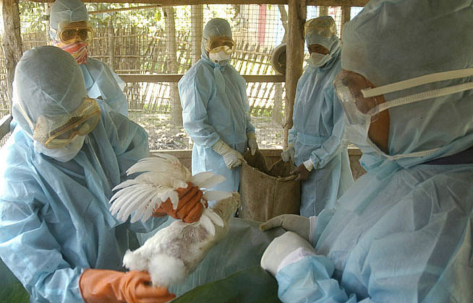
Bird Flu
Notes:
H5N1 – Bird Flu (8/10)
Prior to the first human case in 1997, the H5N1 influenza virus had only been known to affect birds. By 2005, the disease had spread rapidly among birds in Asia in 2005. By 2006, almost every European country had confirmed cases of infected birds. During the last five years, 382 human cases of H5N1 have been reported worldwide.
Infections are a result of direct contact with birds. The virus does not spread easily to humans, but mutations might change human infection probabilities. Air travel and globalization enables infectious diseases to spread quickly, which is why influenza could pose a serious threat to global health in the future.

Slide 14
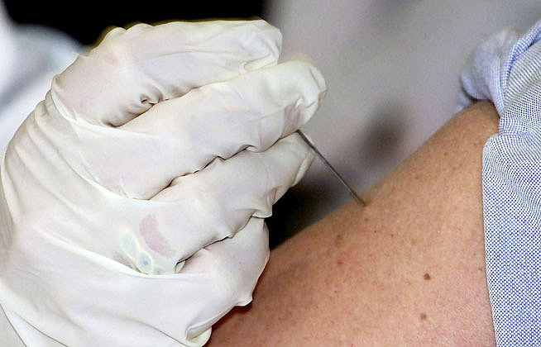
Variola
Notes:
Smallpox (1/10)
Researchers assume that smallpox originated over 3,000 years ago in Egypt or India. Prior to its complete eradication in the 1970s, it was one of the world's most devastating diseases—causing blindness, scarring, and death in around a fourth of its victims. Smallpox still afflicted about 50 million people worldwide as recently as the early 1950s.
To this day, smallpox is the only infectious disease that could be eradicated from nature.

Slide 15

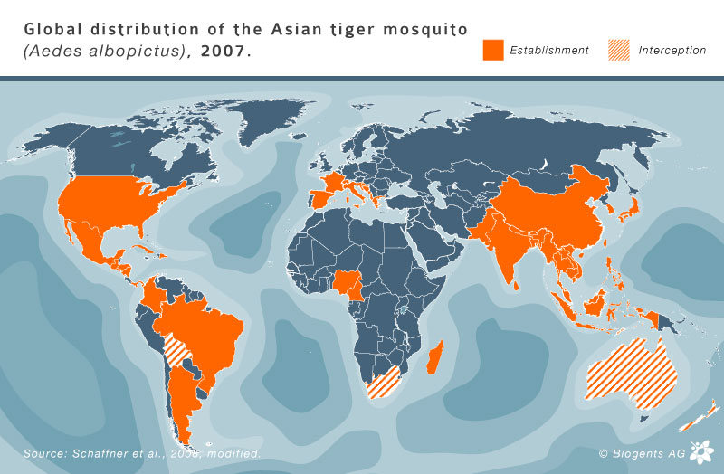
Chikungunya
Notes:
The risk for an outbreak of the Chikungunya virus or the Dengue virus in a specific area depends on two factors:
Risk of the presence of a person who is infected with the Chikungunya virus or Dengue virus.
Risk of transmission of the respective virus by insect disease vectors such as the Asian tiger mosquito (Aedes albopictus). The larger the tiger mosquito population, the larger the risk.
[+] zoom
Hitchhiking Chikungunya
A recent incident where these two risk factors came together was in the Emiglia-Romana region in Northern Italy; however, Italy was not unprepared. As a reaction to the Chikungunya virus epidemic on the French island of La Réunion in the Indian Ocean at the beginning of 2006, the Italian Health Ministry had set up a special surveillance program for Chikungunya cases in August of the same year.
Despite these precautions, a Chikungunya virus outbreak occurred in the areas of Ravenna, Forlì-Cesena, Rimini and Bologna in the Emiglia-Romana region in the summer of 2007. As predicted, the vector was the Asian tiger mosquito. At least 200 people were infected with the virus. Luckily, the outbreak could be contained and the virus did not manage to survive into the tiger mosquito season of 2008.
For the Chikungunya virus, the first two known cases being imported into the Emiglia-Romana region were reported in 2006. One came from Mauritius, the other from India. Three further Chikungunya cases were recorded in 2007, this time all of them coming from India. The first of these was the source of the Chikungunya outbreak in the areas of Ravenna, Forlì-Cesena, Rimini and Bologna.

Slide 16
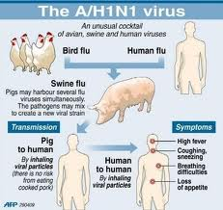
Swine Flu

Slide 17
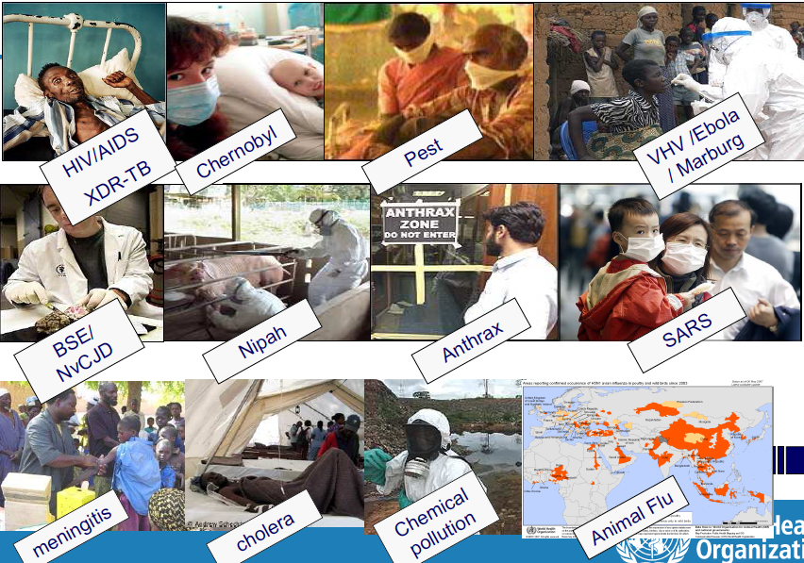

Slide 18
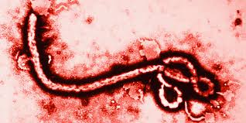
Ebola

Slide 19
Strategy
WHO 2008. International health regulations (2005) -- 2nd ed. Geneva: World Halth Organization.

Slide 20
PHEIC
Public Health Emergency of International Concern means an extraordinary event which is determined, as provided in these Regulations:
  to constitute a public health risk to other States through the international spread of disease, and
  to potentially require a coordinated international response.

Slide 21
Parameters for notification to WHO
The parameters for notification to WHO of all events which may constitute a public health emergency of international concern (PHEIC) are based on the following criteria:
  seriousness of the public health impact of the event;
  unusual or unexpected nature of the event;
  potential for the event to spread internationally; and/or
  the risk that restrictions to travel or trade may result because of the event.
Timely and transparent notification of events combined with a collaborative assessment of the risks by the concerned
State and WHO, along with effective risk communication will reduce the potential for international disease spread and the likelihood of unilateral imposition of trade or travel restrictions by other countries.

Slide 22
Four diseases that must be automatically notified to WHO
All cases of these :
  smallpox,
  poliomyelitis due to wild-type poliovirus,
  SARS and
  cases of human influenza caused by a new subtype.
Case definitions for each of these four diseases have been prepared by WHO and posted at on its website at www.who.int/ihr.

Slide 23
3 domains
7 areas of work
Build on existing
  WHO alert & response operations
  WHO (relevant) control programmes
    (e.g. GIP, ADE, ERI, IVB, POL, FOS, PHE …)
  Regional strategies for surveillance & response
    (e.g. joint WPRO/SEARO, PAHO, IDSR in AFRO & EMRO)
…
Elements for a WHO strategy

Slide 24
Coordination
Monitoring
Reporting
Resource mobilisation
Administration
Alert & Response Ops
IHR Contact Point
Intelligence
Verification
Risk assessment
Risk communication
Notification
Response
IHR Bodies & Procedures
IHR Focal Points
Roster of experts
Emergency Committee
Review Committee
National legislation
WHO Alert, Preparedness, and Response Operations
Project Management
Specific threats
influenza
polio
smallpox
SARS
Chemical/Radionuclear
others
IHR Communication
information
education
advocacy
National Core Capacity
Country Alert & Response
IHR NFP Operations
National ARO
Laboratory training / support
Epidemiology training / support
National system assessment
Response preparedness
-Social mobilization
-Case management
Points of Entry
Ports
Airports
Ground crossings

Slide 25
Coordination:
Many players to bring on board
Potential Donors
WHO Senior Management
Country relevant professionals
Country IHR Focal Points
Regional Organizations (ASEAN, EU, …)
WHO Country Offices
International Organisations (FAO, OIE, WTO, …)
Media / The public
WHO Governing Bodies

Slide 26
Event notification and determination under IHR (2005)
External
advice
Emergency
Committee
Determine whether an event constitutes a PHEIC and recommend measures
WHO DG
WHO IHR
Contact Points
Coordinate
Other competent
Organizations
(IAEA etc.)
Receive, assess and respond to events notified
Consult events or notify WHO of any events that may constitute a PHEIC
National IHR
Focal Points
Communicate
Ministries/
Sectors
Concerned
Detect and report any urgent or unexpected events
Various disease and event surveillance
systems within a country
Report

Slide 27
IHR M & E : 5 Pillars System
Pillar 1
Policy
Planning Financing
Pillar 2
IHR Infrastructures & Institutions
Pillar 3
IHR Human Resources knowledge & skills
Pillar 4
IHR Technical Resources
Pillar 5
IHR Systems and Services
  National IHR Focal Point
  Focal Point for
  communication
  with Media
  Points of Entry
  National Emergency
  Committee
IHR training & continuous education
Roster of professional with IHR “qualification”
Active Participation in Int. IHR related Networks
IHR Resources Mapping
Telecommunication Resources
Infection Control SOPs
Clinical Management guidelines for PHEIC
Early Warning System
Verification and risk assessment system
Rapid Investigation &
Response Team
Equipment and
Stockpiles
Functioning laboratory system
for PHEIC
Legal framework for IHR
National Plan for PHEIC
Budget allocation for IHR
W H O R e s o u r c e s
I D S R – A P S E D – E I D – H M N
GOARN – EMS – E-Health- Global Atlas – Health Mapper – CSUN- GLADNet…

Slide 28
What do the IHR call for?
Strengthened national capacity for surveillance and control, including in travel and transport
Prevention, alert and response to public health emergencies of international concern
Rights, obligations and procedures, and progress monitoring
Global partnership and international collaboration

Slide 29
Local/National Activities
Step 1: Review of the National Action Plan (or equivalent) for strengthening IHR core capacities and the results of the IHR Monitoring Tool, together with information from other sources.
Step 2: Consultation with relevant sectors wherever necessary and approval by appropriate authorities.
Step 3: Development of IHR implementation plan or equivalent (for extension period) and dissemination to relevant stakeholders
Step 4: Report and request for extension as needed
Step 5: Follow up actions

Slide 30
Case study of wild polio
Kaliner E, Moran-Gilad J, Grotto I, Somekh E, Kopel E, Gdalevich M, Shimron E, Amikam Y, Leventhal A, Lev B, Gamzu R. Silent reintroduction of wild-type poliovirus to Israel, 2013 – risk communication challenges in an argumentative atmosphere . Euro Surveill. 2014;19(7):pii=20703.
Israel has been certified as polio-free by the World Health Organization and its routine immunization schedule consists of inactivated poliovirus vaccine (IPV) only. At the end of May 2013, the Israeli Ministry of Health (MOH) has confirmed the reintroduction of wild-type poliovirus 1 into the country. Documented ongoing human-to-human transmission necessitated a thorough risk assessment followed by a supplemental immunization campaign using oral polio vaccine (OPV). The unusual situation in which ongoing poliovirus transmission was picked up through an early warning system of sewage monitoring without active polio cases, brought about significant challenges in risk communication.

Slide 31
Reaction
International spread of wild-type poliovirus in 2014 declared a Public Health Emergency of International Concern under the International Health Regulations (IHR). 28 May 2014
On 5 May 2014, the Director-General of the World Health Organization (WHO), Dr Margaret Chan, acted on the recommendation of the International Health Regulations Emergency Committee and declared that the spread of wild-type poliovirus (WPV) in 2014 constitutes a Public Health Emergency of International Concern (PHEIC) in accordance with the International Health Regulations (IHR) [1]. This is the second time that a PHEIC has been declared under IHR 2005. The first time was for pandemic influenza A(H1N1) in 2009. In a press conference held by WHO on 5 May 2014, Dr Bruce Aylward, WHO Assistant Director-General responsible for polio eradication, stated that if
‘the situation as of today and April 2014 is unchecked, it could result in the failure to eradicate globally one of the world’s most serious vaccine-preventable diseases’ .
As a result of the PHEIC, WHO issued temporary recommendations for controlling the spread of polioviruses.
This Rapid Risk Assessment examines the implications of the temporary recommendations for EU Member States and assesses whether the developments leading to the declaration of a PHEIC represent an increased risk of WPV importation to, and sustained transmission in, Member States of the European Union. It also considers practical suggestions for implementing the WHO recommendations in the EU.

Slide 32
PHEIC Public Health Emergency of International Concern
Following the declaration of a PHEIC, WHO has issued temporary recommendations that will be re-assessed in three months [1].
The main purpose of the measures presented in the temporary recommendations is to reduce the risk of international spread of wild-type poliovirus before the high WPV transmission season in May and June.
The WHO recommendations divide the 10 polio-affected countries into two groups.
  Three ‘currently exporting countries’ (Pakistan, Cameroon and Syria) from which the virus has been carried to other countries in 2014.
  Seven countries (Afghanistan, Equatorial Guinea, Ethiopia, Iraq, Israel, Somalia and Nigeria) which are affected but are currently not exporting poliovirus.

Slide 33
Control measures
The three exporting countries are requested to ensure that all residents and long-term visitors (defined as those staying in the country for more than four weeks) receive a dose of either OPV or IPV between four weeks and 12 months prior to international travel. Countries have to ensure that such travellers are provided with an International Certificate of Vaccination or Prophylaxis in the form specified in Annex 6 of the International Health Regulations (2005) to record their polio vaccination and serve as proof of vaccination.
The seven non-exporting countries are requested to encourage the same vaccinations and ensure that travellers who receive such vaccination have access to an appropriate document to record their polio vaccination status.
In addition, the 10 countries have to officially declare – if they have not already done so – at the level of head of state or government, that the interruption of poliovirus transmission is a national public health emergency. They have to maintain these measures until the following criteria have been met: (i) at least six months have passed without the detection of wild poliovirus transmission in the country from any source, and (ii) there is documentation of full application of high-quality eradication activities in all infected and high risk areas.

Slide 34
Floods in Bosnia and Herzegovina, Croatia, and Serbia: communicable disease risks 18 June 2014
Continuous and heavy rainfall from 14 to 16 May 2014 resulted in extensive flooding in Bosnia and Herzegovina, Croatia, and Serbia, mainly around the Sava river catchment area. It was considered the worst flood since the beginning of record keeping in the region. On 25 May, the World Health Organization’s Regional Office for Europe (WHO/EURO) reported that two million people were affected by the flooding, more than 60 000 were displaced, and 60 people died in the three countries [4]. In the affected areas, 61 healthcare facilities were damaged. Prevention and control measures against infectious diseases were focused on water- and vector-borne diseases, together with psychological support.
The flood water slowly receded and has currently returned to normal water levels in most places. As of 13 June 2014, the number of displaced persons decreased from nearly 60 000 to 22 500 persons in the three countries. Current efforts are focused on the reestablishment of general services (water, centralised wastewater collection/treatment services, transportation and electricity), general cleaning (debris removal, disposal of waste), disinfection and rodent control.

Slide 35
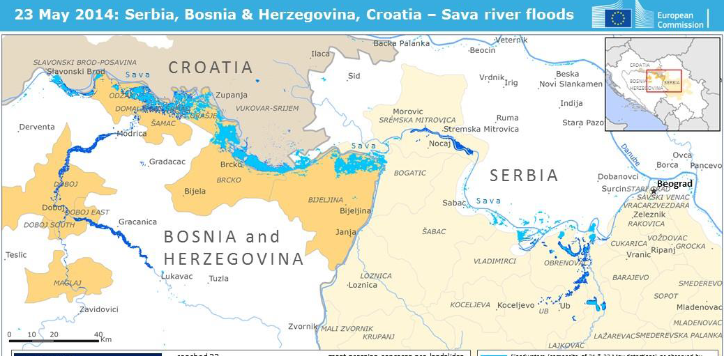
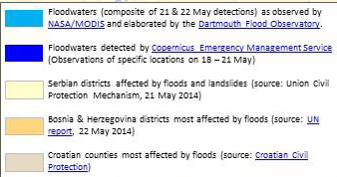

Slide 36
WHO conclusions
According to WHO/EURO, as of 13 June 2014, no outbreaks of communicable diseases have been reported in the affected areas. WHO/EURO also reported that the early response phase had ended, which focused on enhanced epidemiological surveillance, the strengthening of early warning systems for communicable diseases, and the prevention of water- and vector-borne infections.
A post-disaster needs assessment is underway for Bosnia and Herzegovina and Serbia. Vector control measures are ongoing in the three countries (aerial spraying of some flood-affected municipalities).

Slide 37
Summary
IHR = Formal code of conduct for public health emergencies of international concern.
Globalisation - problem in one location is everybody’s headache
Public Health Emergency of International Concern PHEIC means an extraordinary event
National approach: IHR implementation plan and dissemination to relevant stakeholders
Case studies: wild polio, floods in Balkan

Slide 38
Further reading
NATIONAL, RESEARCH & COUNCIL 2014. An All-of-Government Approach to Increase Resilience for International Chemical, Biological, Radiological, Nuclear, and Explosive (CBRNE) Events: A Workshop Summary. Steering Committee on An All-of-Government Approach to Increase Resilience for International Chemical, Biological, Radiological, Nuclear, and Explosive (CBRNE) Events, Division on Earth and Life Studies. Washington, DC: The National Academies Press.
HUFNAGEL, L., BROCKMANN, D. & GEISEL, T. 2004. Forecast and control of epidemics in a globalized world. Proceedings of the National Academy of Sciences., 101, 15124-15129.
WILSON, K., MCDOUGALL, C., FIDLER, D. P. & LAZAR, H. 2008. Strategies for implementing the new International Health Regulations in federal countries. Bull World Health Organ, 86, 215-20.

Slide 39
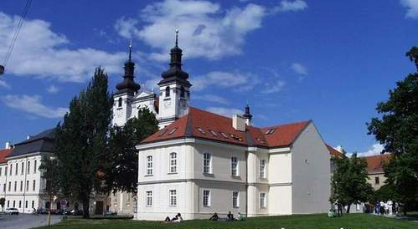
See you in Trnava

