Slide 1
Meranie účinnosti zavedených politík
prof. Martin Rusnak, MD, PhD
prof. Viera Rusnáková, MD, PhD, MBA
PhDr. Kristína Grendová, PhD
Dpt. Public Health, Trnava University
Slovakia, EU
Contact: rusnakm@truni.sk

Slide 2
This module is about:
  monitoring and evaluating population health and health inequity,
  suggesting data sources for health policy-making and
  introducing participants to two different approaches to evaluation for generating evidence-based recommendations:
    health impact assessment (HIA) and
    health lens analysis (HLA).

Slide 3

Learning objectives
List reasons for monitoring and evaluation
Recognize different types of monitoring and evaluation related to health
Distinguish between inputs, outputs, outcomes and impact
Explain the purpose and key steps involved in health impact assessment and health lens analysis
Conduct a mock health impact assessment or health lens analysis
Identify sources of health data and policy advice

Slide 4
Key messages
Monitoring can be defined as the systematic collection of data about an indicator or variable of interest.
Evaluation, in contrast, involves a judgement about the value of or change in that variable.

Slide 5
Key messages
Monitoring and evaluation can focus on different aspects of health and health policy-making:
  population health (e.g. incidence of disease and life expectancy),
  epidemiology (e.g. risk factors and exposure levels)
  determinants of health (e.g. income and living conditions),
  health system performance (e.g. access and quality of health services) and
  health policy (e.g. impact on health outcomes and health inequity).

Slide 6
Key messages
The purpose of monitoring and evaluation is to determine the impact of policies, programmes and practices, and, subsequently, to indicate whether policy change is needed.
The five stages of the cycle of health monitoring are:
  Selecting relevant indicators;
  Obtaining data;
  Analysing data;
  Reporting results; and
  Implementing changes.

Slide 7
Key messages
Just as monitoring and evaluation can focus on different aspects of health and policy-making, indicators often correspond to different stages of a policy intervention and can be categorized as a “results chain” as follows:
  “Inputs” – the resources used to initiate a policy or project;
  “Outputs” – processes, products and services that immediately result from a policy or project;
  “Outcomes” – short- to medium-term results of a policy or project; and
  “Impacts” – long-term effects produced by a policy or project.

Slide 8
Key messages
The WHO uses the “results chain” to evaluate the influences of health inputs and outputs on universal health coverage.
In this performance assessment framework, the social determinants of health are construed as influencing health system inputs and outputs, as well as how the users of health systems demand and utilize health services.

Slide 9

Key messages
A health impact assessment is a combination of procedures, methods and tools that assess the potential effects of a policy or project on the health of a population and the distribution of those effects within the population. HIAs also identify appropriate actions to manage those effects.

Slide 10
Key messages
The health lens analysis is an emerging methodology used to translate the HiAP concept into action.
It differs from health impact assessment in its emphasis on relationship building and mutually beneficial outcomes, and the emphasis on navigating the recommendations through the decision-making process.
Building evaluation into any policy recommendations is a key aspect of the methodology.

Slide 11
Key messages
Emphasizing co-benefits between health and another policy focus on area is an important technique to be used in either HIA or HLA. This refers to situations where health gains and sustainability objectives can be mutually reinforcing.
There are many valuable public sources of data and policy advice to inform HiAP development and implementation.

Slide 12
Group discussion
REASONS FOR MONITORING AND EVALUATING (M&E)
AND
HEALTH INDICATORS

Slide 13
Group discussion
This module on measuring progress in health is looking at a different stage of the policy cycle
Monitoring and evaluating is an iterative and cyclical process that operates continuously

Slide 14
Policy cycle

Slide 15
Group discussion
Give reasons for the health ministry to do monitoring and evaluating,

Slide 16
Reasons for M&E
Tracking population health and health inequity
Studying the factors that contribute to or undermine health and universal health coverage
Improving the effectiveness and efficiency of policies and projects
Understanding why particular interventions work or don’t work
Assessing the outcomes and impacts of policies and projects
Ensuring transparency and accountability
Increasing the visibility of the government’s work

Slide 17
It is important to measure whether the HiAP approach is working and not simply monitor the desired impact of a healthier, more equitable society.
Without M&E policy processes, it is difficult to claim partial responsibility for positive changes; they might have occurred independently or be due to the efforts of someone else!

Slide 18
M&E, HiAP, HIA
and HLA

Slide 19
The aim is to provide you with an understanding of some key M&E concepts and explain the purpose and procedure of a health impact assessment and health lens analysis.
There are different definitions of M&E and its stages, but for the purposes of a general discussion the following definition and model is adequate.

Slide 20
Definition of M&E and the cycle of health monitoring
Monitoring can be defined as the systematic collection of data about an indicator or variable of interest.
Evaluation, in contrast, involves a judgement about the value of or change in that variable.

Slide 21
Health monitoring
Health monitoring is the process of tracking the health of a population and the health system that serves that population.
Monitoring and evaluation can focus on different aspects of health and health policy-making. For instance:
  Population health (e.g. incidence of disease and LE);
  Epidemiology (e.g. risk factors and exposure levels);
  Determinants of health (e.g. income and living conditions);
  Health system performance (e.g. access and quality of health services); and
  Health policy (e.g. impact on health outcomes and health inequity).

Slide 22
The cycle of health monitoring

Slide 23
The cycle of health monitoring
1. Selecting relevant indicators
The process begins by identifying indicators that are relevant to the desired type of monitoring as mentioned above.
These measures can be quantitative or qualitative.
The appropriate selection can often be a complicated task that requires consideration of what is:
  easily monitored,
  analytically robust and
  communicates the issue to the public and other policy-makers.

Slide 24
The cycle of health monitoring
2. Obtaining data
Collecting data should occur regularly.
The methodology for this collection will depend on the purpose of the M&E and could include:
  scientific research and trials,
  epidemiological studies,
  household surveys,
  analysis of policy processes,
  interviews and
  project case studies.

Slide 25
The cycle of health monitoring
3. Analysing data
This means interpreting the data and can involve preparing:
  summary statistics,
  modelling,
  literature reviews and political analysis of policy processes
  issues such as the social determinants of health and barriers to health care access.

Slide 26
The cycle of health monitoring
4. Reporting results
Reporting can come in many forms, ranging from internal memos to press releases, technical reports and academic publications, each including various methods of presenting data (such as tables, graphs, maps or text).
The goal should be to ensure that the results of the monitoring process are communicated effectively, and can be used to inform policies, programmes and practice.

Slide 27
The cycle of health monitoring
5. Implementing changes
Based on monitoring results, changes may be implemented that will improve health policy, maximize the net health benefits of activities outside the health sector and thus, enhance population health and reduce health inequities.

Slide 28

Health impact assessment
Given many of the determinants of health and health inequities in populations have social, environmental and economic origins that extend beyond the direct influence of the health sector and health policies.
It is important to monitor the activities of other sectors for significant health consequences.
Routine consideration of health and health equity impacts in policy development is one way to achieve a reduction in health inequalities.
A common approach to achieve this is using a health impact assessment.

Slide 29
Definition of HIA
a combination of procedures, methods and tools that assesses the potential effects of a policy or project on the health of a population and the distribution of those effects within the population
HIAs also identify appropriate actions to manage those effects.

Slide 30
Definition of HIA
Many different people and organizations have defined HIA. Each definition is similar, differing through the emphasis given to particular components of the HIA approach.
There is no correct definition – what follows is merely a selection of ways to describe HIA.

Slide 31
Purpose of HIA
HIAs look not only for negative impacts, but also for impacts favourable to health.
This provides decision-makers with options to strengthen and extend the positive features of a proposal, with a view to improving the health of the population.
HIA is an important and useful tool within HiAP as it provides a tangible way for government departments to actually work together rather than just talking about working together.

Slide 32
Purpose of HIA
HIA is suitable for use at many different levels. HIA can be used on:
  projects,
  programmes and
  policies.
The flexibility of HIA allows these projects, programmes and policies to be assessed at :
  a local,
  regional,
  national or
  international level
making HIA suitable for almost any proposal.

Slide 33
HIA – four values
HIA is based on four values that link the HIA to the policy environment in which it is being undertaken.
Democracy – allowing people to participate in the development and implementation of policies, programmes or projects that may impact on their lives.
Equity – HIA assesses the distribution of impacts from a proposal on the whole population, with a particular reference to how the proposal will affect vulnerable people.

Slide 34
HIA – four values
Sustainable development – both short- and long-term impacts are considered, along with the obvious and less obvious impacts.
Ethical use of evidence – the best available quantitative and qualitative evidence must be identified and used in the assessment. A wide variety of evidence should be collected using the best possible methods.

Slide 35
Procedure - five stages of HIA

Slide 36
Health lens analysis (HLA)
The HiAP health lens analysis process builds on traditional health impact assessment methodology by incorporating a suite of additional methods (e.g. economic modelling) to allow the process to deliver both rigour and flexibility that accommodates the operational culture and policy imperatives of the partner agency.
As a consequence, the methodology employed for a health lens is modified for each target area.
Evaluation, an essential component of the HiAP process, is built into each individual health lens.

Slide 37
HLA – procedure
The emerging methodology for the health lens analysis consists of a series of steps that underpin its effectiveness and ability to deliver mutually beneficial outcomes:
1. Engage: establishing and maintaining strong collaborative relationships with other sectors. Determine agreed policy focus.
2. Gather evidence: establishing impacts between health and the policy area under focus, and identifying evidence-based solutions or policy options.

Slide 38
HLA – procedure
3. Generate: producing a set of policy recommendations and a final report that are jointly owned by all partner agencies.
4. Navigate: helping to steer the recommendations through the decision-making process.
5. Evaluate: determining the effectiveness of the health lens.

Slide 39
Group activity
HEALTH IMPACT ASSESSEMENT
HIA

Slide 40
Group activity
the policy scenario: a new large car manufacturing factory in a city
set the scope of the HIA by identifying stakeholders to engage and the potential health risks and other issues that should be assessed.
try to identify indicators or measures for data collection and questions you might ask different stakeholders
you have around 30 minutes to draft your terms of references
remember to include benefits and possible unintended consequences from various determinants of health
nominate a presenter

Slide 41
HEALTH IMPACT ASSESSEMENT(HIA)
HIAs look at health risks and benefits from many direct and indirect paths.
A HIA takes time and can be expensive.
However, conducting the assessment at the proposal stage allows for changes to mitigate risks and maximize benefits.
A HIA can be far less costly than the potential long-term health impacts and other socioeconomic consequences of poorly considered policies and projects.

Slide 42
Group discussion
DATA SOURCES FOR HiAP

Slide 43
Statistical databases

Slide 44
WHO Global Health Observatory
WHO's gateway to health-related statistics for its 194 Member States.
The aim: to provide easy access to:
  country data and statistics with a focus on comparable estimates;
  WHO’s analyses to monitor global, regional and country situation and trends.
provides access to an interactive repository of health statistics.
Users are able to display and download data for selected indicators, health topics, countries and regions.

Slide 45
WHO Global Health Observatory
GHO theme pages cover global health priorities:
  health-related Millennium Development Goals,
  mortality and burden of disease,
  health systems,
  health,
  noncommunicable diseases,
  infectious diseases,
  health equity and
  violence and injuries.
The GHO issues analytical reports on priority health issues, including the World Health Statistics annual publication, which compiles statistics for key health indicators. Analytical reports will address cross‐cutting topics such as women and health.

Slide 46
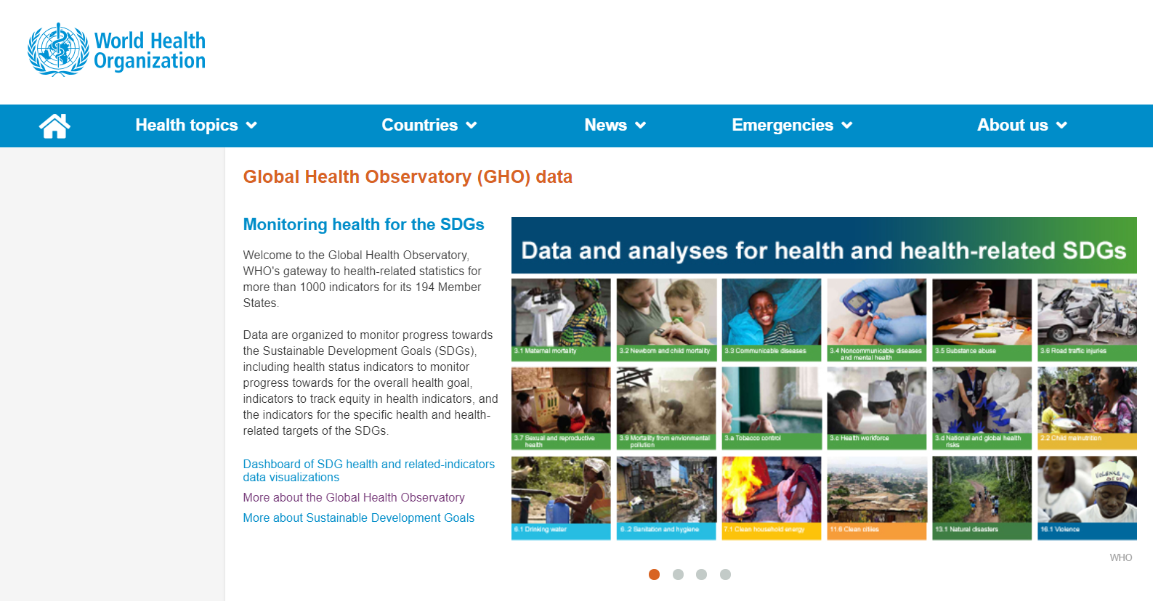
WHO Global Health Observatory
http://www.who.int/gho/en/

Slide 47
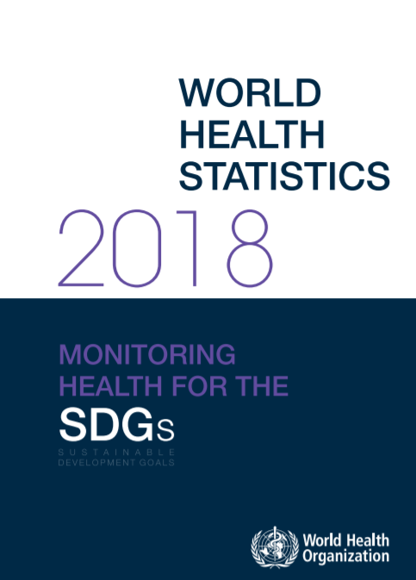
WHO World Health Statistics Reports
WHO's annual World Health Statistics reports present the most recent health statistics for the WHO Member States
http://www.who.int/gho/publications/world_health_statistics/en/

Slide 48
National Health Accounts
Global Health Expenditure Database – the National Health Accounts (NHA) provides evidence to monitor trends in health spending, different health care activities, providers, diseases, population groups and regions in a country.
It helps in developing national strategies for effective health financing and in raising additional funds for health.
Information can be used to make financial projections of a country’s health system requirements and compare their own experiences with the past or with those of other countries.

Slide 49
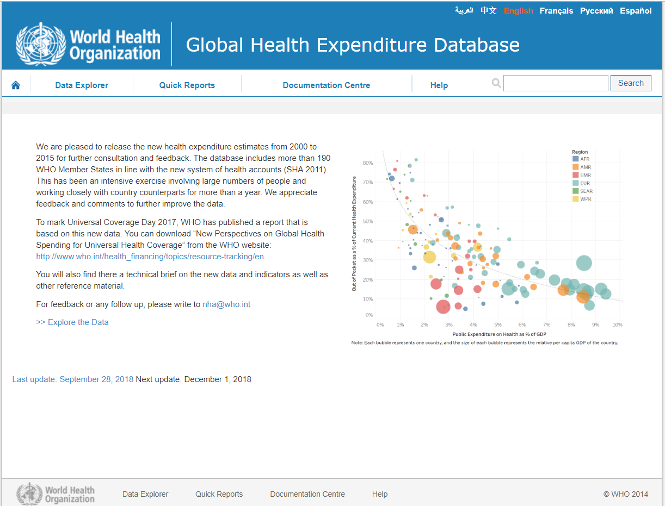
National Health Accounts
http://apps.who.int/nha/database

Slide 50
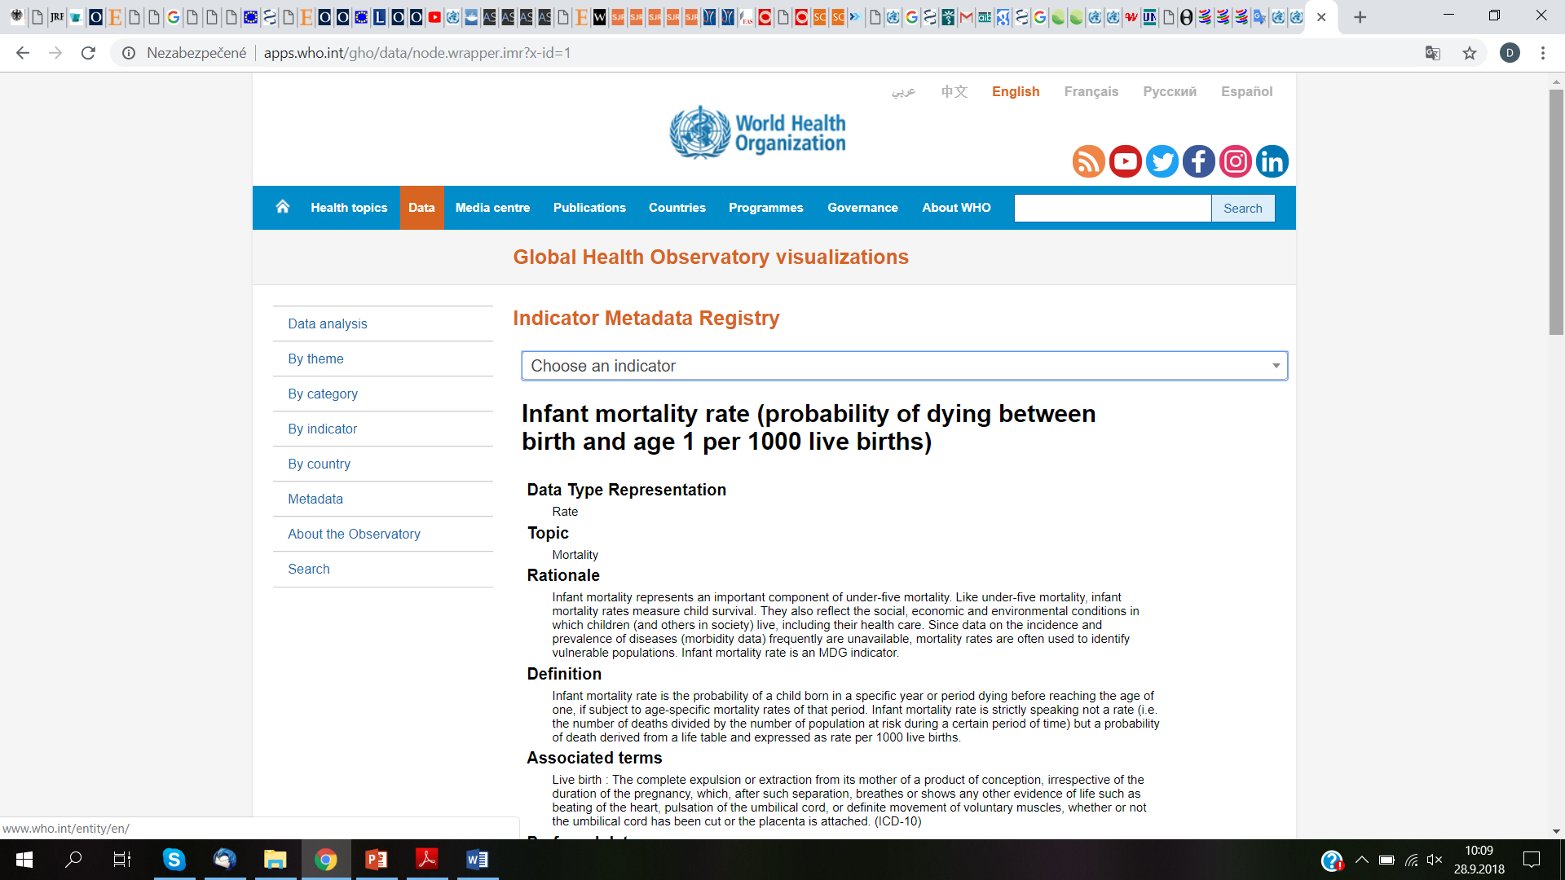
WHO Indicator and Metadata Registry
a central source of metadata of health-related indicators used by WHO and other organizations.
It includes indicator definitions, data sources, methods of estimation and other information that allow users to get better understanding of their indicators of interest.
http://www.who.int/gho/indicator_registry/en/

Slide 51
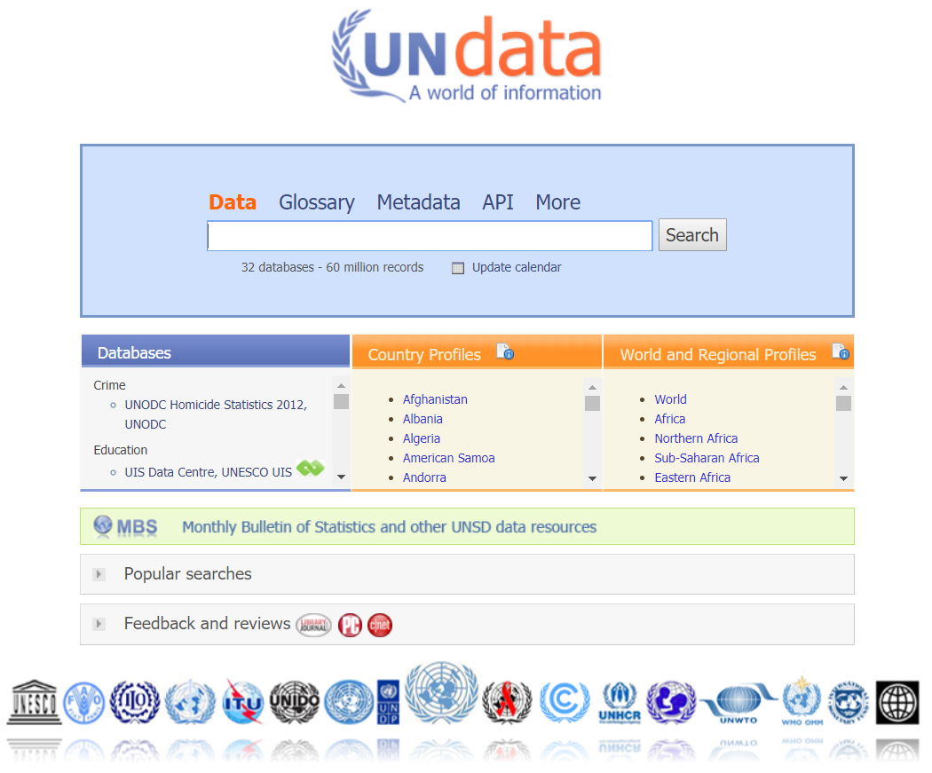
UN Data
An internet based data service for the global user community.
easy reach of users through a single entry point
Users can search and download a variety of statistical resources of the UN system.
http://data.un.org/

Slide 52
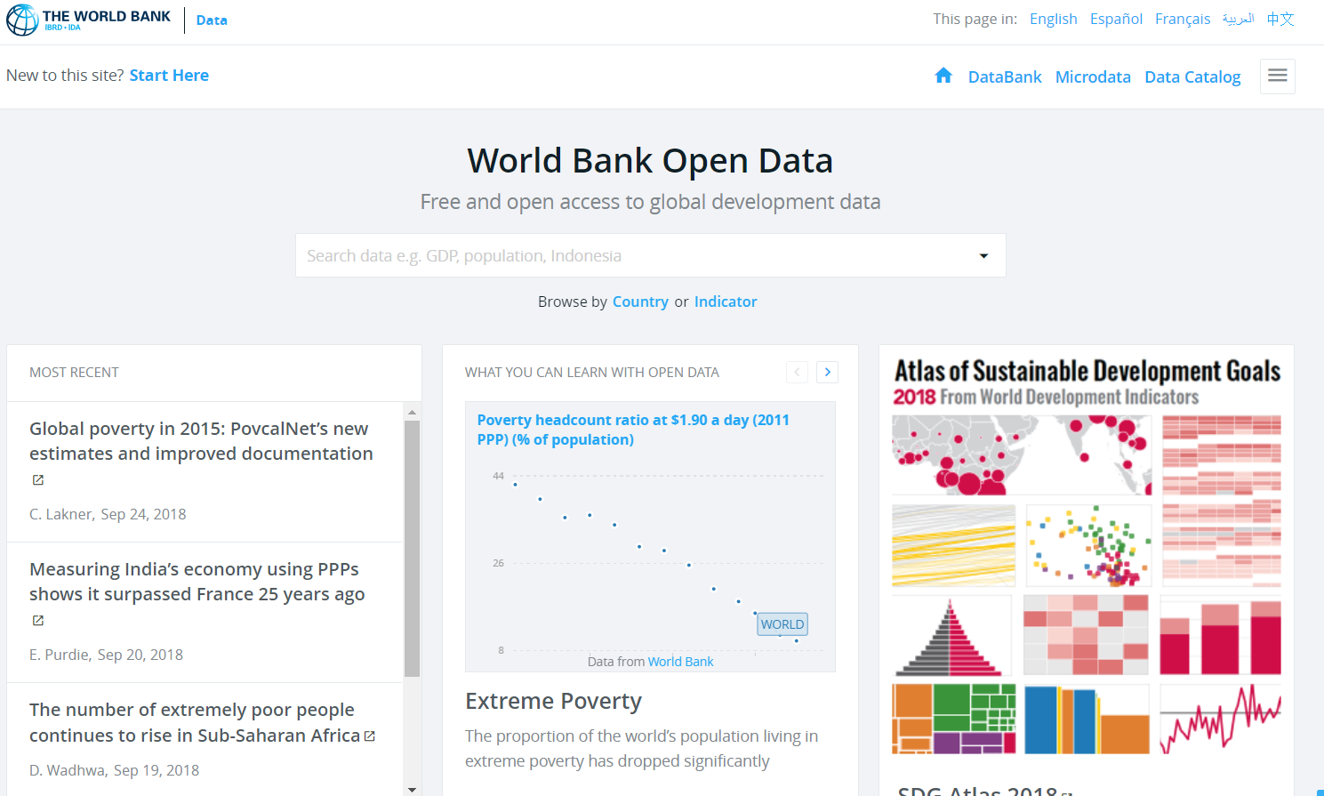
World Bank
The World Bank’s development indicators database contains time series data for a large range of economic and social issues for countries around the globe.
https://data.worldbank.org/

Slide 53
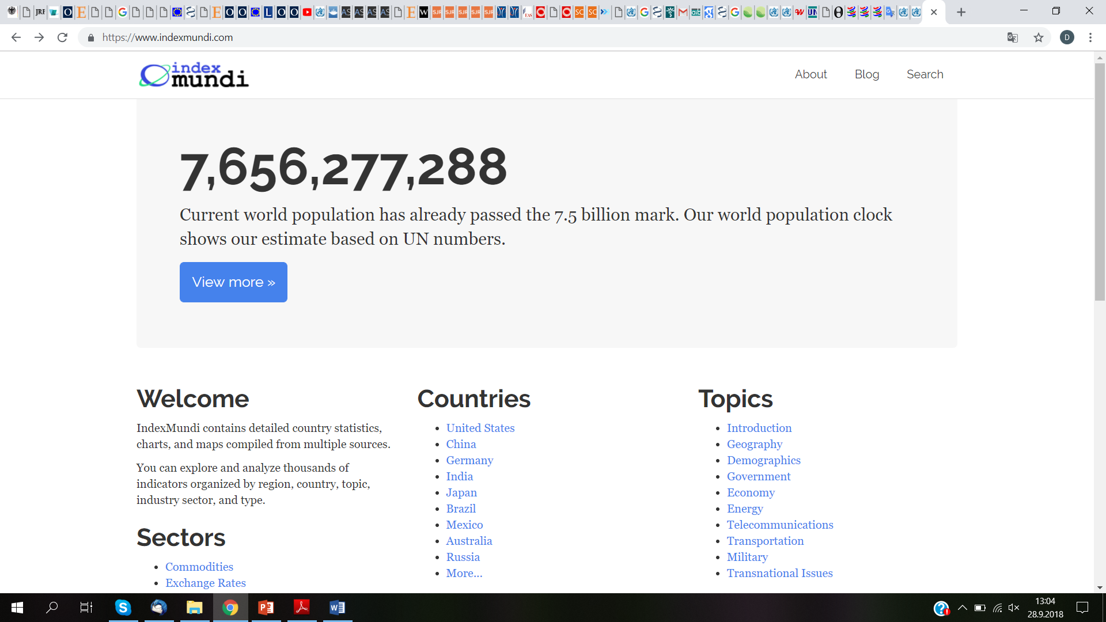
Index Mundi
a data portal that gathers facts and statistics from multiple sources and turns them into easy to use visuals.
https://www.indexmundi.com/

Slide 54
Concise policy advice

Slide 55
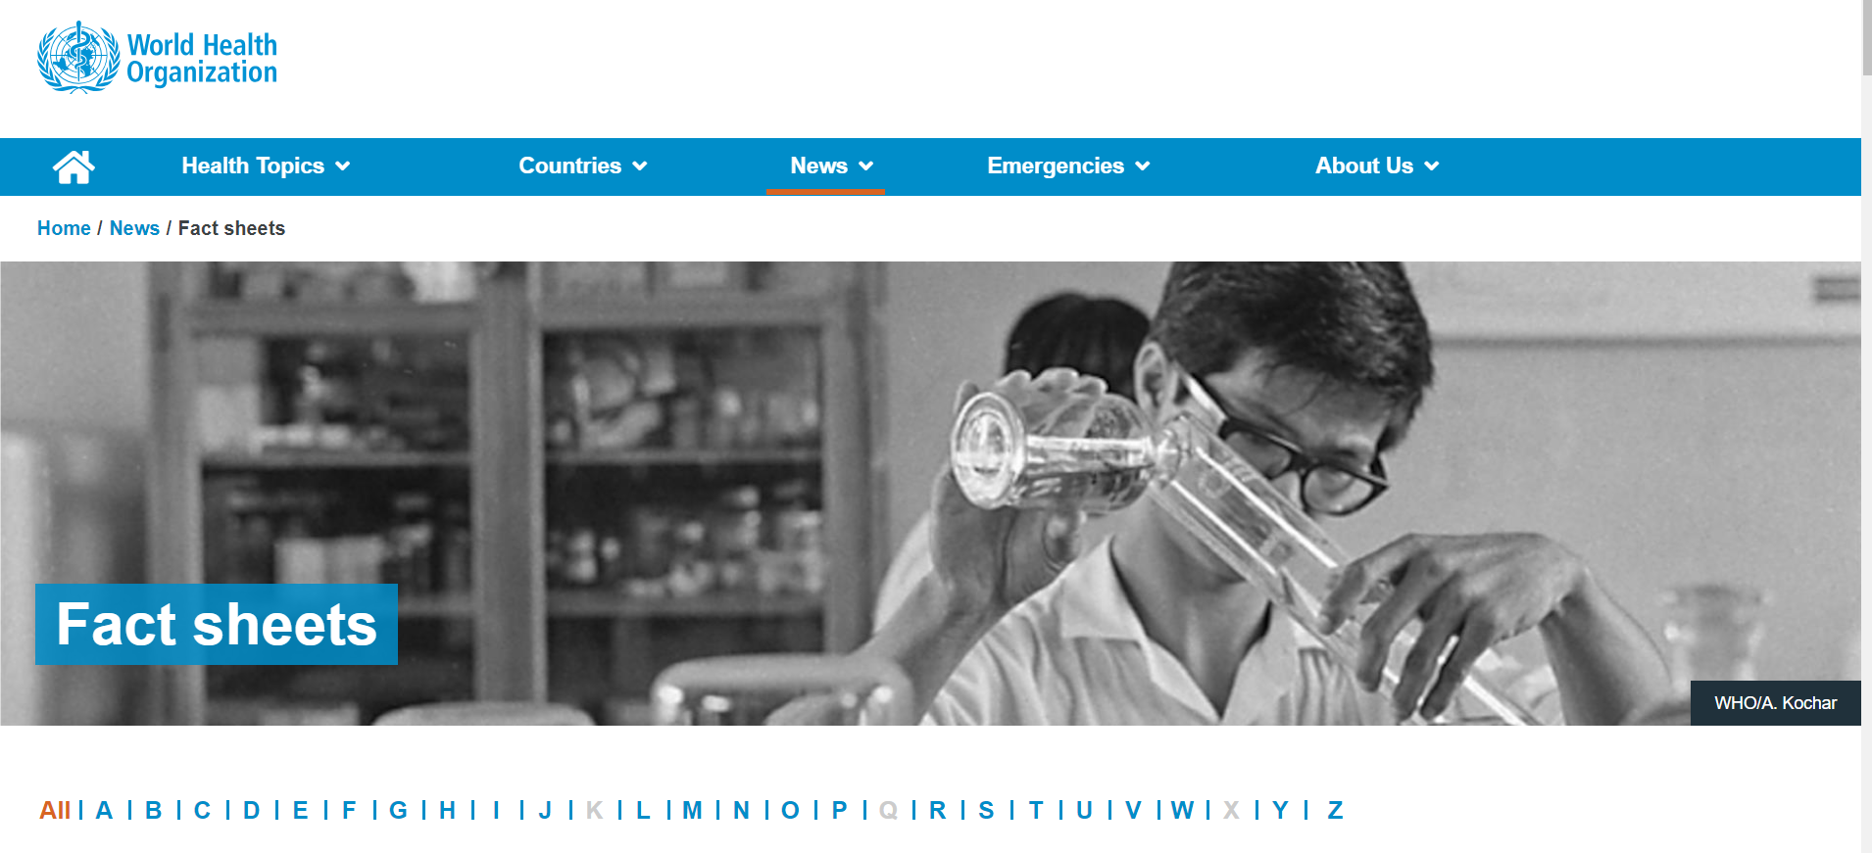
WHO Factsheets
fact sheets on different health issues that detail key facts and concise policy advice
http://www.who.int/news-room/fact-sheets

Slide 56

NCD Alliance policy briefs
an international NGO has a number of factsheets focusing on the four main NCDs: cardiovascular disease, diabetes, cancer and chronic respiratory disease.
https://ncdalliance.org/

Slide 57
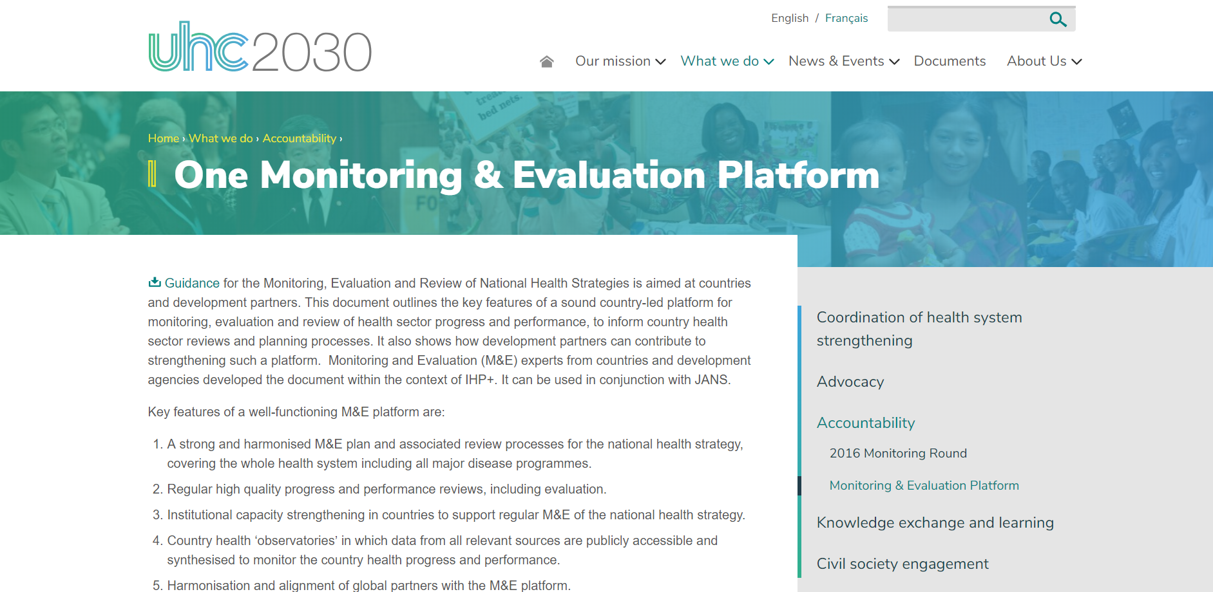
WHO monitoring and evaluation systems’ information
One Monitoring and Evaluation Platform
platform is supported by International Health Partnership (IHP+) which is a group of partners committed to improving the health of citizens in developing countries
https://www.uhc2030.org/what-we-do/accountability/monitoring-evaluation-platform/

Slide 58
Infographics, video clips and films

Slide 59
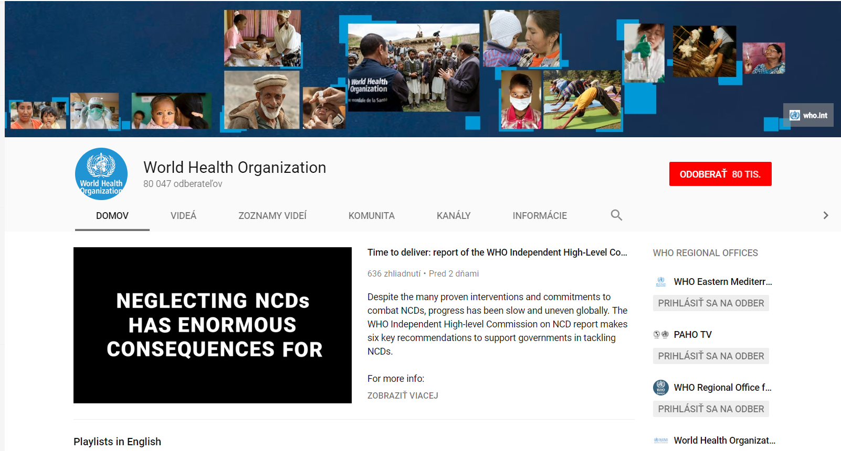
WHO YouTube Channel
WHO’s video clips communicate key facts about health issues in a brief and accessible way

Slide 60
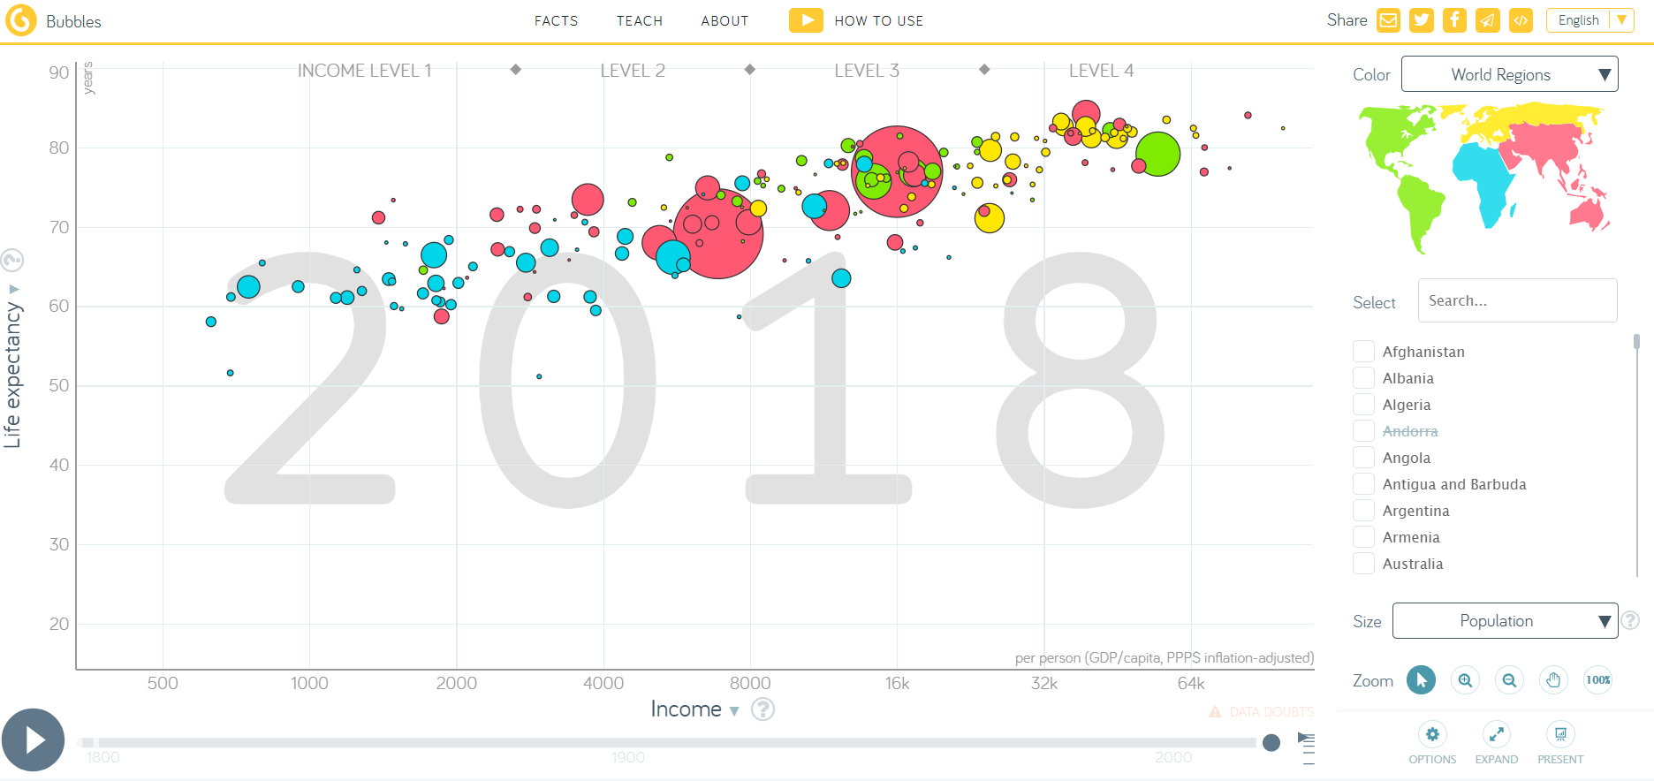
GapMinder
a non-profit venture promoting sustainable global development and the achievement of the UN Millennium Development Goals
allow to produce animated infographics on a range of social and economic issues including health and health inequity
https://www.gapminder.org/

Slide 61
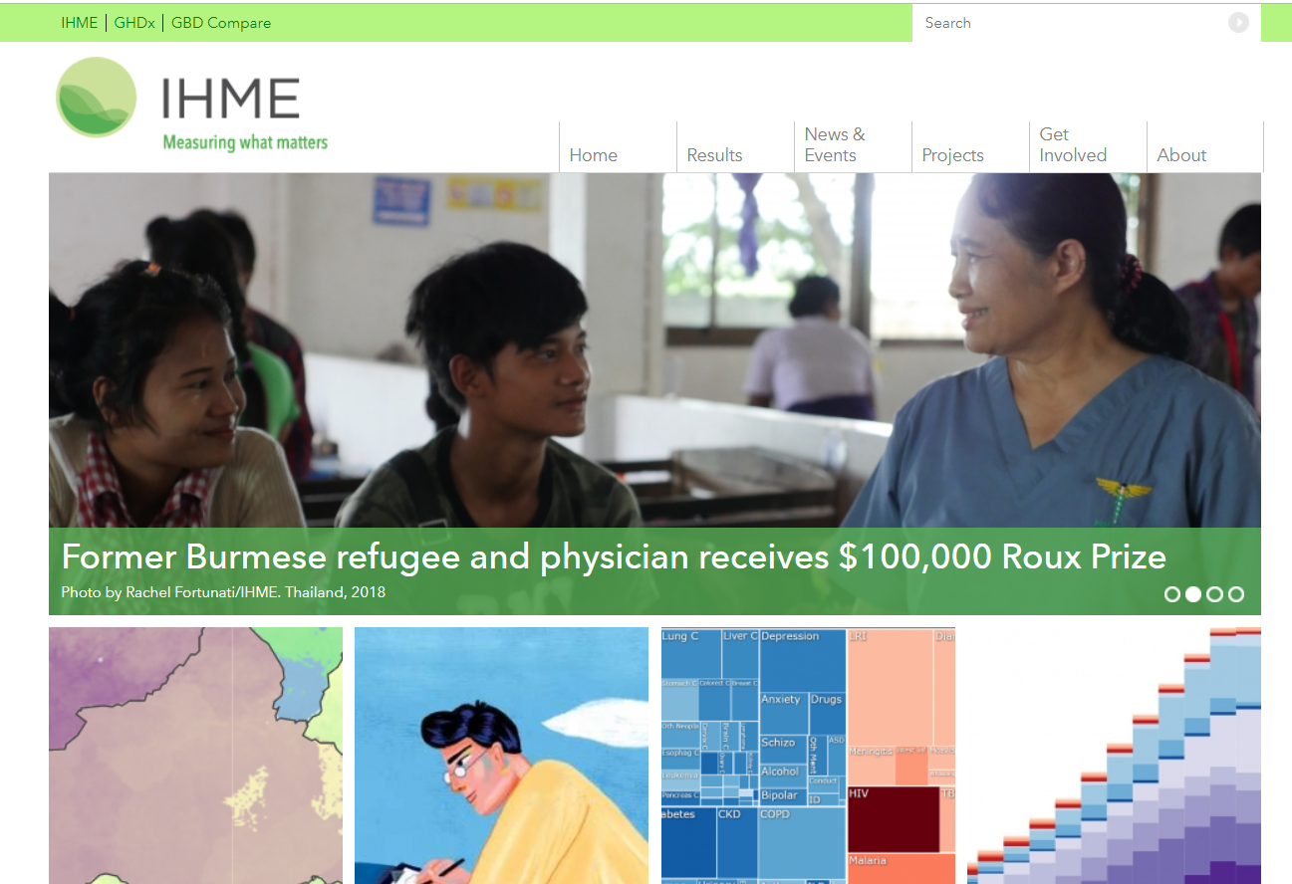
IHME – Institute for Health Metrics and Evaluation
an independent global health research centre at the University of Washington
provides rigorous and comparable measurement of the world’s most important health problems.
Their web site contains many useful data visualization tools such as GDB Compare and GDB Insight
http://www.healthdata.org/

Slide 62
Blogs and newsletters

Slide 63
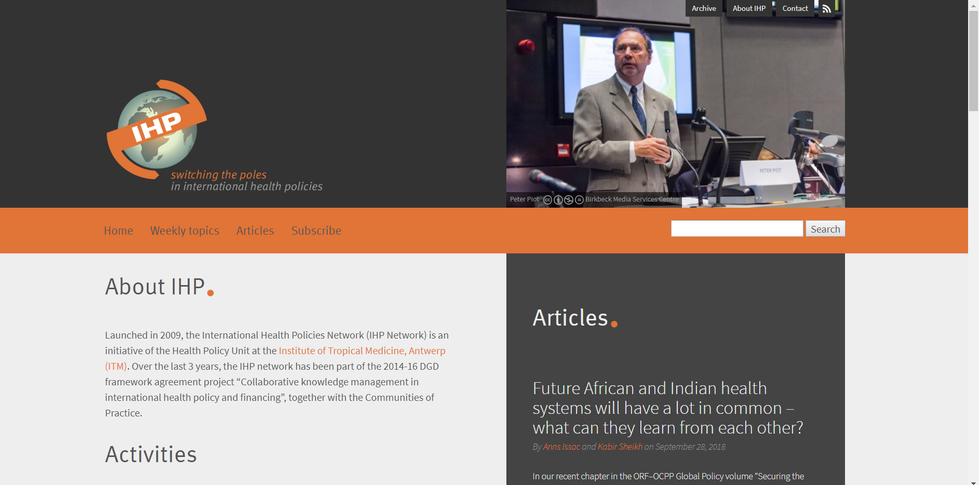
International Health Policies blog
an initiative of the Health Policy Unit at the Institute of Tropical Medicine in Antwerp, Belgium (ITM),
fits in the wider project of “Strategic Network on International Health Policies”
It is in line with the ITM objective of “Switching the Poles,” aiming to increase the influence of the Global South on the global health debate.
http://www.internationalhealthpolicies.org/

Slide 64
Academic journals

Slide 65
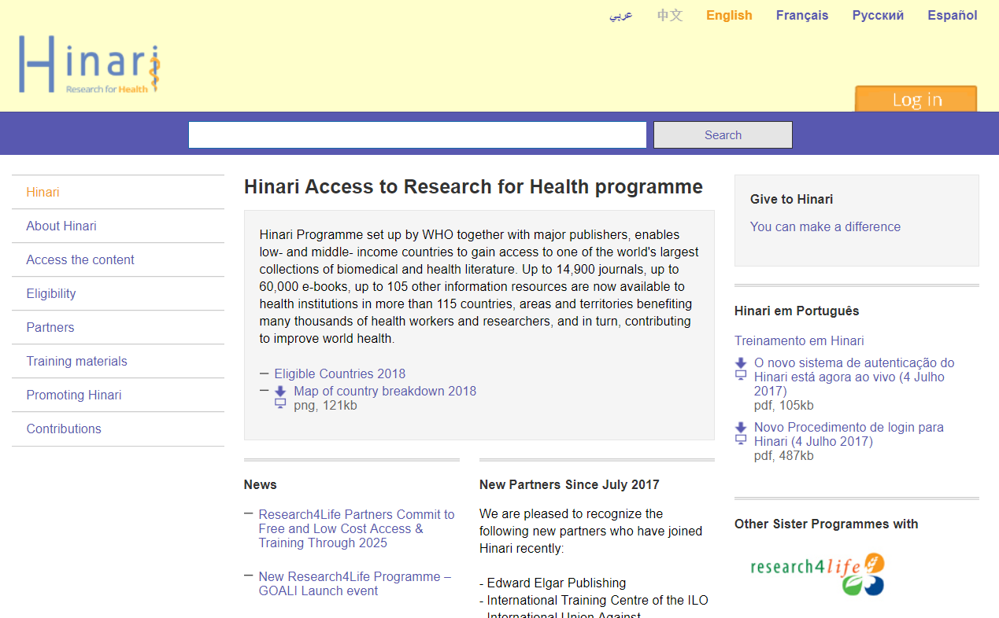
HINARI
WHO’s Health InterNetwork Access to Research Initiative (HINARI) enables local and not-for-profit institutions in low- and middle-income countries to gain free or low-cost access to one of the world’s largest collections of biomedical and health literature
http://www.who.int/hinari/en/

Slide 66
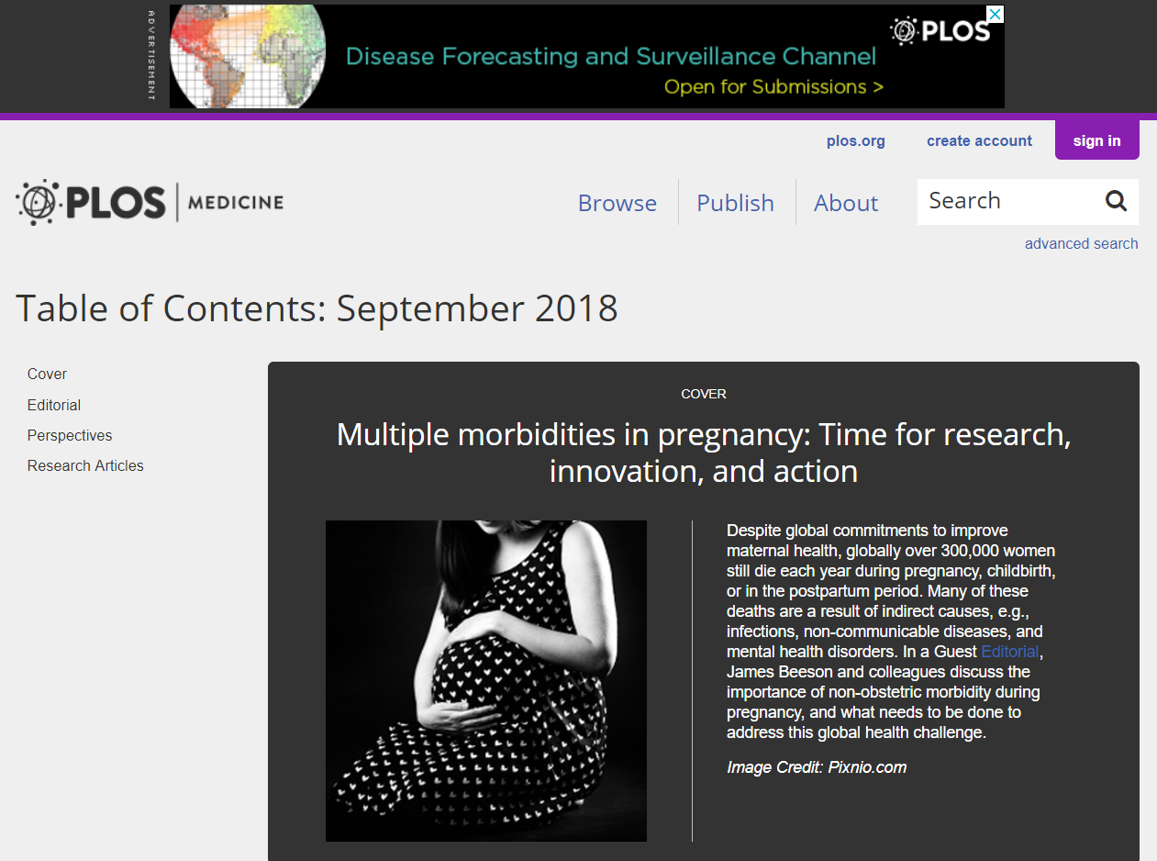

Publicly accessible
http://www.who.int/bulletin/en/
https://journals.plos.org/plosmedicine/
Bulletin of the WHO
Public Library of Science Medicine (PLOS Med)

Slide 67
By subscription
New England Journal of Medicine (NEJM)
The Lancet
Journal of American Medical Association (JAMA)
British Medical Journal (BMJ)
JAMA Internal Medicine (formerly Archives of Internal Medicine)
Cochrane Database of Systematic Reviews (Cochrane DB Syst Rev)

Slide 68
MEASURE Evaluate
Mission is to contribute to better health for people living in low-income countries by assisting governments and health institutions to generate and use information to change what doesn’t work and to scale up what does.
https://www.measureevaluation.org/about/introduction

Slide 69
National Information Center on Health Services Research and Health Care Technology (NICHSR)
Health Indicators: a 4-Part Webinar Series
https://www.nlm.nih.gov/nichsr/healthindicators/

Slide 70
Zhrnutie
Monitorovanie možno definovať ako systematické zhromažďovanie údajov o ukazovateli alebo premennej, ktorá nás zaujíma.
Hodnotenie spočíva v posúdení hodnoty alebo zmeny tejto premennej.
Posúdenie vplyvu na zdravie je kombináciou postupov, metód a nástrojov, ktoré posudzujú možné účinky politiky alebo projektu na zdravie obyvateľstva a distribúciu týchto účinkov v rámci obyvateľstva. Hodnotenia HIA tiež určujú vhodné opatrenia na riadenie týchto účinkov.
Analýza šošoviek zdravia je nová metodika používaná na premietnutie koncepcie HiAP do praxe.

Slide 71
Diskusia v skupinách
Navrhnite príklady opatrení v oblasti zdravia a zdravotnej politiky a k tomu ukazovatele ich úspešnosti.
Kde by ste hľadali zdroje pre tvorbu takýchto ukazovateľov

