Slide 1
Global Health Policy and Governance
prof. MUDr. martin rusnak, csc
http://rusnak.truni.sk
rusnakm@truni.sk

Slide 2
The World is not Enough

Slide 3
War

Slide 4
River Neretva Bosna and Herzegovina, 2013

Slide 5
Hunger

Slide 6
Disability

Slide 7
Overeating Alcohol

Slide 8
Poverty Social Exclusion

Slide 9
Transport Injuries Infrastructure

Slide 10
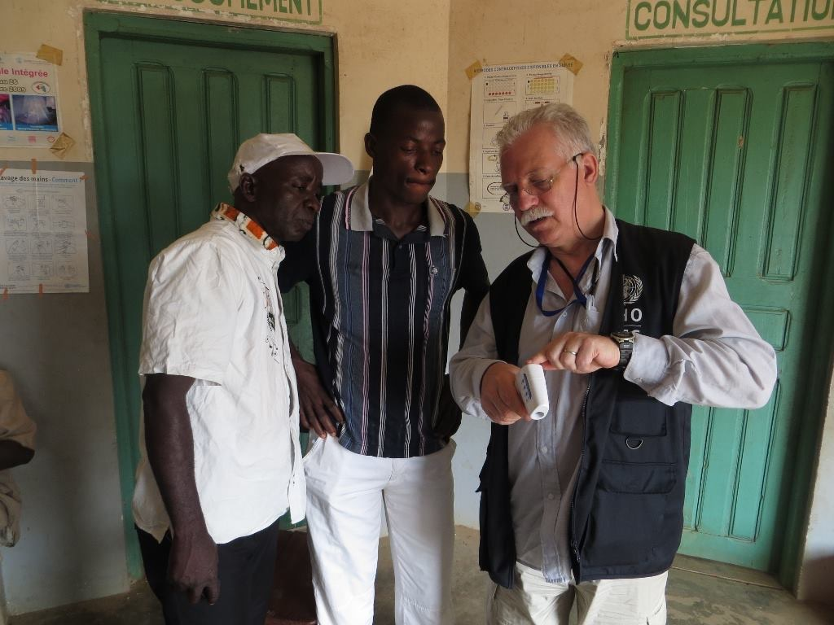
Emerging Diseases Ebola

Slide 11
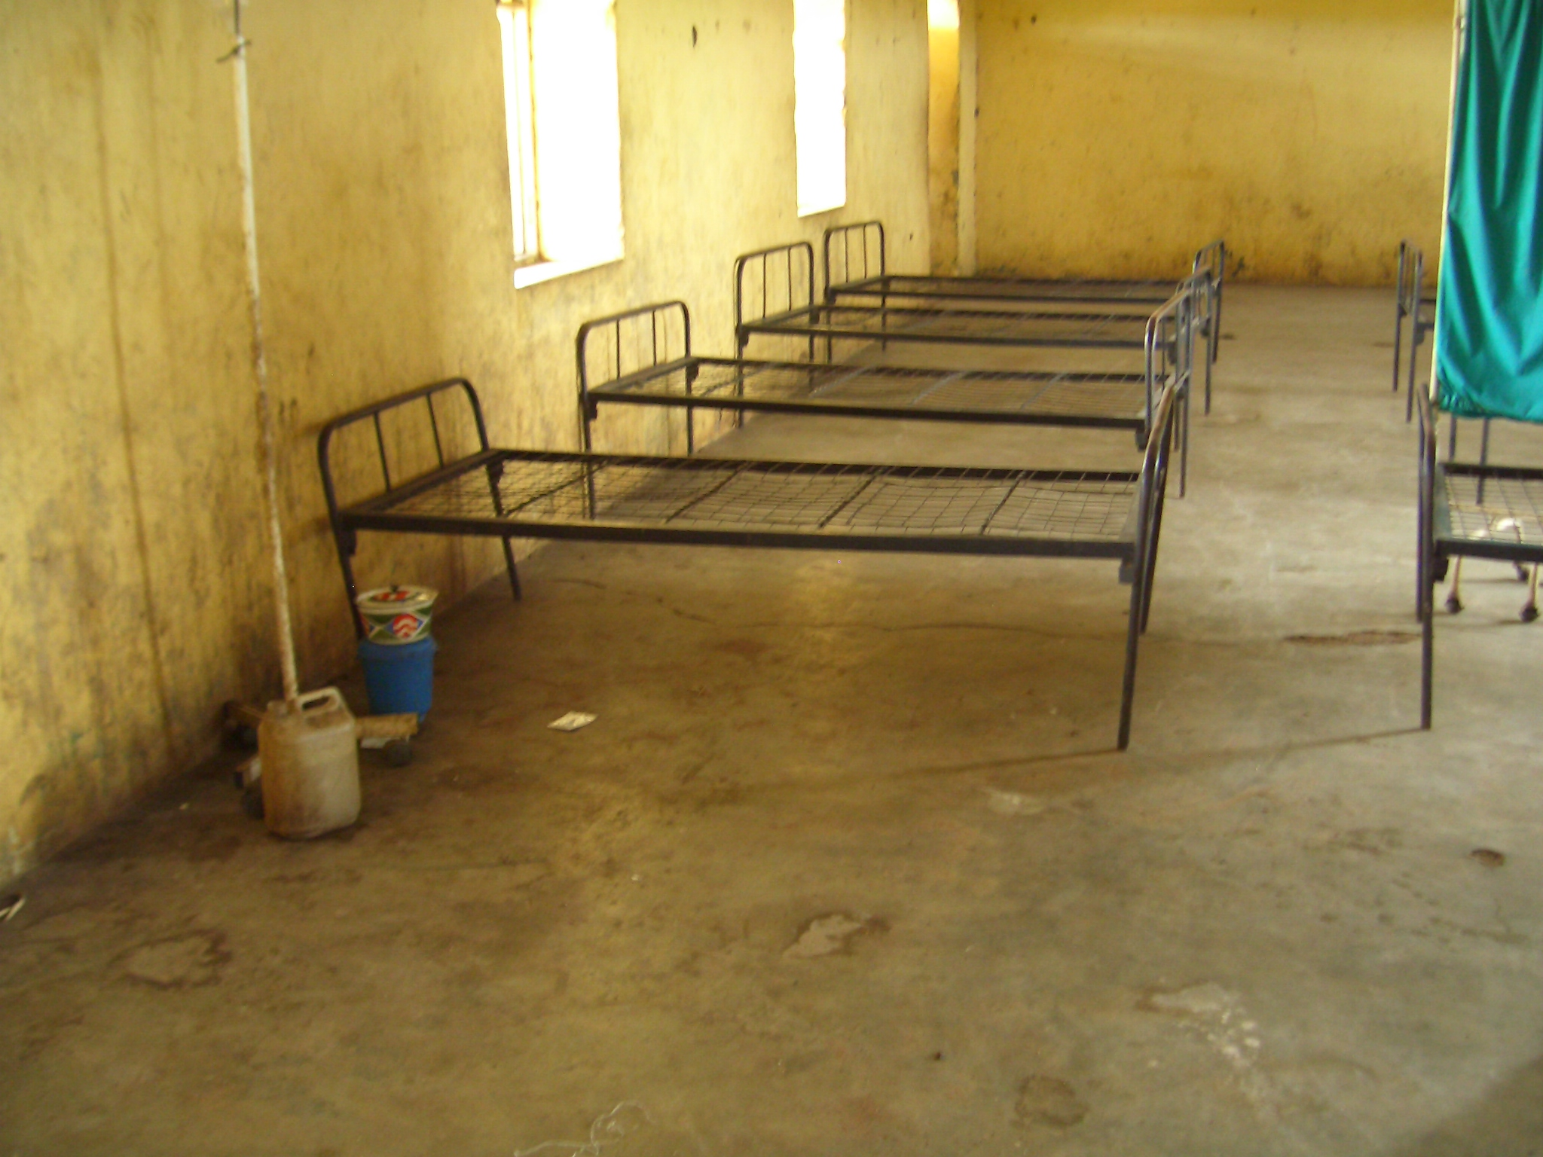
Access to Health Services

Slide 12
Key issues in current global health policy and governance
Every year reminds political leaders and the public that people’s safety is a genuine challenge at a time of
disease epidemics,
terrorism,
refugee and migration crises, and
climate change among others.
The recent Ebola virus outbreaks in west Africa exposed weaknesses in core global functions, such as the provision of global public goods, management of cross-boarder externalities and fostering of leadership and stewardship.

Slide 13
The Health is not Enough
Topics
Global Health – concept and the need
Demographic and epidemic transition
Global Health Governance
Global Health Challenges
Challenges in Global Health Policy

Slide 14
What is Global Health?
Focuses on improvement of health worldwide, the reduction of disparities, and protection of societies against global threats that disregard national borders. (Macfarlane et al., 2008)
Health problems, issues, and concerns that transcend national boundaries, may be influenced by circumstances or experiences in other countries, and are best addressed by cooperative actions and solutions. (Institute of Medicine, 1997)
Notes:
Health problems, issues, and concerns that transcend national boundaries, may be influenced by circumstances or experiences in other countries, and are best addressed by cooperative actions and solutions. (Institute of Medicine, 1997)

Slide 15
Indicators to depict health and disease
Mortality – count of death
Morbidity – counts of ill people
Health Surveys – what people think about own health
Indirect / Proxy – services
Economic / Financial / Administrative

Slide 16
Mortality
Infant Mortality Rate (IMR) | No. deaths between birth and age 1 year Total no. live births | X 1000
Perinatal Mortality Rate (PMR) | No. deaths from the 28th completed week of gestation till the end of the 1st week of life Total no. live & stillbirths | X 1000
Under five Mortality Rate (U5MR) | No. deaths occurring below the age of 5 years Total no. live births | X 1000
Life Expectancy | At birth, at the age of 60, ….

Slide 17
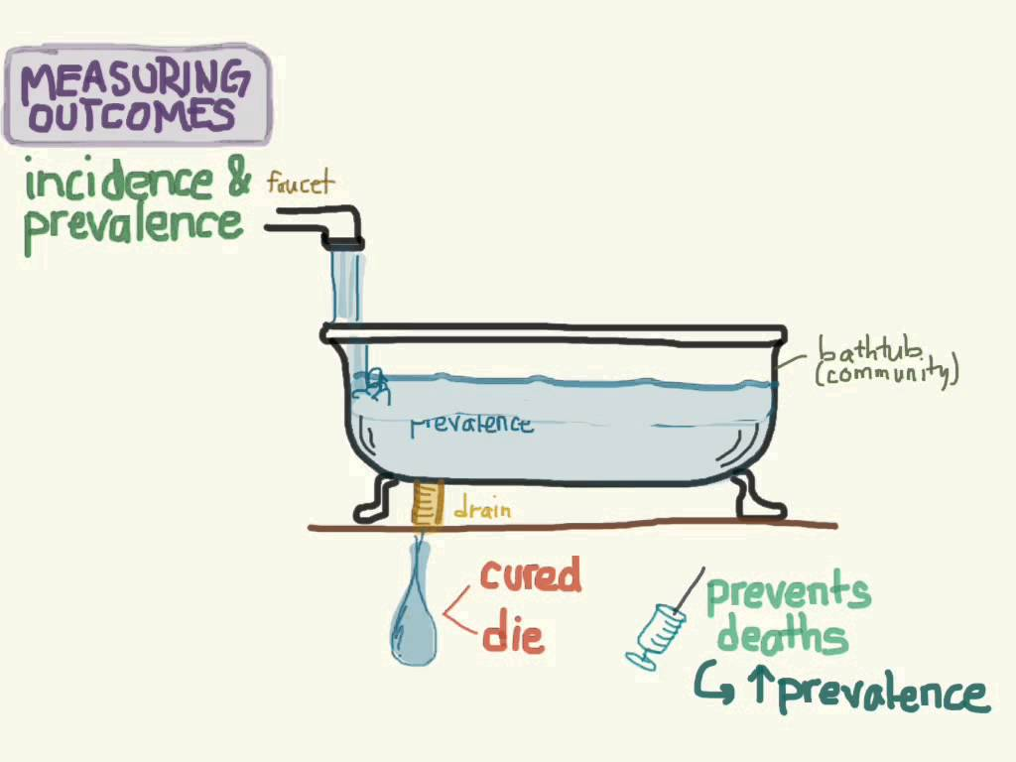
Measures of Diseases: Incidence and Prevalence

Slide 18
Services (indirect)
Visits to doctor‘s office
Hospitalizations
Sick-leave days
Ambulance kms / helicopter hours

Slide 19
Administrative/Financial
Bed turn over interval
Number of nurses per 1000 inhabitants
Budget for health services
Expenditures
National Health Accounts

Slide 20
But what if we want to know how much life of people is affected by their health?

Slide 21
Burden of Diseases Source: PORTA, M. 2008. A Dictionary of Epidemiology. In: PORTA, M., GREENLAND, S. & LAST, J. M. (eds.) A Dictionary of Epidemiology. Oxford: Oxford University Press, New York.
The impact of health and disease in a population. An approach to the analysis of health problems.
It is an important concept for public health and for other professions interested in the societal impact of ill-health, including injuries and disabilities.
Use of indicators that integrate the societal burden caused by both death and morbidity allows for the comparison of the burden due to various risk factors or diseases.

Slide 22
Burden of Diseases
Sophisticated methodologies used in global burden of disease studies enable the combined measurement of mortality and non-fatal health outcomes, and provide comparable and comprehensive measures of population health across countries.
They are also relevant to investigate the costs, efficacy, effectiveness, and other impacts of major health interventions applied in diverse settings.

Slide 23
The burden may be expressed as composite indicators
Lost Healthy Life Years (HeaLYs),
Disability-Adjusted Life Years (DALYs), or
Quality-Adjusted Life Years (QALYs).

Slide 24
Healthy Life Years
We know people are living longer. However, do we live longer and better or do we gain only years of life in bad health?
The indicator of healthy life years (HLY) measures the number of remaining years that a person of specific age is expected to live without any severe or moderate health problems.
The notion of health problem for Eurostat's HLY is reflecting a disability dimension and is based on a self-perceived question which aims to measure the extent of any limitations, for at least six months, because of a health problem that may have affected respondents as regards activities they usually do.
The indicator is therefor also called disability-free life expectancy (DFLE). So, HLY is a composite indicator that combines mortality data with health status data.

Slide 25
HLY also monitor health as a productive or economic factor.
An increase in healthy life years is one of the main goals for European health policy. And it would not only improve the situation of individuals but also result in lower levels of public health care expenditure. If healthy life years are increasing more rapidly than life expectancy, it means that people are living more years in better health.

Slide 26
Computation
Health expectancies are calculated using the method which combines information on mortality and health status data.
Variables used for mortality component:
Age specific death rate (Mx)
Probability of dying between exact ages (qx)
Probability of surviving between exact ages (px)
Number left alive at given exact age (lx)
Person-years lived between exact age (Lx)
Life expectancy at given exact age (ex)
Variable used for health status, in casu disability:
Variable is an answer to question: for at least the past six months, to what extent have you been limited because of a health problem in activities people usually do? Would you say you have been:
severely limited?
limited but not severely?
not limited at all?
Based on this variable the proportions of the population in healthy (answer code: "not limited at all") and unhealthy conditions (answer codes: "severly limited" and "limited but not severely") are calculated by sex and age.

Slide 27
Health Surveys
US: National Health Interview Survey (NHIS)
http://www.cdc.gov/nchs/nhis/about_nhis.htm
EU: European Health Interview Survey (EHIS)
http://ec.europa.eu/eurostat/web/microdata/european-health-interview-survey
Main objective is to monitor the health of population through the collection and analysis of data on a broad range of health topics. A major strength of this survey lies in the ability to display these health characteristics by many demographic and socioeconomic characteristics.

Slide 28
National Health Interview Survey (NHIS)
NHIS has been conducted continuously since 1957, the content of the survey has been updated about every 10-15 years.
Cross-sectional household interview survey. Sampling and interviewing are continuous throughout each year.
Survey participation is voluntary and the confidentiality of responses is assured under Section 308(d) of the Public Health Service Act.
Set of basic health and demographic items (known as the Core questionnaire), and one or more sets of questions on current health topics.

Slide 29
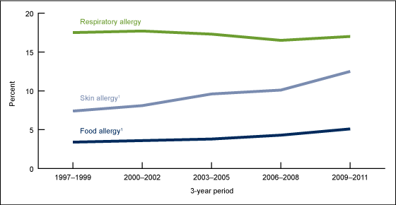
Percentage of children aged 0–17 years with a reported allergic condition in the past 12 months: United States, 1997–2011. Significant increasing linear trend for food and skin allergy from 1997–1999 to 2009–2011. SOURCE: CDC/NCHS, Health Data Interactive, National Health Interview Survey

Slide 30
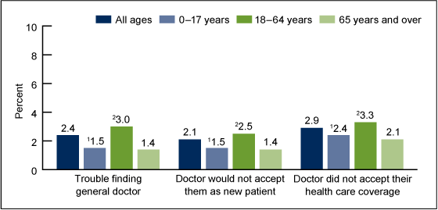
Percentage of people who had selected experiences with physician availability in the past 12 months, by age group: United States, 2012

Slide 31
European Health Interview Survey (EHIS)
The first wave of EHIS 1 was conducted between years 2006 and 2009; foreseen to be run every 5 years.
The 17 participating EU Member States strived towards comparability via a standard questionnaire, guidelines and translation recommendations.
Background variables on demography and socio economic status such as sex, age, household type, etc.
Health status such as self-perceived health, chronic conditions, limitation in daily activities, disease specific morbidity, physical and sensory functional limitations, etc.
Health care use such as hospitalisation, consultations, unmet needs, use of medicines, preventive actions, etc.
Health determinants such as height and weight, consumption of fruits, smoking, alcohol consumption, etc.

Slide 32
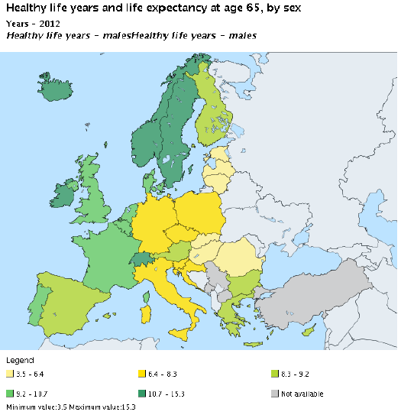
Healthy Life Years (HLY) at age 65
The indicator measures the number of years that a person at age 65 is still expected to live in a healthy condition. HLY is a health expectancy indicator which combines information on mortality and morbidity. The data required are the age-specific prevalence (proportions) of the population in healthy and unhealthy conditions and age-specific mortality information. A healthy condition is defined by the absence of limitations in functioning/disability. The indicator is calculated separately for males and females.
The indicator is also called disability-free life expectancy (DFLE). Life expectancy at age 65 is defined as the mean number of years still to be lived by a person at age 65, if subjected throughout the rest of his or her life to the current mortality conditions.

Slide 33
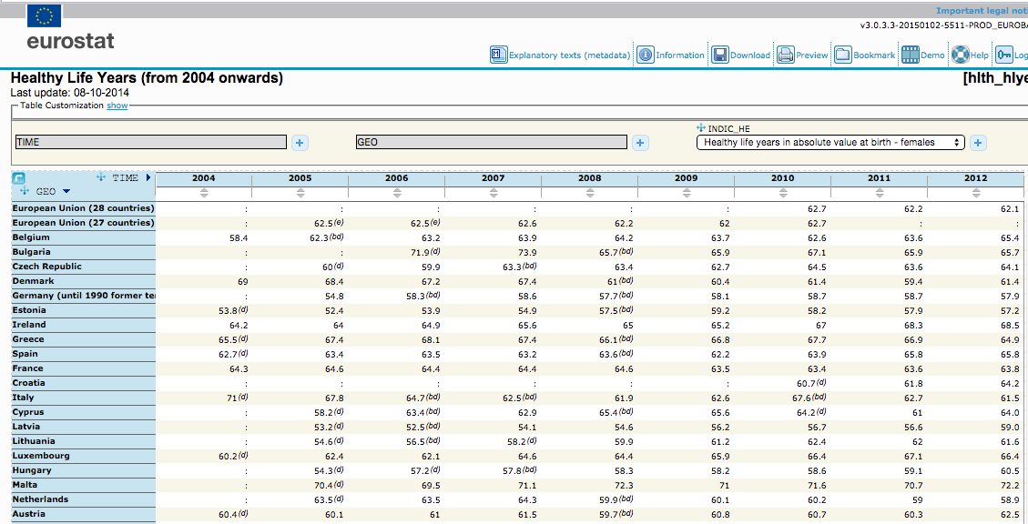

Slide 34
Global Burden of Diseases

Slide 35
The Global Burden of Disease (GBD) study Source: 2015. Global, regional, and national age-sex specific all-cause and cause-specific mortality for 240 causes of death, 1990-2013: a systematic analysis for the Global Burden of Disease Study 2013. Lancet, 385, 117-71.
Provides a unique comprehensive framework to systematically assess national trends in age-specific and sex-specific all-cause and cause-specific mortality.
Up-to-date and comprehensive evidence for levels and trends for each country is critical for informed priority setting.
Trends quantify progress against explicit health targets, whether local, national, or global, and help to evaluate where programmes are working or not.
Quantification across populations and over time using comparable definitions and methods can also enable benchmarking.
Regular comprehensive updates about causes of death will identify emerging public health challenges.
The GBD 2013 study provides the first GBD study to use a continuously updated approach to global health surveillance.

Slide 36
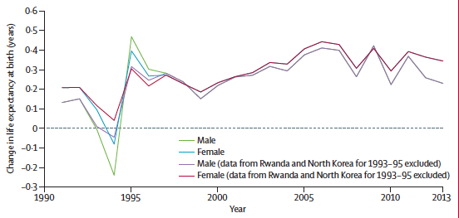
Yearly change in global life expectancy at birth, with a large drop in the 1990s as a result of the Rwanda genocide and famine in North Korea and the return to increases of about 0·3 years or more per year since 2003

Slide 37
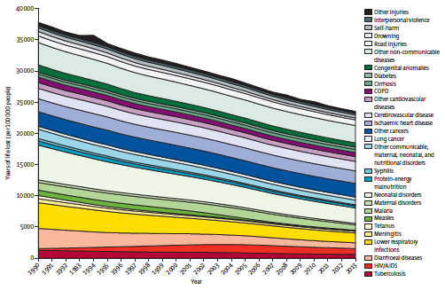
Global years of life lost by large cause groupings for 1990 to 2013

Slide 38
Conclusions
Global collective action to reduce mortality from major communicable diseases such as diarrhoea, measles, tetanus, tuberculosis, and, more recently, HIV/AIDS and malaria, is working, but will require continued intervention efforts and resources and will probably be even more responsive if periodic assessments such as that reported here are available and used.
While progress is being made to control several major non-communicable diseases of global concern, others have been largely neglected but are rising in importance, particularly drug use disorders, cirrhosis, diabetes, and chronic kidney disease.
Greater prominence to reducing disease burden from these diseases, as well as continuing priority for injury control, is strongly suggested by our analysis.
The findings on global, regional, and national trends in mortality from diseases should provide an important baseline for discussions about the next generation of health goals and targets after the Millennium Development Goals.

Slide 39
Summary
We learned what is the burden of diseases
What composite indicators are there to characterize the burden
How data are collected in US and EU
What is The Global Burden of Disease (GBD) study
What results with consequences the GBD came with

