Slide 1
Evidence Based Public Health
prof. MUDr. martin rusnak, csc
http://rusnak.truni.sk
rusnakm0@GMAIL.COM

Slide 2
OUTLINE
Introduction to Evidence-Based PH
Resources for Evidence
Discussion

Slide 3
CASE of TABACCO
Tobacco was introduced to Europe as a new world crop in the early 1600s. Despite the availability of pipe tobacco and later, cigars, the mass production and consumption of tobacco through cigarette smoking did not begin until the development of the cigarette rolling machine by ]ames Duke in the 1880s. This invention allowed mass production and distribution of cigarettes for the first time.
Men were the first mass consumers of cigarettes. During World War I, cigarettes were widely distributed free of charge to American soldiers. Cigarette smoking first became popular among women in the 1920s—an era noted for changes in the role and attitudes of women—and at this time advertising of cigarettes began to focus on women. The mass consumption of cigarettes by women, however, trailed that of men by at least two decades.
By the 1950s, over 50 percent of adult males and approximately 25 percent of adult females were regular cigarette smokers. The health problems of cigarette smoking were not fully recognize until decades after the habit became widespread. As late as the 1940s, R.I. Reynolds advertised that “more doctors smoke Camels than any other cigarette.” Epidemiologists observed that lung cancer deaths were increasing in frequency in the 1930s and 1940s.
The increase in cases did not appear to be due to changes in efforts to recognize the disease, ability to recognize the disease, or the definition of the disease. Even after the increasing average life span and aging of the population was taken into account, it was evident that the rate of death from lung cancer was increasing—and more rapidly for men than women. In addition, it was noted that residents of states with higher rates of smoking had higher rates of lung cancer. In the 19505, the number of lung cancer deaths in females also began to increase and by the 1960s, the disease had become the most common cause of cancer-related deaths in males and was still rising among women.

Slide 4
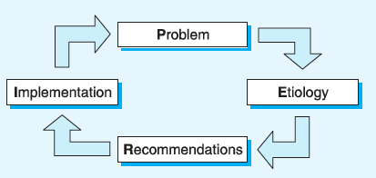
Questions to ask for making up the evidence-based public health approach
PERI Approach:
Problem: What is the health problem?
Etiology: What is/are the contributory cause(s)?
Recommendations: What works to reduce the health impacts?
Implementation: How can we get the job done?

Slide 5
PERI: HOW CAN WE DESCRIBE A HEALTH PROBLEM?
Burden of disease
disability is called morbidity
death is called mortality
Distribution of disease. how the disease is spread out or distributed in a population.
Public health professionals called epidemiologists investigate factors known as “person” and “place” and “time” to see if they can find patterns or associations in the frequency of a disease.
We call these group associations.
are the differences or changes used to suggest group associations artifactual (false) or real?
In public health, we use rates to summarize our measurement of changes.

Slide 6
Incidence rates
Measure the chances of developing a disease over a period of time—usually one year.
Incidence rates are the number of new cases of a disease that develop during a year divided by the number of people in the at-risk population
Expressed as the number of events per 100,000 population in the denominator. For instance, the incidence rate of lung cancer might be 100 per 100,000 p year.
In evidence-based public health, comparing incidence rates is often a useful starting point when trying to establish the cause of a problem.
Mortality rates are a special type of incidence rate that measure the incidence of death due to a disease during a particular year. When most people who develop a disease die from the disease, as is the situation with lung cancer, the mortality rate and the incidence rates are very similar. Thus, if the incidence rate of lung cancer is 100 per 100,000 per year, the mortality rate might be 95 per 100,000 per year. When mortality rates and incidence rates are similar and mortality rates are more easily or more reliably obtained, epidemiologists may substitute mortality rates for incidence rates.

Slide 7
Prevalence
is the number of individuals who have a disease at a particular time divided by the number of individuals who could potentially have the disease.
it tells us the proportion or percentage of individuals who have the disease.
Despite the fact that lung cancer has become the most common cancer, the prevalence will be low—perhaps one tenth of one percent or less—because those who develop lung cancer do not generally live for a long period of time. Therefore, you will rarely see people with lung cancer. The prevalence of chronic diseases of prolonged duration, such as asthma or chronic obstructive pulmonary disease (COPD), is often relatively high, hence you will often see people with these diseases.
Prevalence is often useful when trying to assess the total impact or burden of a health problem in a population and can help identify the need for services. For example, knowledge that there is a high prevalence of lung cancer in a certain region may indicate that there is a need for healthcare services in that area.

Slide 9
PERI: ETIOLOGY HOW D0 WE ESTABLISH CONTRIBUTORY CAUSE?
Understanding the reasons for disease is fundamental to the prevention of disability and death. We call these reasons etiology or causation.
In evidence-based public health, we use a very specific definition of causation—contributory cause.
The evidence-based public health approach relies on epidemiological research studies to establish a contributory cause. This requires that we go beyond group association and establish three definitive requirements.
1. The “cause” is associated with the “effect” at the individual level. That is, the potential “cause” and the potential “effect” occur more frequently in the same individual than would be expected by chance. Therefore, we need to establish that individuals with lung cancer are more frequently smokers than individuals without lung cancer.

Slide 10
Etiology cntd.
2. The “cause” precedes the “effect” in time. That is, the potential “cause” is present at an earlier time than the potential “effect.” Therefore, we need to establish that cigarette smoking comes before the development of lung cancer.
3. Altering the “cause” alters the “effect.” That is, when the potential “cause” is reduced or eliminated, the potential “effect” is also reduced or eliminated. Therefore, we need to establish that reducing cigarette smoking reduces lung cancer rates.
These three definitive requirements are ideally established using three different types of studies, all of which relate potential “causes” to potential “effects” at the individual level. That is, they investigate whether individuals who smoke cigarettes are the same individuals that develop lung cancer.
The three basic types of investigations are called
case—control or retrospective studies,
cohort studies or prospective studies, and
randomized clinical trials or experimental studies.

Slide 11
The most useful for establishing requirement 1 previously, i.e., the “cause” is associated with the “effect” at the individual level.
Case—control studies can demonstrate that cigarettes and lung cancer occur together more frequently than would be expected by chance alone. To accomplish this, cases with the disease (lung cancer) are compared to controls without the disease to determine whether the cases and the controls previously were exposed to the potential “cause” (cigarette smoking).
When a factor such as cigarettes has been demonstrated to be associated on an individual basis with an outcome such as lung cancer, we often refer to that factor as a risk factor.

Slide 12
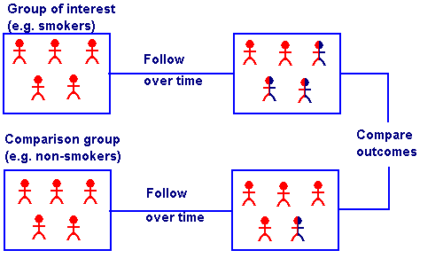
Cohort Studies
Cohort studies are most useful for establishing requirement #2 previously—the “cause” precedes the “effect.”
Those with the potential “cause” or risk factor (cigarette smoking) and those without the potential “cause” are followed over time to determine who develops the “effect” (lung cancer).

Slide 13
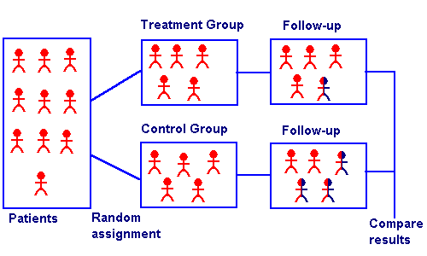
Randomized clinical trials
The most useful for establishing requirement #3—altering the “cause” alters the “effect.”
Using a chance process known as randomization, individuals are assigned to be exposed or not exposed to the potential “cause” (cigarette smoking).
Individuals with and without the potential “cause” are then followed over time to determine who develops the “effect.”
Conducting a randomized clinical trial of cigarettes and lung cancer would require investigators to randomize individuals to smoke cigarettes or not smoke cigarettes and follow them over many years.

Slide 14
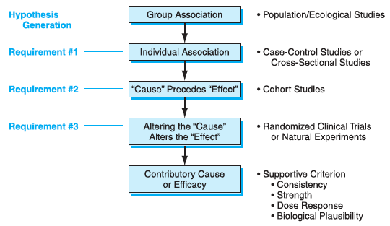

Slide 15
Necessary, sufficient and contributory causes
Despite the convincing evidence that cigarette smoking is a contributory cause of lung cancer, some individuals never smoke and still develop lung cancer. Therefore, cigarettes are not what we call a necessary cause of lung cancer.
Others smoke cigarettes all their lives and do not develop lung cancer. Thus, cigarettes are not what we call a sufficient cause of lung cancer.
The fact that not every smoker develops lung cancer implies that there must be factors that protect some individuals from lung cancer. The fact that some nonsmokers develop lung cancer implies that there must be additional contributory causes of lung cancer.
Thus, the existence of a contributory cause implies that the “cause” increases the chances that the “effect” will develop. Its presence does not guarantee that the disease will develop. In addition the absence of cigarette smoking does not guarantee that the disease will not develop.

Slide 16
PERI: RECOMMENDATIONS: WHAT WORKS TO REDUCE THE HEALTH IMPACT?
The evidence for cigarette smoking as a cause of lung cancer, as well as other diseases, was so strong that it cried out for action.
In evidence-based public health, however, action should be grounded in recommendations that incorporate evidence.
That is, evidence serves not only to establish contributory cause, but is central to determining whether or not specific interventions work.
Recommendations are built upon the evidence from studies of interventions.
Recommendations are summaries of the evidence of which interventions work to reduce the health impacts and they indicate whether actions should be taken. These studies utilize the same types of investigations we discussed for contributory cause. In fact, the requirements of contributory cause are the same as those for establishing that an intervention works or has efficacy on the particular population that was studied.

Slide 17
Quality of the evidence and the magnitude of the impact
Each of these criteria is given what is called a score.
The quality of the evidence is scored based in large part upon the types of investigations and how well the investigation was conducted. Well-conducted randomized clinical trials that fully address the health problem are considered the highest quality evidence. Often, however, cohort and case control studies are needed and are used as part of the recommendation. Expert opinion, though lowest on the hierarchy of evidence, is often essential to fill in the holes in the research evidence.
In evidence-based public health the quality of the evidence is often scored as good, fair, or poor. Good quality implies that the evidence fulfills all the criteria for quality. Poor quality evidence implies that there are fatal flaws in the evidence and recommendations cannot be made. Fair quality lies in between having no fatal flaws.

Slide 18
MY
EXPERT
OPINION

Slide 19
Randomized
controlled
trial

Slide 20
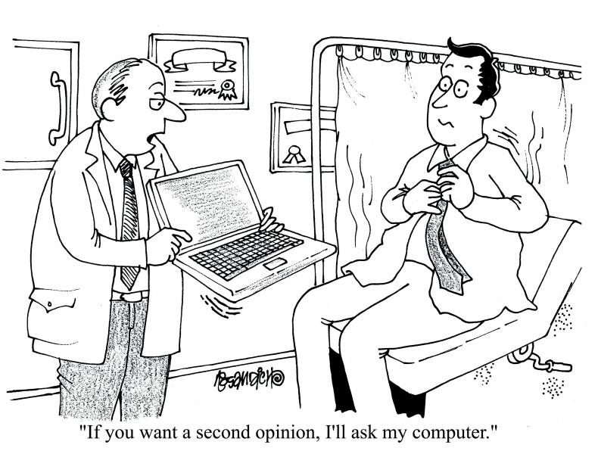

Slide 21
AGREE: Appraisal of Guidelines for Research and Evaluation
AGREE II Overview Tutorial
This tool provides an Avatar-guided overview of the AGREE II tool. This tool takes approximately 10 minutes to complete.
AGREE II Tutorial + Practice Exercise
Expanding upon the Avatar-guided tutorial, the “Practice Exercise” tool provides trainees with the opportunity to appraise a test practice guideline with the AGREE II
http://www.agreetrust.org/

Slide 22
PERI: Magnitude of the impact of the intervention
The magnitude of the impact asks the question: how much of the disability and/or death due to the disease can be potentially removed by the intervention?
In measuring the magnitude of the impact, evidence-based recommendations take into account the potential benefits of an intervention, as well as the potential harms. Therefore, we can regard the magnitude of the impact as the benefits minus the harms, or the “net benefits.”
The magnitude of the impact, like the quality of the evidence, is scored based upon a limited number of potential categories. In one commonly-used system, the magnitude of the impact is scored as substantial, moderate, small, and zero/negative.
A substantial impact may imply that the intervention works extremely well for a small number of people, such as a drug treatment for cigarette cessation. These are the types of interventions that are often the focus of individual clinical care. A substantial impact may also imply that the intervention has a modest net benefit for any one individual, but can be applied to large numbers of people, such as in the form of media advertising or taxes on cigarettes. These are the types of interventions that are most often the focus of traditional public health and social policy.

Slide 23
PERI: IMPLEMENTATION: HOW DO WE GET THE JOB DONE?
Today, there are often a large number of interventions with adequate data to consider implementation. Many of the interventions have potential harms, as well as potential benefits.
The large and growing array of possible interventions means that health decisions require a systematic method for deciding which interventions to use and how to combine them in the most effective and efficient ways. One method for examining the options for implementation uses a structure we will call the “When-Who-How” approach.
“When” asks about the timing in the course of disease in which an intervention occurs. This timing allows us to categorize interventions as primary, secondary, and tertiary.
Primary interventions take place before the onset of the disease. They aim to prevent the disease from occurring.
Secondary interventions occur after the development of a disease or risk factor, but before symptoms appear. They are aimed at early detection of disease or reducing risk factors while the patient is asymptomatic.
Tertiary interventions occur after the initial occurrence of symptoms, but before irreversible disability. They aim to prevent irreversible consequences of the disease.

Slide 24
Implementation cntd.
“Who” asks: at whom should we direct the intervention?
Should it be directed at individuals one at a time as part of clinical care? Alternatively, should it be directed at groups of people, such as vulnerable populations, or should it be directed at everyone in a community or population?“
How should we implement interventions?
There are three basic types of interventions when addressing the need for behavioral change. These interventions can be classified as: information (education), motivation (incentives), and obligation (requirements).

Slide 25
Cigarette smoking example
WHEN | WHO | HOW
Primary—Prevention of smoking, reduction in second-hand exposure Secondary—Assistance in quitting, screening for cancer if recommended Tertiary—Health care to minimize disease impact | Individual smoker At-risk—Groups at risk of smoking or disease caused by smoking, e.g., adolescents as well as current and ex-smokers Population—Entire population including those who never have or never will smoke | Information—Stop smoking campaigns, advertising, warning on package, clinician advice Motivation—Taxes on cigarettes, increased cost of insurance Obligation—Prohibition on sales to minors, exclusion from athletic eligibility, legal restrictions on indoor public smoking

Slide 26
Evidence-Based Public Health: Glossary
EVIDENCE:
In the broadest sense, evidence can be defined as “facts or testimony in support of a conclusion, statement or belief” and “something serving as proof”.
Such a generic definition is a useful starting point, but it is devoid of context and does not specify what counts as evidence, when, and for whom.
J Epidemiol Community Health 2004;58:538–545. doi: 10.1136/jech.2003.011585
https://jech.bmj.com/content/58/7/538

Slide 27
Evidence-Based Public Health: Glossary
EVIDENCE BASED PUBLIC HEALTH:
Evidence based public health can be defined as a public health endeavour in which there is an informed, explicit, and judicious use of evidence that has been derived from any of a variety of science and social science research and evaluation methods.
J Epidemiol Community Health 2004;58:538–545. doi: 10.1136/jech.2003.011585
https://jech.bmj.com/content/58/7/538

Slide 28
Evidence-Based Public Health
CRITICAL APPRAISAL CRITERIA:
Critical appraisal criteria are checklists or standards that are used to evaluate research evidence.
Critical appraisal criteria can be applied to assess the value of a single study, or they are used to appraise several studies as part of the process of systematic review.
Critical appraisal criteria address different variables, depending on the nature and purpose of the research, and the expectations and priorities of the reviewers.
J Epidemiol Community Health 2004;58:538–545. doi: 10.1136/jech.2003.011585
https://jech.bmj.com/content/58/7/538

Slide 29
Cochrane Podcasts
Cochrane evidence in under five minutes, deliver the latest Cochrane evidence in an easy to access audio format, allowing you to stay up to date on newly published reviews wherever you are.
http://www.cochranelibrary.com/more-resources/cochrane-podcasts.html

Slide 30
MEDLINE/PUBMED
PubMed comprises over 25 million citations for biomedical literature from MEDLINE, life science journals, and online books. PubMed citations and abstracts include the fields of biomedicine and health, covering portions of the life sciences, behavioral sciences, chemical sciences, and bioengineering. PubMed also provides access to additional relevant web sites and links to the other NCBI molecular biology resources.
http://www.ncbi.nlm.nih.gov/pubmed

Slide 31
The National Institute for Health and Care Excellence (NICE)
Provides national guidance and advice to improve health and social care.
Our guidance, advice, quality standards and information services for health, public health and social care. Also contains resources to help maximize use of evidence and guidance.
Essential information for key groups including GPs, local government, public health professionals and members of the public.
https://www.nice.org.uk/

Slide 32
G-I-N Guidelines International Network
Our mission is to lead, strengthen and support collaboration in guideline development, adaptation and implementation. As a major player on the global healthcare quality stage, G-I-N facilitates networking, promotes excellence and helps our members create high quality clinical practice guidelines that foster safe and effective patient care.
http://www.g-i-n.net/

Slide 33
Google Scholar
https://scholar.google.com/

Slide 34
MediSys
MedISys is an internet monitoring and analysis system providing event based surveillance to rapidly identify potential threats to the public health using information from the internet. It displays only those articles with interest to Public Health, grouped by disease or disease type. It analyses the news and warns users with automatically generated alerts. The information processed by Medisys is derived from the Europe Media Monitor (EMM), developed by the JRC.
http://medisys.newsbrief.eu/medisys/homeedition/en/home.html

Slide 35
https://ec.europa.eu/health/state/summary_en

Slide 36
EU example of Evidence Based PH: ECDC Technical Report 2011

Slide 37
Message to take home
Evidence-Based Public Health:
Overview
Methodology
Key documents and recommendations

Slide 38
Discussion in groups
Use PERI approach to discuss “hand hygiene” in acute health care institutions. Find basic evidence using your mobile phones

