Slide 1
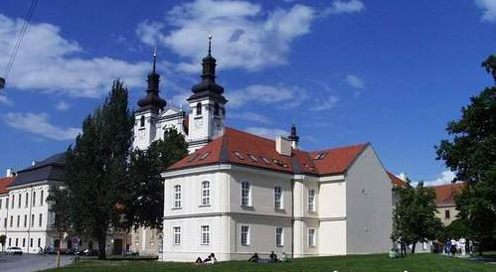
History of the Medical School at Trnava University
To commemorate 375th Anniversary

Slide 2
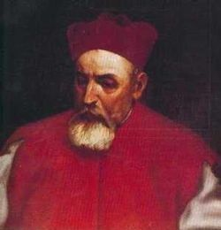
University Established
Document establishing the Trnava University as the Jesuit Univ. was issued by Peter Pazmanyi in the year 1635
School of Philosophy and Theology
1667 School of Law
On 7th November 1769 the Medical School was established

Slide 3
First years of Medical School
1st Director, principal physician of Trnava
Ján Gilg z Gilgenburgu (Sliezsko)
Graduated from Vienna Univ.
Professors – physicians from Vienna Medical School, young (average age 31 years)
1772 the building was finished

Slide 4
Structure
Theoretical areas - Institutionum Medicarum:
1. Dpt. Anatomy
2. Dpt. Physiology and Pharmacology
3. Dpt. Botanics and Chemistry
Clinical Areas - Praxeos:
1. Dpt. Pathology and Internal Medicine
2. Dpt. Surgery, obstetrics and ophtalmology

Slide 5
Format
Lessons daily except Sunday and Thursday
Lessons were strictly based on reading texts and students had to memorize it
Teachers were not allowed to interpret what was read

Slide 6
Students
Graduated 39 physicians, out of them 15 from Upper Hungary (today Slovakia);
131 magisters of surgery;
2 magisters of obstetrics;
2 eye physicians
21 obstetric nurses
32 magisters of pharmacy

Slide 7
New Trends
Anton von Störck
In 1775 new regulation was issued by Störck which allowed free lecturing
Institutionalized 5 years study
Included surgery into the education as equal to other medical disciplines
First year – anatomy, botanic, chemistry; second year – repetition plus physiology; third year – clinical medicine; fourth – internal ; fifth - surgery

Slide 8
Quality
The School posses printing workshop and pharmacy
Number of books printed, some of them translated to Dutch and even Japanese
7 graduates became professors, 2 recognized researchers, number of municipal physicians, some prominent botanics
Jakub Reineggs became personal physician of the king of Georgia Herakleitos ll
Zachariáš Teofil Huszty (1754-1803) published a book ”Discours über medizinsche Police“ and is regarded as a pioneer of social medicine and public health

Slide 9
Problems
Low number of students
Inhabitants of Trnava complained of riots, burglaries, noise, etc.
Low availability of corps for sections
No hospital
Lack of cooperation with the City Hall
Lack of finances for chemicals
Reluctance to introduced changes required by the emperor
Result: 1777 the Medical School was moved to Pest (Budapest) – Semmelweiss Univ. today

Slide 10
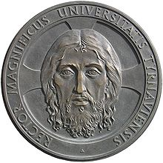
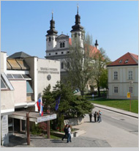
1992 the Trnava University was reinsitutionalized with
Christian values in its mission
School of Health and Social Work was reestablished in 1995
This year is the 375th anniversary of the original Trnava University

Slide 11
Structure of the Faculty
Students:
regular:608 external: 1005 foreign: 29
PhD internal: 59 (2) external: 155 (20)
Teachers
Without PhD: 6.99 PhD:23.29 Doc:29.04 prof:16.54
Administrative
21.50

Slide 12
Study Areas
BA, MA, PhD in
Public Health:
Communal Hygiene
Clinical Epidemiology
Social Work
General Social Work
Management in Social Work
Social Work in Health Care
Laboratory work
Nursing

Slide 13
Research Topics
Epidemiology of Infectious and Chronic Diseases
Occupational and Environmental Health
Tropical Diseases and Social Care
Quality of Health Care
Quality of Life
Evidence based nursing and PH
Virology, molecular genetics
Clinical epidemiology in internal medicine, oncology, intensive care, injuries, gynecology, pediatrics

Slide 14
Thank you

