Slide 1
Quality of Health Care in Developing Countries – Case Study of Caribbean Countries
Authors: Martin & Viera Rusnak

Slide 2
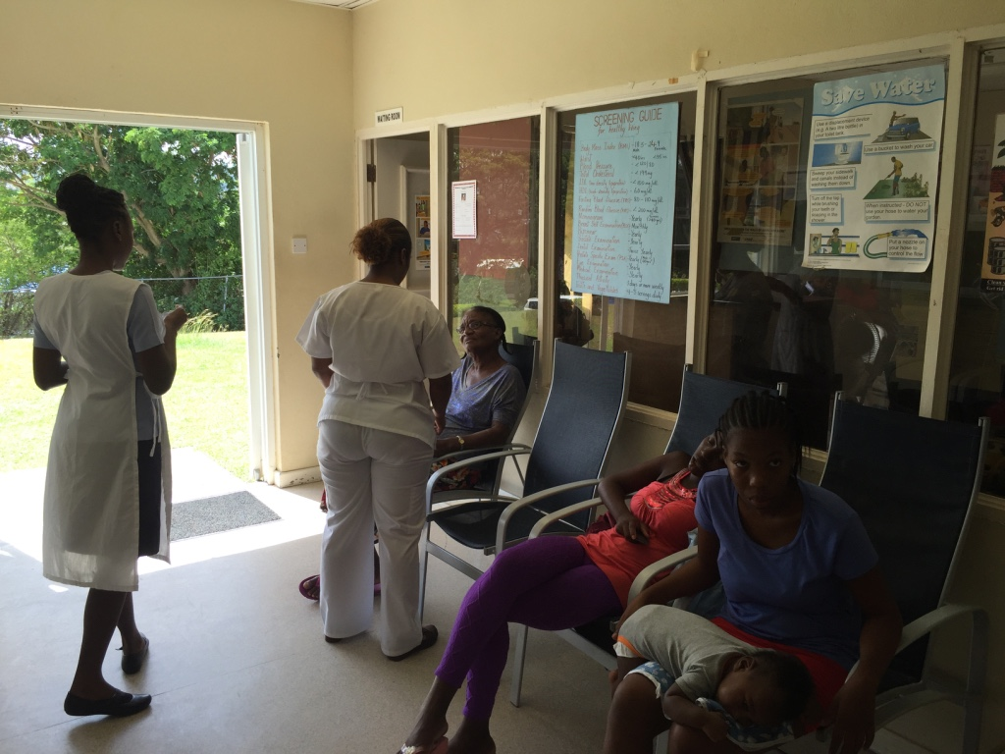
Poor locals versus rich westerners
Is the quality of health care an issue in countries where resources are scarce?

Slide 3
Case Study: St Lucia
Total mid-year population of Saint Lucia was estimated at 162,434 in 2004

Slide 4
Diseases

Slide 5
Human Resources

Slide 6
Public Health Issues
Access to health services:
1 public hospital, 1 semi-public, 1 private
9 health centers served by 6 general practitioners
Dental service out of pocket
Public funds to support treatment of diabetes and hypertension announced, but not delivered
New hospital donated from EU

Slide 8
Solutions?
Education?
Very expensive
Cheap from Cuba
Distance learning
Increased funding?
Increased quality of care?

Slide 9
How to increase quality of HC?
More funds? not realistic
Increased access? limited by human resources
Better outcomes? Monitoring and evaluation?
Clinical governance? Limited
More public health? Preventative services?
General health insurance?

Slide 10
Conclusions
Capacities development
Monitoring and evaluation
Protocols

