Slide 1
Scaling-up strategies of EB diabetes and hypertension prevention and management
Scaling‐Up NCD interventions in South‐East Asia
Rusnáková V, Rusnák M, Pekarčíková J, Taylor M.
Department of Public Health, Faculty of Health and Social Work Trnava University, Trnava
This project has received funding from the European Union’s Horizon 2020 research and innovation programme under grant agreement No 825026

Slide 2
Presentation: Aims and Structure
Aims:
Set up the background for NCDs in developing world
Describe the project SUNI SEA
Structure:
The burden of NCDs in South East Asia
The SUNI SEA Project
The role of Trnava team
Activities in the first year
Next steps

Slide 3
Background
Three quarters of all NCDs deaths are in Low- and Middle-Income Countries (LMIC).
While countries in Europe struggle with ever-increasing costs of chronic diseases, Indonesia, Myanmar and Vietnam have developed innovative strategies to curb the epidemic of NCDs in an early phase.
Horizon 2020 SUNISEA project role is to react on and support the exchange of experiences

Slide 4
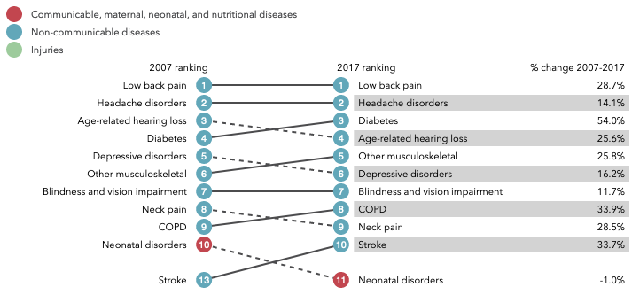
Vietnam Top 10 causes of years of life lost (YLLs) in 2017 and percent change, 2007-2017, all ages
http://www.healthdata.org/vietnam
Notes:
Institute for Health Metrics and Evaluation (IHME)

Slide 5
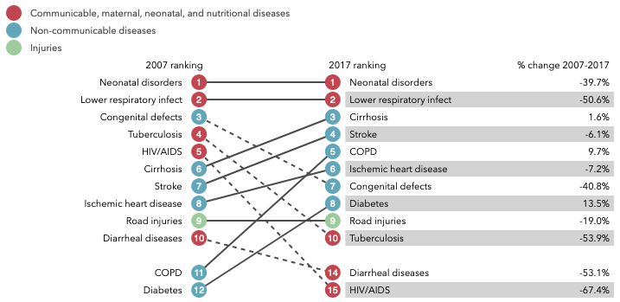
Myanmar Top 10 causes of years of life lost (YLLs) in 2017 and percent change, 2007-2017, all ages
Institute for Health Metrics and Evaluation (IHME)

Slide 6
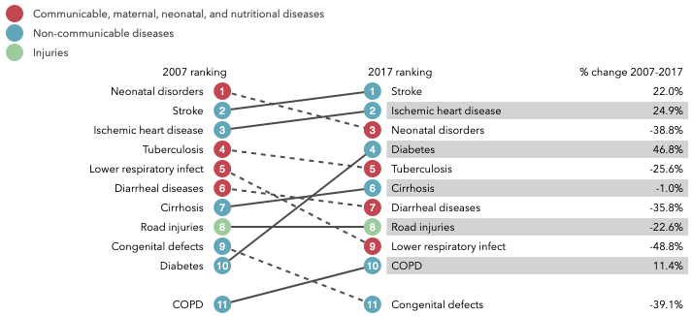
Indonesia Top 10 causes of years of life lost (YLLs) in 2017 and percent change, 2007-2017, all ages

Slide 7
Overall aim of the SUNI SEA project
Validate effective and cost-effective scaling-up strategies of evidence-based diabetes and hypertension prevention and management programmes and
Apply results to enhance sustainable action.
Trnava University team is primarily involved in activities of the Work Package 3 – internationalization of results

Slide 8
Project management
Project coordinated by the University of Groningen with participation of
University Medical Center Groningen, Netherlands
University of Groningen (Faculty of Economics and Business), Netherlands
University of Passau, Germany
Trnava University, Slovak Republic
HelpAge International
Age International
Partners in Indonesia, Myanmar and Vietnam
Thai Nguyen University of Medicine and Pharmacy, Vietnam
Health Strategy and Policy Institute, Vietnam
Sebelas Maret University, Indonesia
The project spans from 2019 to 2022.

Slide 9
General approach
Initial activities
Identify a set of evidence-based interventions and based on systematic review of evidence
scaling-up strategies for prevention and management of hypertension and diabetes.
In parallel
perform cost-effectiveness analysis of ongoing interventions to identify the most cost-effective strategies.
Collect data on baseline performance and after intervention based on guidelines recommendations
Finally
improve and test guidelines and instruments for scaling-up prevention and management of hypertension and diabetes worldwide. The component is being coordinated from Trnava University.

Slide 10
Expected results for Work Package 3
Verify effective strategies for expanding the evidence-based prevention and treatment programs for diabetes and hypertension.
Work Package 3
provides capacity building to professionals in primary health care services and community organisations.
transforms evaluated research outputs into existing training modules and clinical guidelines and
coordinates educational activities, based on clinical guidelines and internationally recognised best practices.
Trnava University is also involved in developing MOODLE-based learning platform.

Slide 11
Work package 3
Improves and tests evidence-based guidelines and instruments for scaling-up prevention and management of hypertension and diabetes worldwide by:
reviewing the critical success factors concerning sustainability of scaling-up the comprehensive community-based and primary health facility-based programmes (micro-level);
sharing lessons learned from Indonesia, Myanmar and Vietnam for wider implementation of NCD interventions with an optimal synergy between management and prevention programmes worldwide (meso-level); and
reviewing and updating global scaling-up and assessment tools, which will be available via international agencies (macro-level).

Slide 12
Current activities
Description of programmes in SEA, based on existing data-sources: review of scientific publications, reports and grey literature sources.
Realistic Systematic Review
Field visits planning:
Focus groups and
Delphi methods application -
Moodle platform to support training activities

Slide 13
Systematic reviews
provide a summary of results from carefully selected studies in a methodologically defined reproducible process
typically it is more than literature review
based on following guidelines:
MOHER, D. et al. Preferred reporting items for systematic review and meta-analysis protocols (PRISMA-P) 2015 statement. In Systematic reviews . 2015. Vol. 4, no. 1, s. 1. https://www.ncbi.nlm.nih.gov/pubmed/25554246
Wong, G., Greenhagh, T., Westhorp, G., Buckingham, J., & Pawson, R. (2013). RAMSESES publication standards: realist syntheses. BMC Medicine, 11:21. https://bmcmedicine.biomedcentral.com/articles/10.1186/1741-7015-11-21
Notes:
Systematic reviews provide a summary of the results of carefully selected
studies in a methodologically defined reproducible process

Slide 14
Conclusions
The vision of the SUNI-SEA project is to have a set of evidence-based guidelines and instruments that can be used in South-East Asia and worldwide to scale-up hypertension and diabetes prevention and management programmes.
It is expected that the project results will be available for health institutions also in Slovakia to be applied for the same purpose.
However, the project team especially during the first phases of the realisation of ambitious plan see not only the benefits but also limitations of the work in the broad international environment.

Slide 15
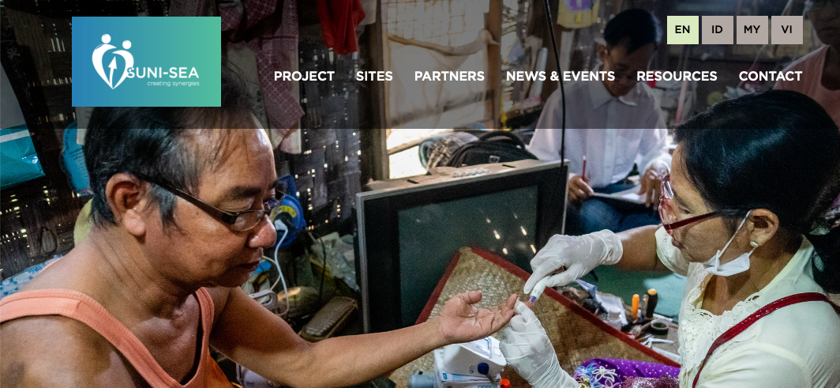
More information
https://www.suni-sea.org/en/
Notes:
Hope in the next period actual results and more precise information will be available
Please to follow we page and contact us

