Slide 1
Traumatic Brain Injuries – Silent Epidemics and How to React?
Martin Rusnák
Marek Majdan
Trnava University in Trnava, Faculty of Health Sciences and Social Work
contact: rusnakm@truni.sk

Slide 2
Some definitions
Traumatic Brain Injury (TBI) is a nondegenerative, noncongenital insult to the brain from an external mechanical force, possibly leading to permanent or temporary impairment of cognitive, physical, and psychosocial functions, with an associated diminished or altered state of consciousness.
Silent epidemic is used to characterize the incidence of traumatic brain injury (TBI) worldwide, in part because many cases are not recognized and are, therefore, excluded from official statistics.

Slide 3
Burden of TBI

Slide 4
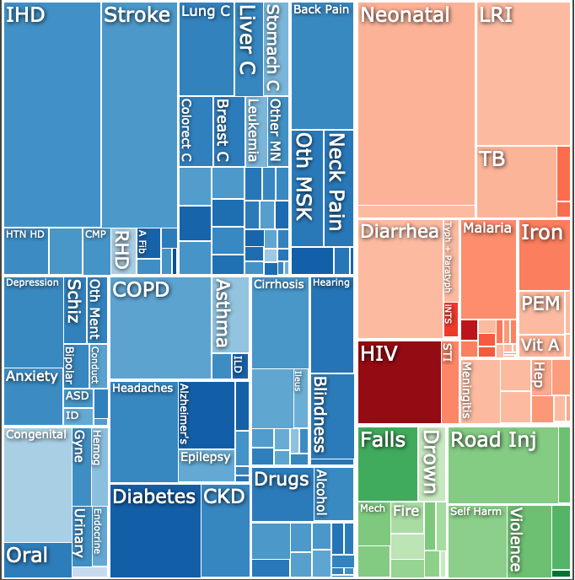
Global DALYs, both sexes, 2017
Injuries
Notes:
https://www.thelancet.com/lancet/visualisations/gbd-compare

Slide 5
Methodology used to estimate the burden of TBI:
Results from the Global Burden of Diseases, Injuries, and Risk Factors (GBD) Study 2016
Incidence and prevalence of all causes of injury requiring medical care in inpatient and outpatient records, literature studies, and survey data.
Literature studies to establish standardised mortality ratios and applied differential equations to convert incidence to prevalence of long-term disability.
Applied GBD disability weights to calculate YLDs.
Bayesian meta-regression tool for epidemiological modelling, used cause specific mortality rates for non-fatal estimation, and adjusted our results for disability experienced with comorbid
conditions.
Analysed results on the basis of the Socio-demographic Index, a compound measure of income per capita, education, and fertility.
Notes:
JAMES, S.L. et al. Global, regional, and national burden of traumatic brain injury and spinal cord injury, 1990–2016: a systematic analysis for the Global Burden of Disease Study 2016. In The Lancet Neurology [online]. 2019. Vol. 18, no. 1, s. 56–87. Dostupné na internete: <https://www.thelancet.com/action/showPdf?pii=S1474-4422%2818%2930415-0>.

Slide 6
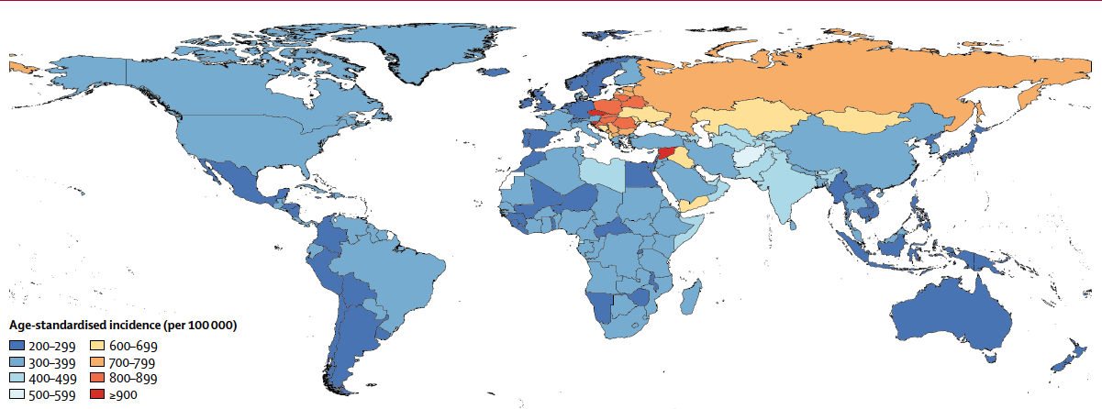
Age-standardised incidence of traumatic brain injury per 100 000 population by location for both sexes, 2016
JAMES, S.L. et al. Global, regional, and national burden of traumatic brain injury and spinal cord injury, 1990–2016: a systematic analysis for the Global Burden of Disease Study 2016. In The Lancet Neurology [online]. 2019. Vol. 18, no. 1, s. 56–87.

Slide 7
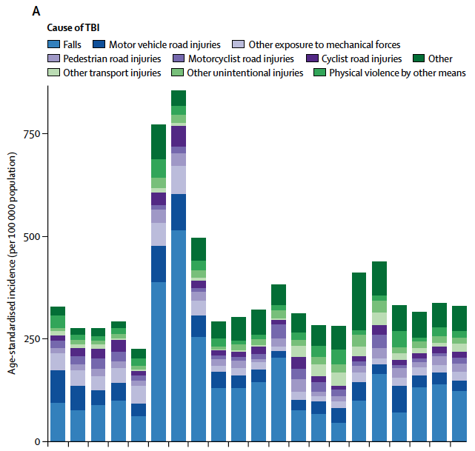

Slide 8
Mortality, prevalence and incidence in USA
Approximately 52,000 US deaths per year result from TBI.
The mortality rate for deaths outside of the hospital is approximately 17 per 100,000 people; it is approximately 6 per 100,000 people for patients who are hospitalized.
Prevalence estimates often are based on existing disabilities. A National Health Interview Survey estimated that annually, 1.9 million persons sustain a skull fracture or intracranial injury, with such trauma making up approximately 1% of all injuries.
Incidence of mild TBI is about 131 cases per 100,000 people, the incidence of moderate TBI is about 15 cases per 100,000 people, and the incidence of severe TBI is approximately 14 cases per 100,000 people. The inclusion of prehospital deaths increases the last figure to 21 cases per 100,000 people.
Notes:
https://emedicine.medscape.com/article/326510-overview#a2

Slide 9
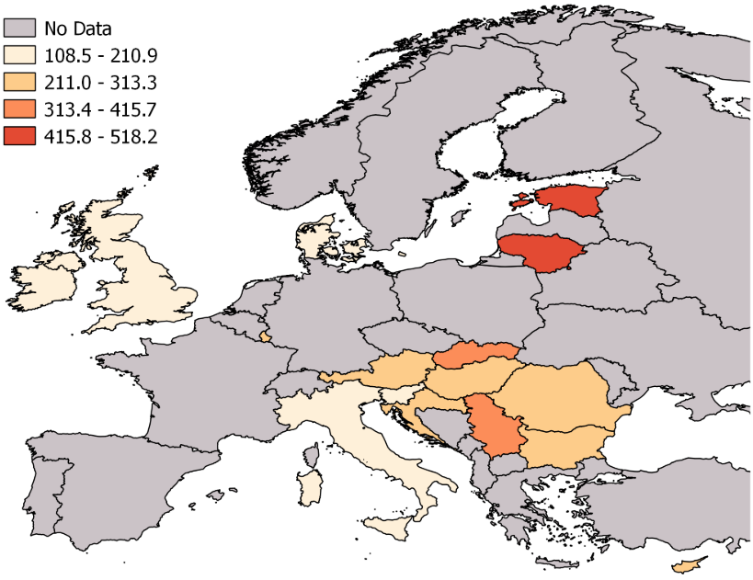
﻿Age-standardized TBI YLL rates per 100,000 persons in 16 European countries in 2013. TBI, traumatic brain injury; YLL, year of life lost.
MAJDAN, M. et al. Years of life lost due to traumatic brain injury in Europe: A cross-sectional analysis of 16 countries. In PLoS Medicine [online]. 2017. Vol. 14, no. 7, s. e1002331.

Slide 11
From prevention to treatment and rehabilitation
﻿Change Human Factors Voluntarily
Laws and Rules Directed at Individual Behavior
Agent, Vehicle, and Environmental Modifications
Postinjury Treatment and Rehabilitation
Injury Epidemiology and Economics
ROBERTSON, L.S. Injury Epidemiology: Research and Control Strategies [online]. . [s.l.]: Oxford University Press, 1998. ISBN 9780195122022.

Slide 12
Programs aimed at changing human factors without resort to law
﻿ Attempts to change abilities, such as driving skills among drivers and strength and gait among the elderly;
Attempts to change behaviors that are presumed or known to contribute to risk, such as storage of materials hazardous to children, violent responses to peer challenges, speeding, and alcohol use;
Attempts to increase use of protection, such as child restraints, seat belts, motorcycle and bicycle helmets, and certain sports equipment.

Slide 13
Enforcement of laws and regulations
﻿Epidemiological data may provide lawmakers and administrators with information to justify, change, or repeal laws or rules;
﻿Examples of proscribed behaviors are drunk driving and exceeding posted speed limits in motor vehicles.
Examples of protective laws include required use of hardhats at work- sites, required use of helmets by motorcyclists, and required use of seat belts or child restraints by vehicle occupants.

Slide 14
Agent, Vehicle, and Environmental Modifications
The sources of the vast majority of serious injuries are the products of industry and builders in everyday or frequent use, among them motor vehicles, roads, guns, agricultural and industrial machines, stairs, cigarettes, matches, propane lighters, stoves and space heaters, clothing, bedding, swimming pools, and watercraft.

Slide 15
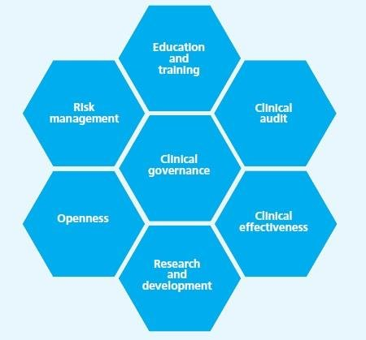
Brescia Valerio, et al.: Multidisciplinarity in the Treatment Process: An Essential Element in Clinical Governance. International Journal of Management Sciences and Business Research, March-2019 ISSN (2226-8235) Vol-8, Issue 3 http://www.ijmsbr.com Page 47
Postinjury Treatment and Rehabilitation

Slide 16
TBI Management Guidelines
MAURITZ, W. et al. Outcome of brain trauma patients who have a Glasgow Coma Scale score of 3 and bilateral fixed and dilated pupils in the field. In European Journal of Emergency Medicine [online]. 2009/03/14. vyd.2009. Vol. 16, no. 3, s. 153–158.
RUSNAK, M. et al. Evaluation of traumatic brain injury guidelines using AGREE instrument. In Bratislava Medical Journal [online]. 2008/10/08. vyd.2008. Vol. 109, no. 8, s. 374–380.
﻿RUSNAK, M. et al. Severe traumatic brain injury in Austria VI: Effects of guideline-based management. In Wiener Klinische Wochenschrift [online]. 2007. Vol. 119, no. 1–2, s. 64–71.

Slide 17
Injury Epidemiology and Economics
﻿One of the most controversial uses of epidemiological data is the assignment of economic costs to distributions of injury and disease, and the balancing of such costs against the costs of reducing risk.
The controversy arises both from repugnance on the part of some people at the notion that all aspects of injury and death can be expressed in monetary values, and from widespread disagreement over the methods when such expression is attempted.
﻿MAURITZ, W. et al. Epidemiology, treatment and outcome of patients after severe traumatic brain injury in European regions with different economic status. In European Journal of Public Health [online]. 2008. Vol. 18, no. 6, s. 575–580.

Slide 18
Conclusion
Give Voice to TBI Silent Epidemic by Including into All Policies

