Slide 1
Educating for Resilience
Advancing public health training to strengthen health and care systems in V4 countries
Martin Rusnák, MD, PhD
Trnava University
Trnava, Slovakia

Slide 2
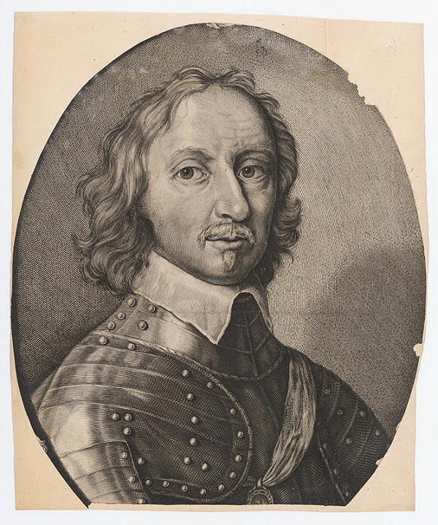
Historical Roots of Public Health in Central Europe
János Nepomuk Huszty
Studied at Trnava University, contributor to Polizey Medizin - Prevention as governance, Population health as state resilience
Interwar period
Development of modern hygiene, epidemiology, and social medicine. National public health institutions emerged
Soviet / socialist era
Strong emphasis on sanitary services and infectious disease control and centralized governance and workforce planning
Post-1989 transformation
Bologna reforms, EU integration, ASPHER and European competency frameworks, growing diversity among V4 educational pathways
Notes:
“The current diversity of public health education in the V4 region reflects a long historical trajectory. The interwar period established national traditions of hygiene and social medicine, while the socialist era strengthened sanitary and epidemiological services. These foundations contributed to strong competencies in communicable disease control. However, newer competencies such as Health in All Policies, Health Impact Assessment, One Health, and Evidence-Based Public Health entered curricula more recently and remain unevenly represented. This historical legacy helps explain both our strengths and our current gaps.”

Slide 3
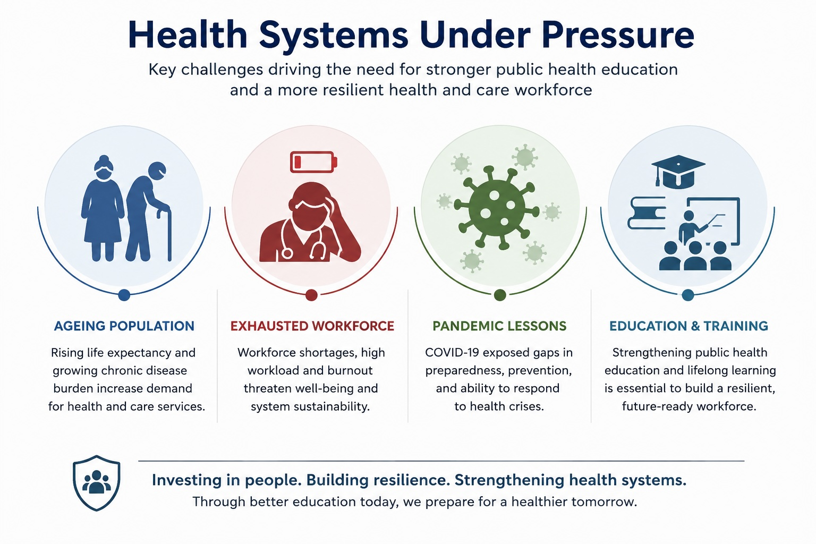

Slide 4
METHODOLOGICAL APPROACH
Objective: Explore strengths, gaps and variability in public health education across V4 countries.
Process:
  Searching Public Sources (not exhaustive): Universities, ASPHER, WHO, Literature
  Competency Mapping – key words: CD Epidemiology, NCD Surveillance, EBPH, IHR, HiAP, HIA, One Health
  Comparison: across V4 Programmes
  Gap Analysis: Strengths, Gaps, Variability
Role of AI: ChatGPT was used as a research support tool to identify programmes, retrieve publicly available information and assist in preliminary competency mapping. Findings were reviewed, interpreted and synthesised by the author.
Limitations: Based on publicly available information; exploratory analysis, not a formal accreditation assessment.

Slide 5
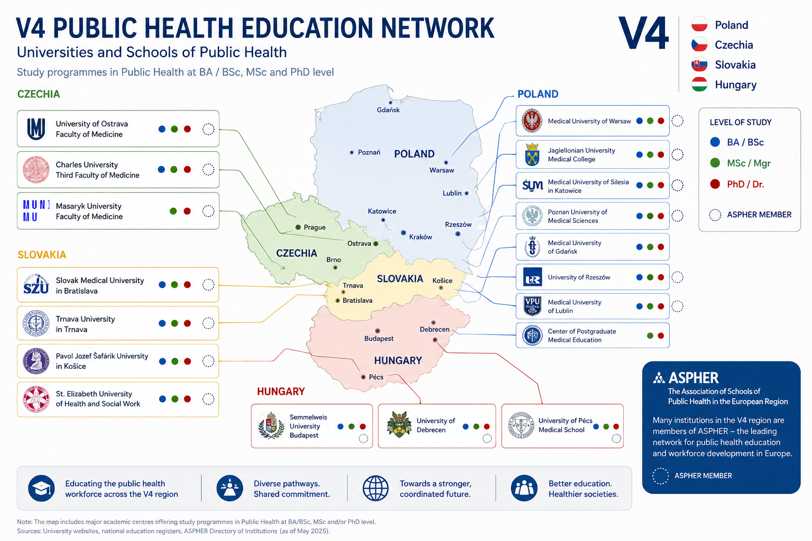

Slide 6
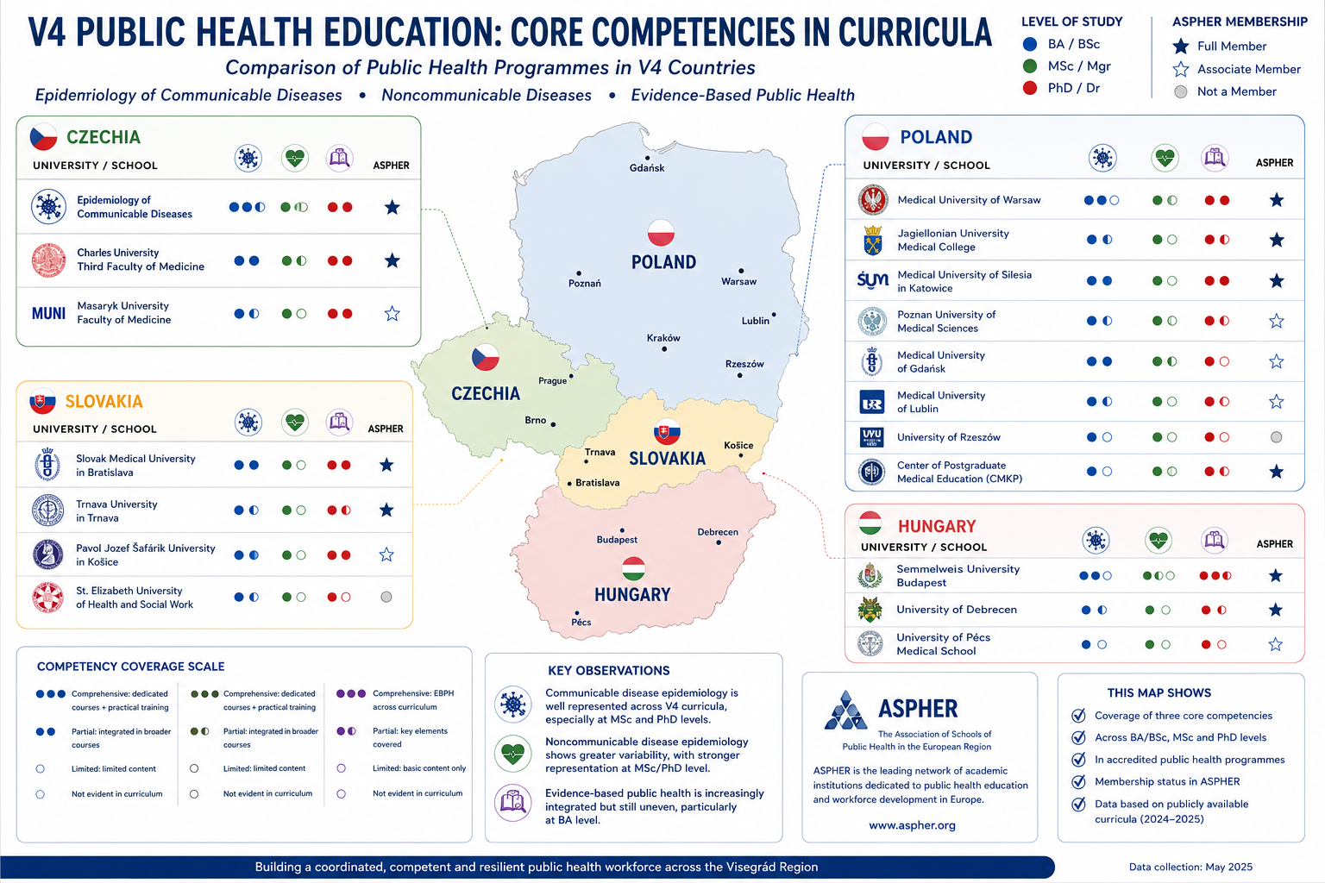

Slide 7
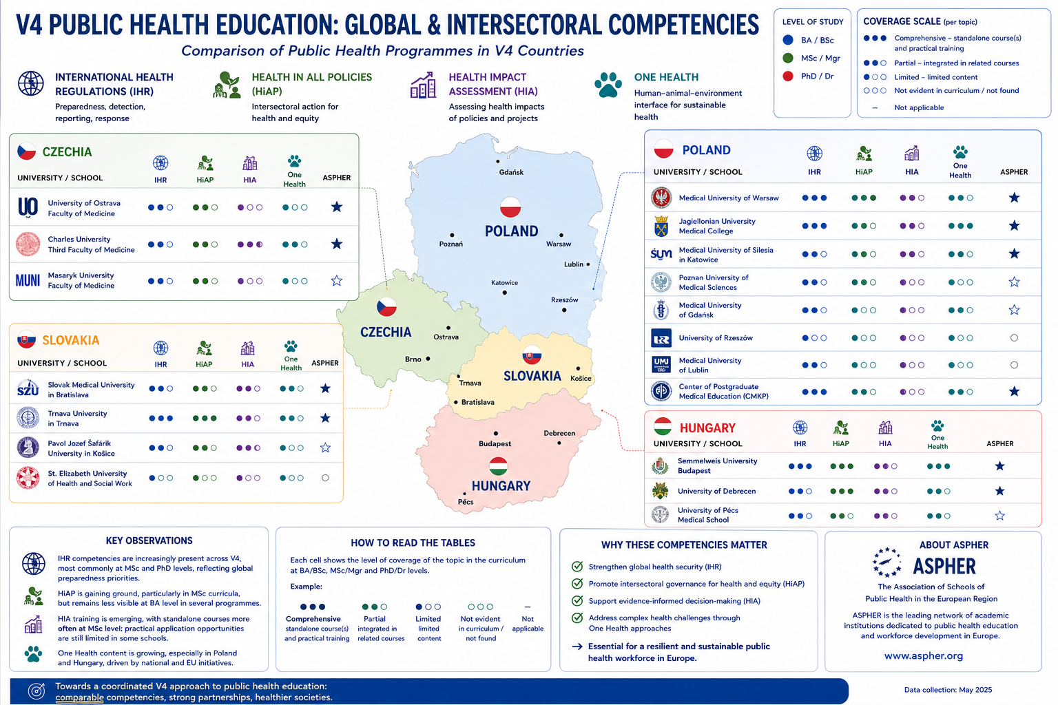

Slide 8
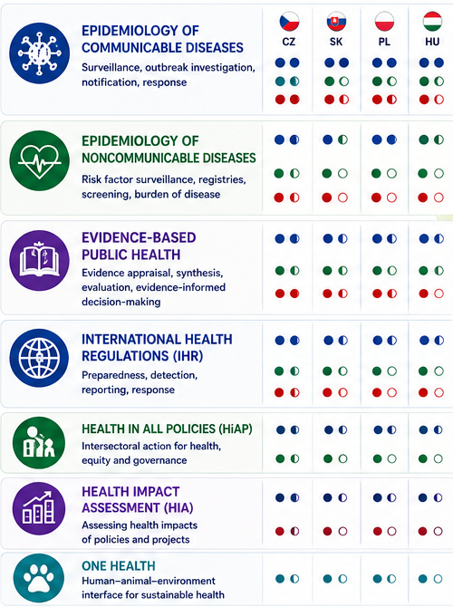
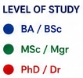
Comparative overview of key public health competencies in curricula
SUMMARY of FINDINGS
Core epidemiology and International Health Regulations (IHR) are well represented across V4 countries.
Considerable variability exists in the coverage of noncommunicable disease (NCD) surveillance, Evidence-Based Public Health (EBPH), Health in All Policies (HiAP), Health Impact Assessment (HIA), and One Health.
Training at the bachelor’s level is often limited in newer, cross-sectoral competencies.
Fragmentation of content, terminology, and competency frameworks reduces comparability, recognition, and mobility.
STRATEGIC IMPLICATIONS
A coordinated approach can turn our diversity into a regional strength rather than a barrier.
Harmonised competencies will improve workforce preparedness and support resilient health systems.
Joint standards will enhance mobility, recognition, and collaboration across V4 countries and with the wider European Higher Education Area.
Together, we can educate for resilience—across borders, sectors, and generations.

Slide 9
Gaps to be ADDRESSED
Uneven competency integration
  Public health competencies are inconsistently embedded in medical and public health curricula.
Weak linkage between education and practice
  Limited collaboration between academic institutions and health services.
  Training content often not aligned with real-world public health workforce needs
Limited life-long learning integration
  Continuing professional development opportunities are insufficient and uneven.
  Limited recognition of non-formal and informal learning
Fragmented accreditation systems
  Different national standards and quality assurance approaches.
  Limited mutual recognition hinders mobility and regional cooperation.
Differentiation between university and technical education
  Different curricula, competences and career pathways.
  Limited permeability and underdeveloped collaboration between the two tracks.
Notes:
Sources: Lafranconi, A. et al. (2016) “ADDRESSING GAPS AND NEEDS IN PUBLIC HEALTH LEADERSHIP ACADEMIC COURSES IN THE EUROPEAN REGION,” Eurohealth, 22(4), pp. 10–13. Available at: https://iris.who.int/server/api/core/bitstreams/4aef56b6-d63c-4e32-9f9c-135eb8527128/content (Accessed: May 21, 2026).
Bashkin, O. et al. (2022) “Identifying the Gaps Between Public Health Training and Practice: A Workforce Competencies Comparative Analysis,” International Journal of Public Health, 67. Available at: https://doi.org/10.3389/ijph.2022.1605303.

Slide 10
Gaps to be ADDRESSED
GAP | CONSEQUENCE
Uneven competency integration | Variable workforce preparedness
Weak education–practice linkage | Skills mismatch
Limited lifelong learning | Reduced adaptability
Fragmented accreditation | Limited mobility
University–technical divide | Competency discontinuities

Slide 11
Why Accreditation?
Current | Future
Different competencies | Shared competencies
Different standards | Shared quality standards
Limited recognition | Greater mobility
 | Better preparedness

Slide 12
From Policy Idea to Implementation need for coordinated approach
These gaps weaken the public health workforce and reduce the resilience of health and care systems.
A coordinated approach to education, competencies and accreditation can close these gaps.
  Stronger training for a competent workforce
  Shared standards for better quality and mobility
  Regional cooperation for preparedness and resilience
  Investing in education for healthier, future-ready societies
Proposed Roadmap
  Establish V4 working group
  Define shared competencies
  Pilot joint programmes
  Develop accreditation standards

Slide 13
Conclusions
Just as Huszty helped shape public health governance for his era, we have an opportunity to shape public health education for the next generation.
Education Is a Strategic Investment in Resilience
Public health education should be viewed not only as academic training, but as a core component of resilient health systems.

