Slide 1
Zdravlje u svim politikama i „One Health“
Integrating HiAP and One Health
prof. dr. Martin Rusnak, MD, PhD
Trnava University, Trnava, Slovakia
Determinante zdravlja i zdravlje u svim propisima – od jugoslovenskog nasleđa do EU integracija
Univerzitet Educons, Sremska Kamenica; 15. septembar 2026.

Slide 2
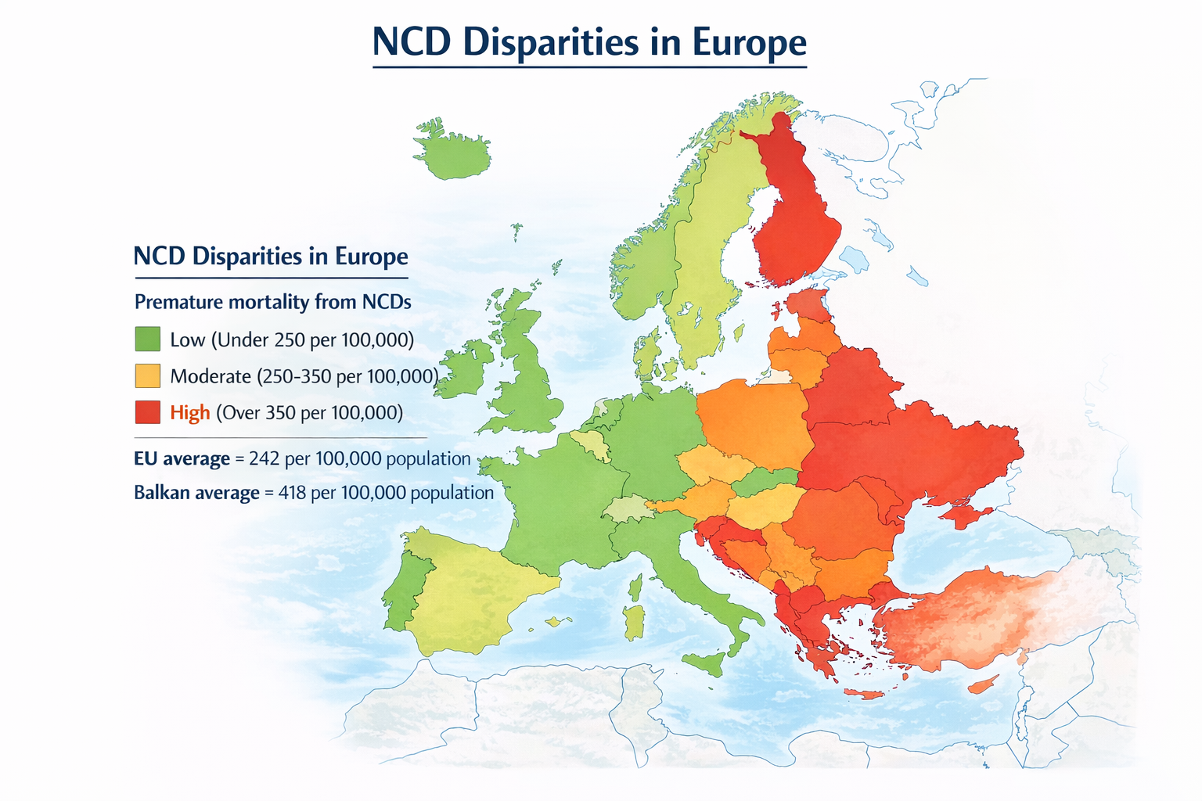
NCD Burden in Central and Southeastern Europe
Countries in Central and Southeastern Europe show:
  higher premature mortality from NCDs
  strong influence of environmental and socioeconomic determinants
  persistent health inequalities
Contributing factors include:
  air pollution
  dietary transitions
  tobacco and alcohol consumption
  urban and industrial legacy
  unequal access to preventive services

Slide 3
Transition Economies and Health: the need for integrated policy frameworks
Countries of the new EU Member States and Western Balkans share common historical dynamics:
  post-socialist economic transformation
  institutional restructuring
  EU integration processes
  rapid environmental and industrial change
These transformations influence:
  health systems
  environmental governance
  public health capacities
Increasing evidence links NCD risk to environmental determinants:
Examples include:
  air pollution and cardiovascular disease
  environmental chemicals and cancer
  climate change and heat-related mortality
  food systems and metabolic diseases
  urban design and physical inactivity

Slide 4
Twenty Years of HiAP Implementation and the One Health Concept
Two decades of experience show:
Successes
  integration into EU public health strategies
  development of Health Impact Assessment tools
  stronger recognition of social determinants of health
Challenges
  limited implementation capacity
  weak cross-sector governance
  competing political priorities
These challenges are particularly visible in transition economies.
The One Health Concept: Integrating Human, Animal and Environmental Health
Traditionally One Health has focused on:
  zoonotic diseases
  veterinary surveillance
  food safety
However, the concept can also contribute to chronic disease prevention by addressing shared environmental determinants such as:
  pollution
  food production systems
  land-use change
  biodiversity loss

Slide 5
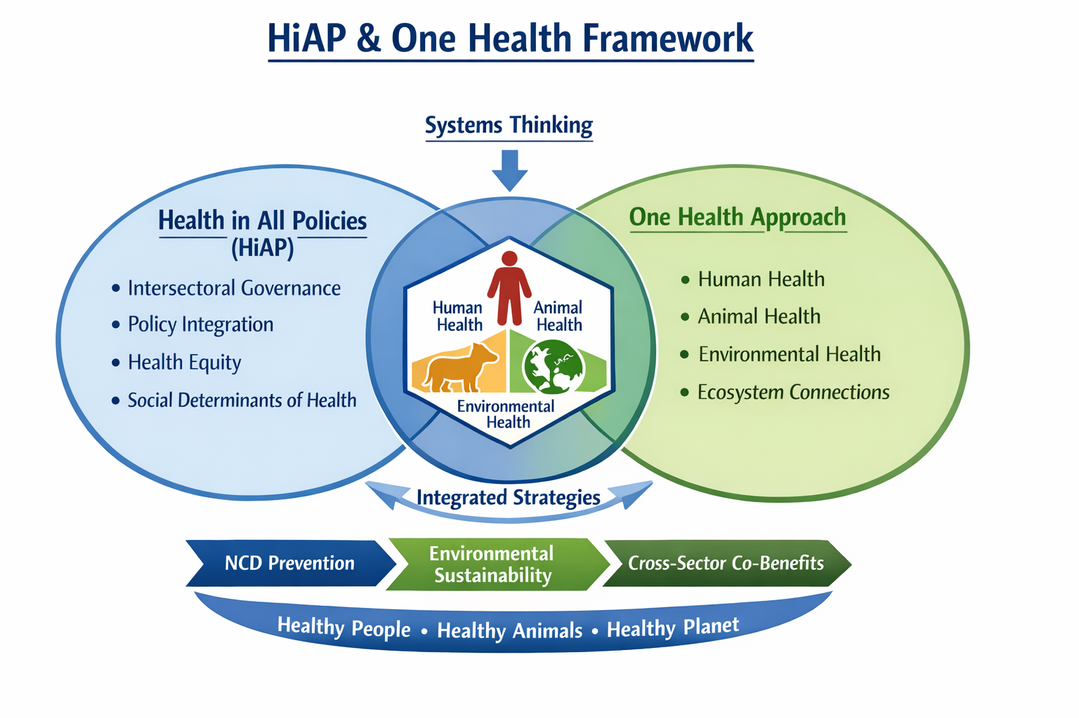
HiAP and One Health framework
The conceptual integration of the Health in All Policies governance approach with the One Health ecological framework.
Health in All Policies emphasizes policy coordination across sectors, while One Health highlights the interconnectedness of human, animal, and environmental health.
Their intersection enables integrated strategies addressing shared upstream determinants such as environmental exposures, food systems, and urban development.
Such integration supports co-benefits including NCD prevention, environmental sustainability, and cross-sector collaboration.

Slide 6
Regional context
New EU Member States
EU accession brought important improvements:
  environmental regulation
  food safety standards
  public health legislation
  monitoring systems
However, challenges remain:
  limited institutional capacity
  fragmented policy coordination
  uneven enforcement of regulations
Countries in the Western Balkans face additional challenges:
  slower regulatory harmonization with the EU
  limited resources for environmental governance
  political and economic instability
At the same time, EU accession processes create opportunities for reform.

Slide 7
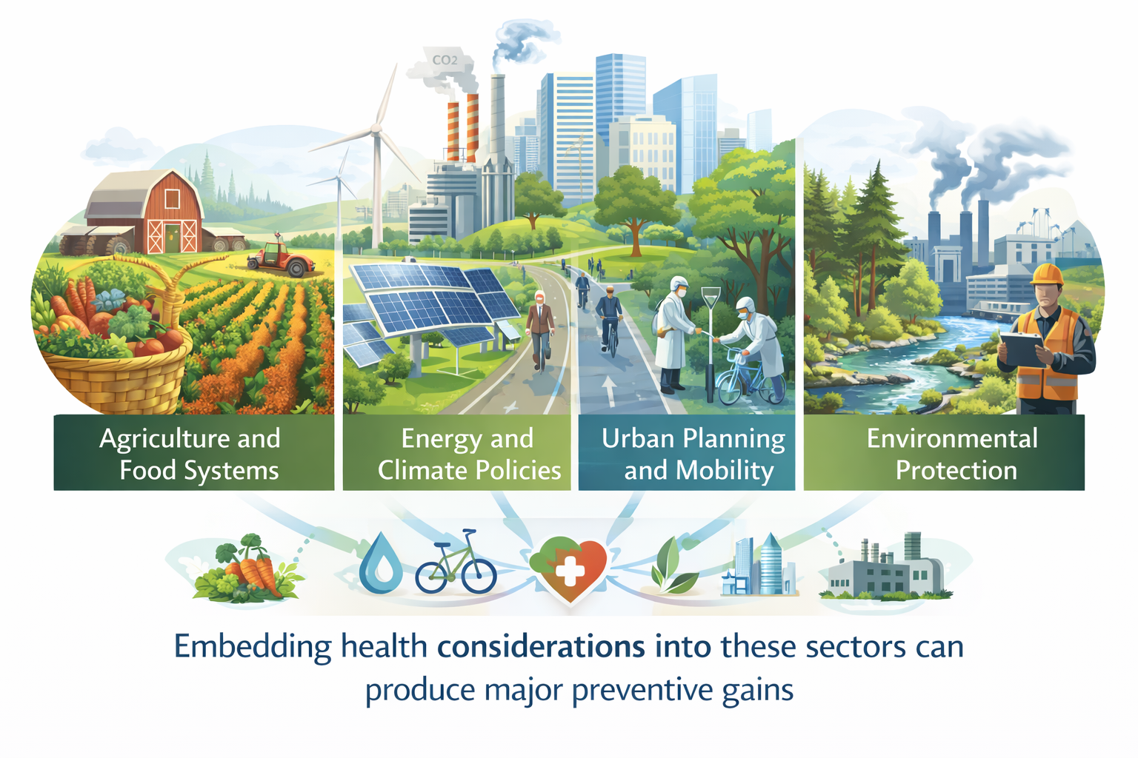
Policy Areas for HiAP–One Health Integration
Important policy sectors include:
  Agriculture and food systems
  Energy and climate policies
  Urban planning and mobility
  Environmental protection
  Industrial regulation
Embedding health considerations into these sectors can produce major preventive gains

Slide 8

Example: Agriculture and Food Systems
Agricultural policies influence:
  diet composition
  food environments
  environmental sustainability
Policy measures may include:
  support for healthier food production
  reduction of harmful agricultural emissions
  promotion of sustainable dietary patterns
These interventions benefit both population health and ecosystems.

Slide 9
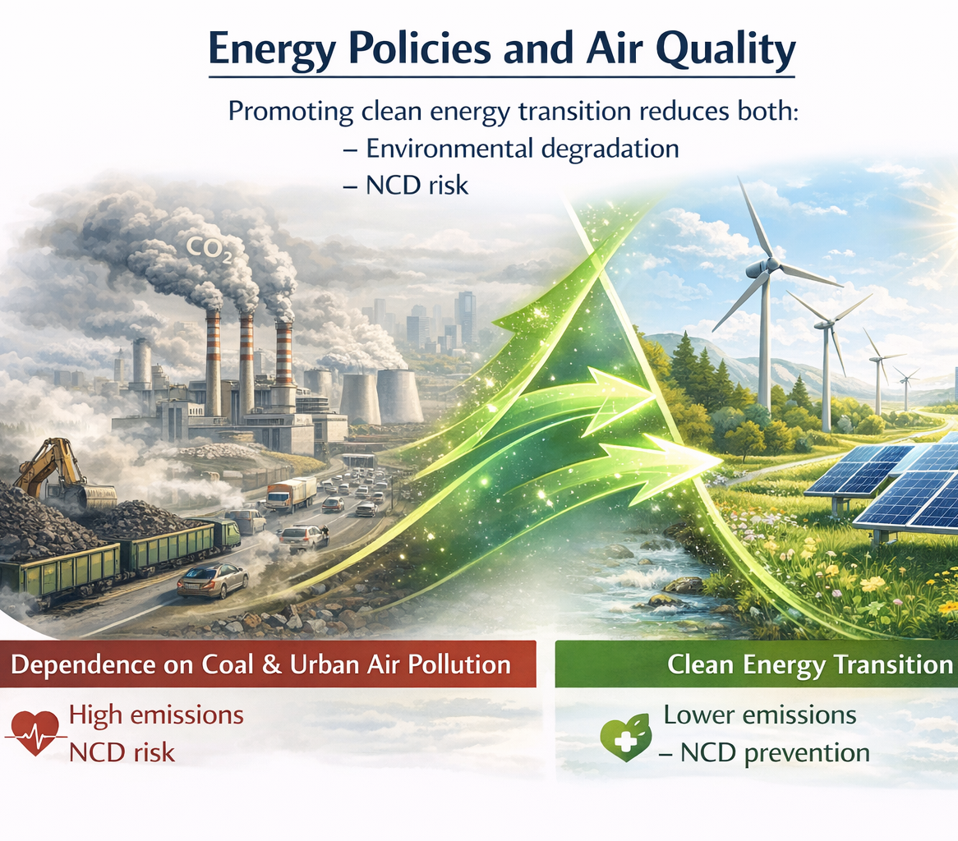
Example: Energy and Air Pollution
Energy policies strongly affect air quality.
In many Central and Southeastern European countries:
  coal dependence remains significant
  urban air pollution contributes to cardiovascular mortality
Policies promoting clean energy transition reduce both:
  environmental degradation
  NCD risk.

Slide 10
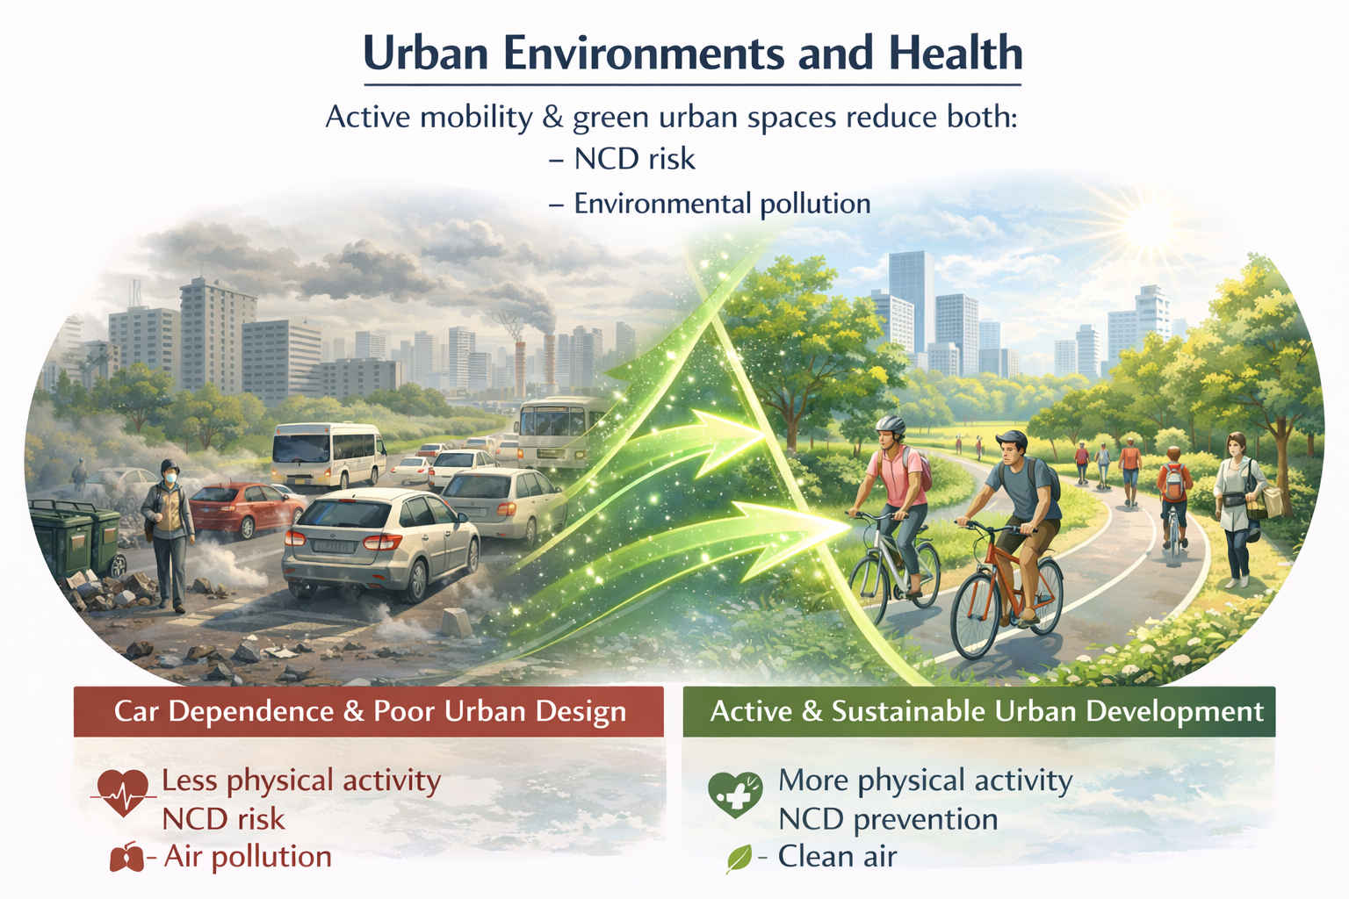
Example: Urban Planning
Urban environments shape health through:
  transport systems
  green spaces
  housing conditions
Policies promoting:
  active mobility
  cycling and walking infrastructure
  sustainable urban development
can reduce NCD risks while improving environmental quality.

Slide 11
Components of a Change
Research
Despite growing interest, important research gaps remain:
Comparative implementation studies
  identifying governance models effective in transition economies.
Cross-sector evaluation metrics
capturing health and environmental co-benefits.
Systems modelling approaches
  examining interactions between environmental stressors and NCD pathways.
Equity-sensitive research
  addressing rural–urban disparities and vulnerable populations.
Systems Thinking
  Traditional public health approaches often analyse individual risk factors.
  However, NCD prevention increasingly requires:
    systems modelling
    policy integration
    multi-sector collaboration
    long-term governance reforms
This aligns with the complexity of contemporary environmental and health challenges.

Slide 12
Research Gaps
🏛️ Governance & Implementation
  Comparative implementation studies
  → What governance models work best in transition economies?
📊 Measurement & Evaluation
  Cross-sector metrics
  → How can we capture health and environmental co-benefits effectively?
🔄 Systems Understanding
  Systems modelling approaches
  → How do environmental stressors interact with NCD pathways?
⚖️ Equity & Context
  Equity-sensitive research
  → How do policies affect rural–urban disparities and vulnerable populations?

Slide 13
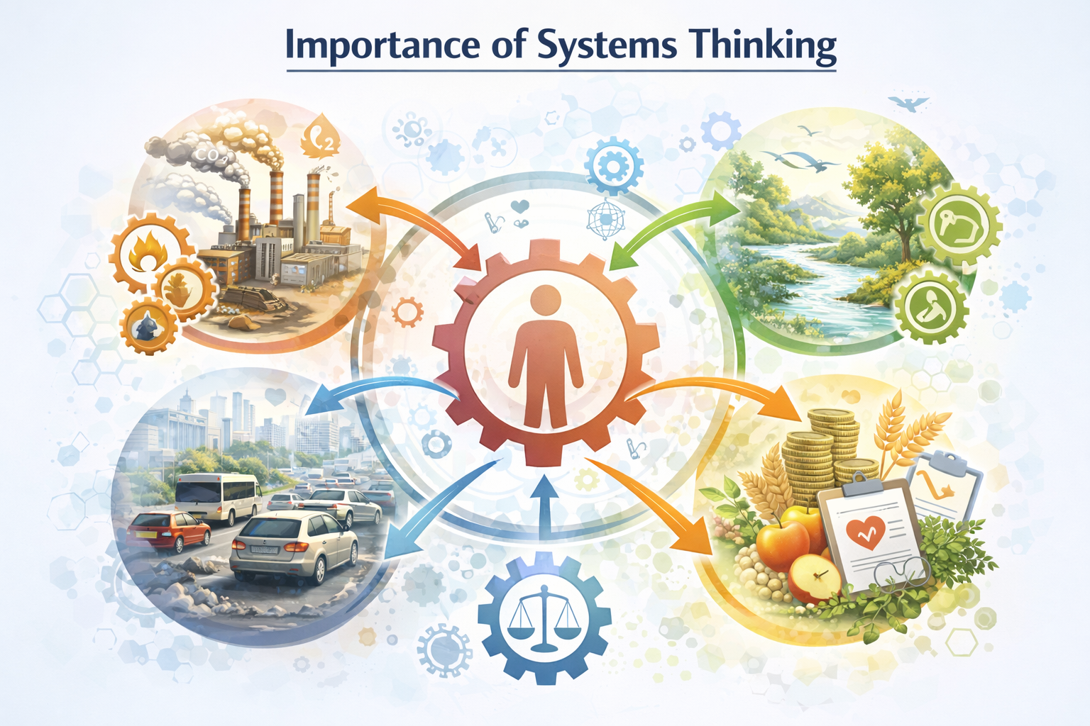
Importance of Systems Thinking
Traditional public health approaches often analyse individual risk factors.
However, NCD prevention increasingly requires:
  systems modelling
  policy integration
  multi-sector collaboration
  long-term governance reforms
This aligns with the complexity of contemporary environmental and health challenges.

Slide 14
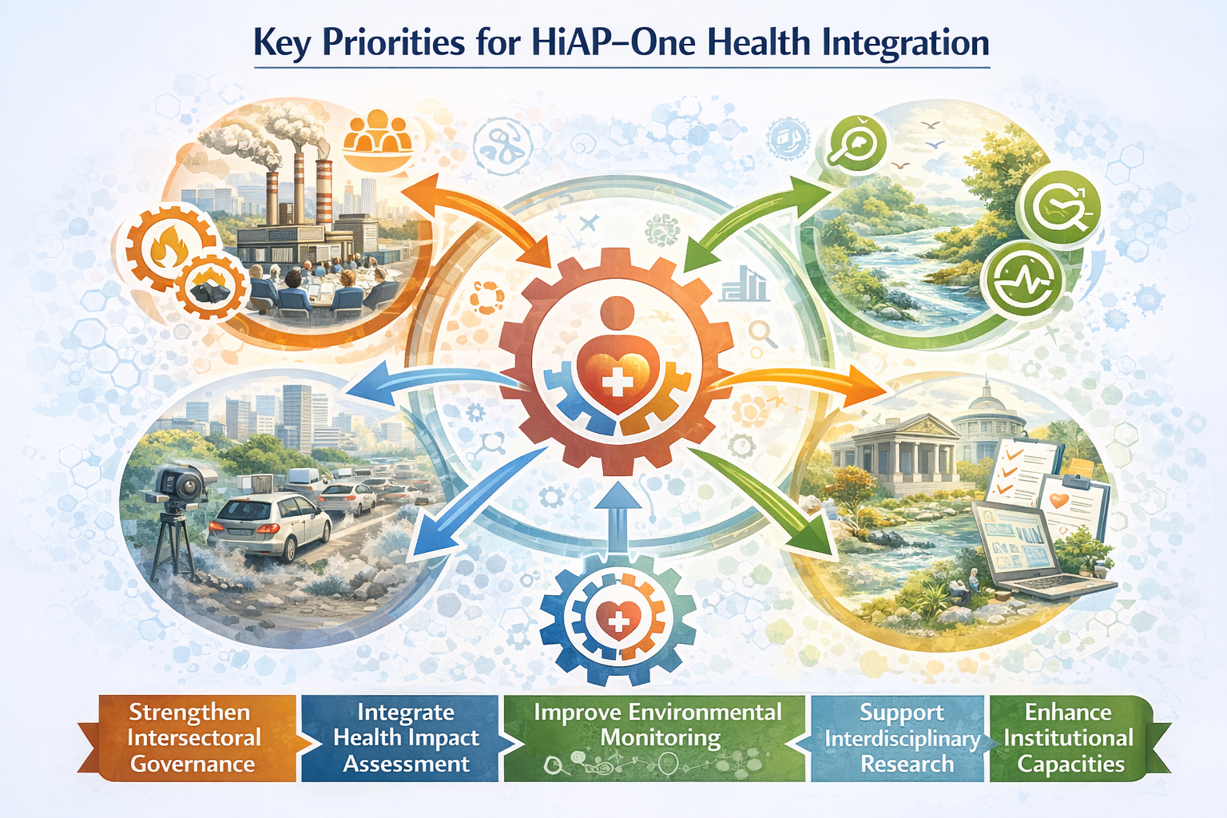
Priorities for Policy Implications
strengthening intersectoral governance mechanisms
integrating health impact assessment into policy design
improving environmental monitoring systems
supporting interdisciplinary research
enhancing institutional capacities

Slide 15
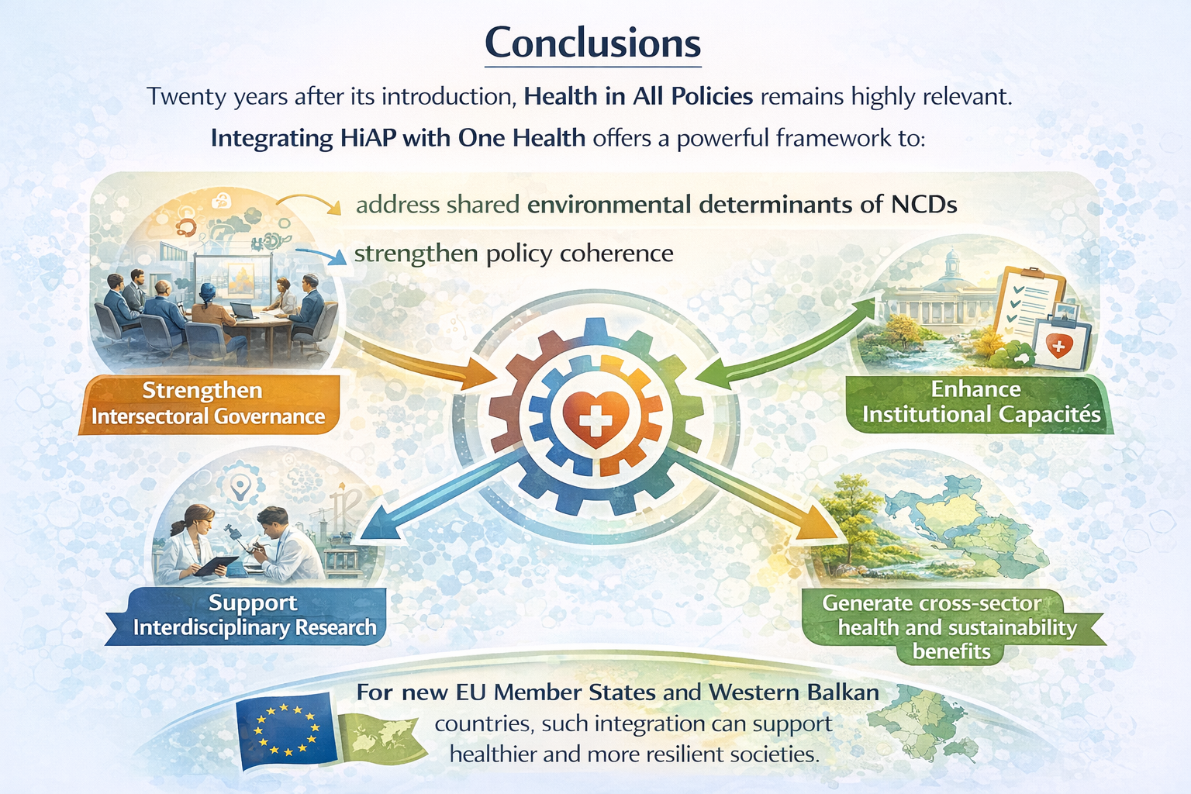
Conclusions
Twenty years after its introduction, Health in All Policies remains highly relevant.
Integrating HiAP with One Health offers a powerful framework to:
  address shared environmental determinants of NCDs
  strengthen policy coherence
  generate cross-sector health and sustainability benefits
For new EU Member States and Western Balkan countries, such integration can support healthier and more resilient societies.

