Slide 1
EPIDEMIOLOGY AS A TOOL TO EVALUATE QUALITY OF CARE
prof. Dr. Martin Rusnak, CSc
Faculty of Health Care and Social Work, Trnava University, Trnava, Slovak Republic

Slide 2
Quality in HC
Quality of care is technically an abstract term and cannot be measured directly;
Quality control represents the management processes selected to enable compliance with standards of performance and the methods to routinely reassess the level of compliance.
Oleske, D.M., Epidemiology and the Delivery of Health Care Services: Methods and Applications. 2009: Springer New York Dordrecht Heidelberg London.

Slide 3
Applying Epidemiology in Health Care Management Practice
Basic knowledge of epidemiological methods and their applications is essential for all health care managers

Slide 4
Donabedian’s Info on Quality
Structure
includes all the factors that affect the context in which care is delivered. This includes the physical facility, equipment, and human resources, as well as organisational characteristics such as staff training and payment methods. These factors control how providers and patients in a healthcare system act and are measures of the average quality of care within a facility or system.
Process
the sum of all actions that make up healthcare. These commonly include diagnosis, treatment, preventive care, and patient education but may be expanded to include actions taken by the patients or their families.
Outcome
all the effects of healthcare on patients or populations, including changes to health status, behaviour, or knowledge as well as patient satisfaction and health-related quality of life.

Slide 5
Basics of Monitoring
Service population size,
Distribution of health needs,
Genesis and consequences of health care problems,
How the health care system and organisational characteristics impact health,
Appropriates of the structure and performance of the health system, organisation, and/or program with epidemiological techniques,
Impacts of a changing environment, and
Response to public policy affecting health care delivery.

Slide 6
Monitoring Service Population Size
Basics of Demography (Birth rate, Fertility rate, Mortality rate, Migration/immigration)
Changes in the service offerings of health care facilities (e.g., elimination of emergency or obstetrics services)
Horizontal integration of organisations (e.g., affiliations, joint ventures, partnerships)
Vertical integration of organisations or services (e.g., addition of palliative care unit in a hospital)

Slide 7
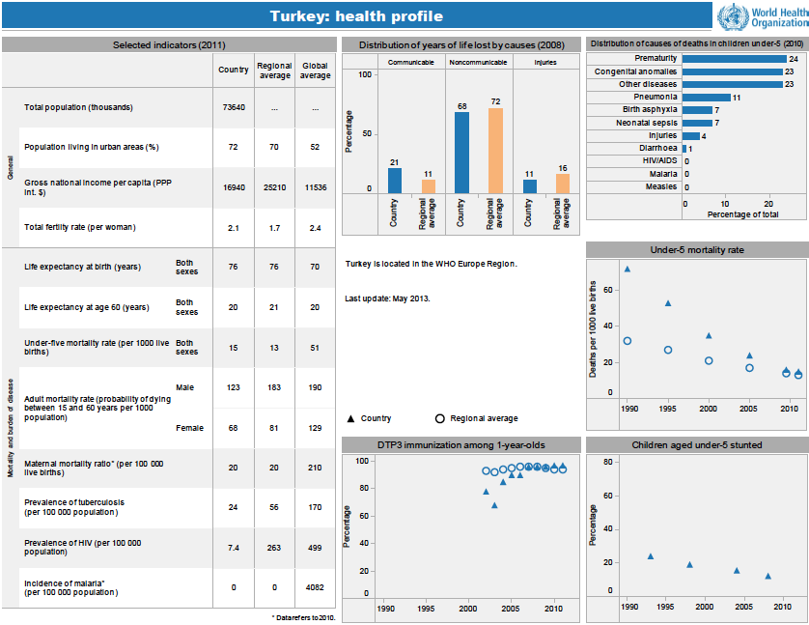
Distribution of Health Needs in a Population
Turkey Health Profile on the WHO site: http://www.who.int/gho/countries/tur.pdf?ua=1

Slide 8
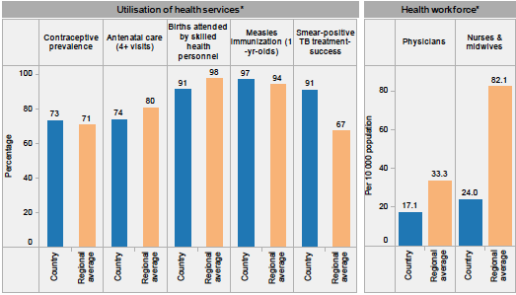

Slide 9
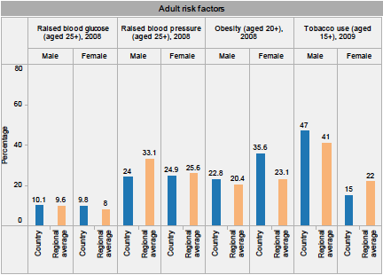

Slide 10
Methods of Measurement
Descriptive epidemiological measures
aid in assessing population health, potential for adverse exposures, and determining priorities for action
Analytic methods
measure the success of the intervention relative to epidemiological measures

Slide 11
Descriptive
Rates: incidence, prevalence, mortality
Adjusted rates: summary descriptive epidemiological measure which takes into account the variables that may emphasise or diminish the detection of the frequency of the health problem in a population examined (SMR, YLL, DALY)
Ratios: risk ratio compares two rate measures of risk (e.g., incidence or mortality rates)

Slide 12
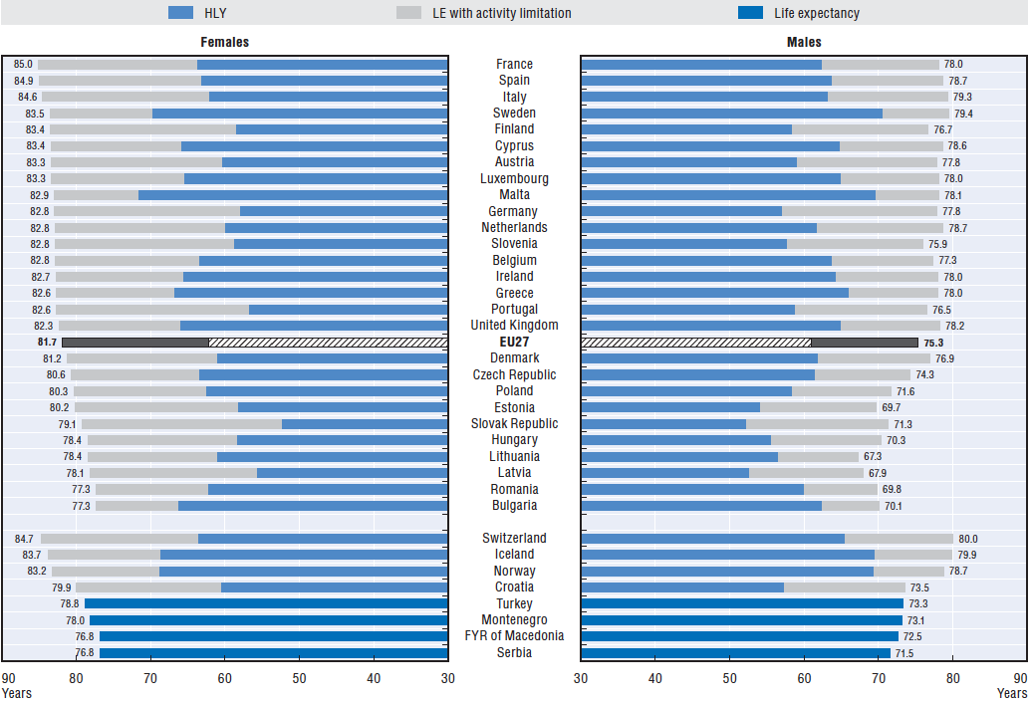
Life expectancy (LE) and healthy life years (HLY) at birth, by gender, 2008-10 average
OECD (2012), “Life expectancy and healthy life expectancy at birth”, in Health at a Glance: Europe 2012 , OECD Publishing

Slide 13
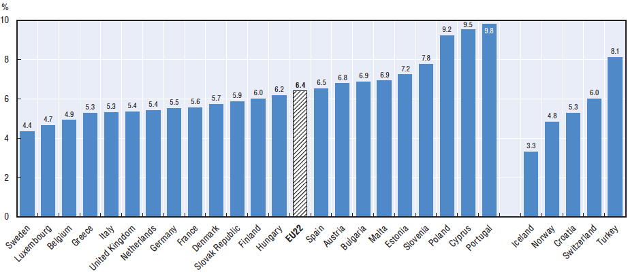
Prevalence estimates of diabetes, adults aged 20-79 years, 2011
OECD (2012), “Diabetes prevalence and incidence”, in Health at a Glance: Europe 2012 , OECD Publishing

Slide 14
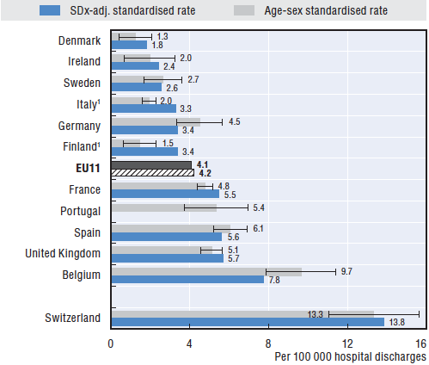
Foreign body left in during procedure,
2009 (or nearest year)

Slide 15
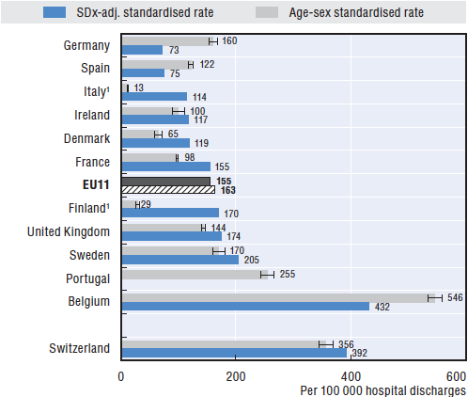
Accidental puncture or laceration,
2009 (or nearest year)
OECD Health Data 2012

Slide 16
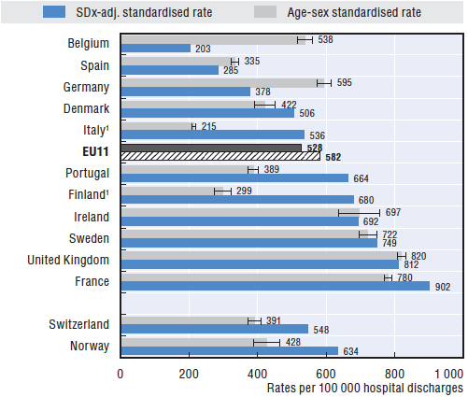
Postoperative pulmonary embolism
or deep vein thrombosis, 2009 (or nearest year)
OECD Health Data 2012

Slide 17
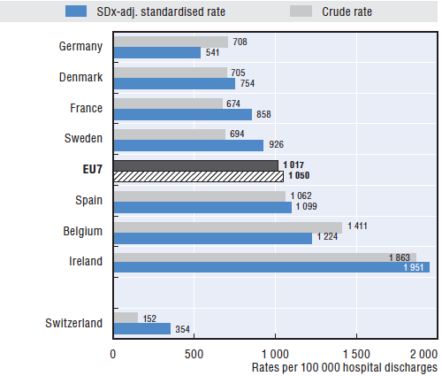
Postoperative sepsis,
2009 (or nearest year)

Slide 18
Study Designs for Evaluating
Health Services, Programs, and Systems
Descriptive study
Quasi-experimental design
Cross-sectional study
Case-control study
Longitudinal study
Cohort
Meta-analysis
Randomised clinical trial

Slide 19
Statistical methods
logistic regression,
survival analysis,
Cox proportional hazards regression
survival analysis
continuous, multiple linear regression

Slide 20
Use of analytical methods
The understanding of the level of evidence, advantages and disadvantages of a study design and accompanying analytic methods, provides the building blocks for epidemiological practice in program evaluation.
Information from evaluations can be used for a wide range of purposes from determining the impacts of various health care alliances to aiding in deciding what services should continue or how treatments could be modified to be more effective.

Slide 21
Conclusions
Epidemiological methods in evaluating quality of care require sophisticated approaches, computational skills and careful interpretation
Involving an epidemiologist with substantial statistical skills into quality team is an efficient way of implementing quality policies.

